Slide 1


Slide 2
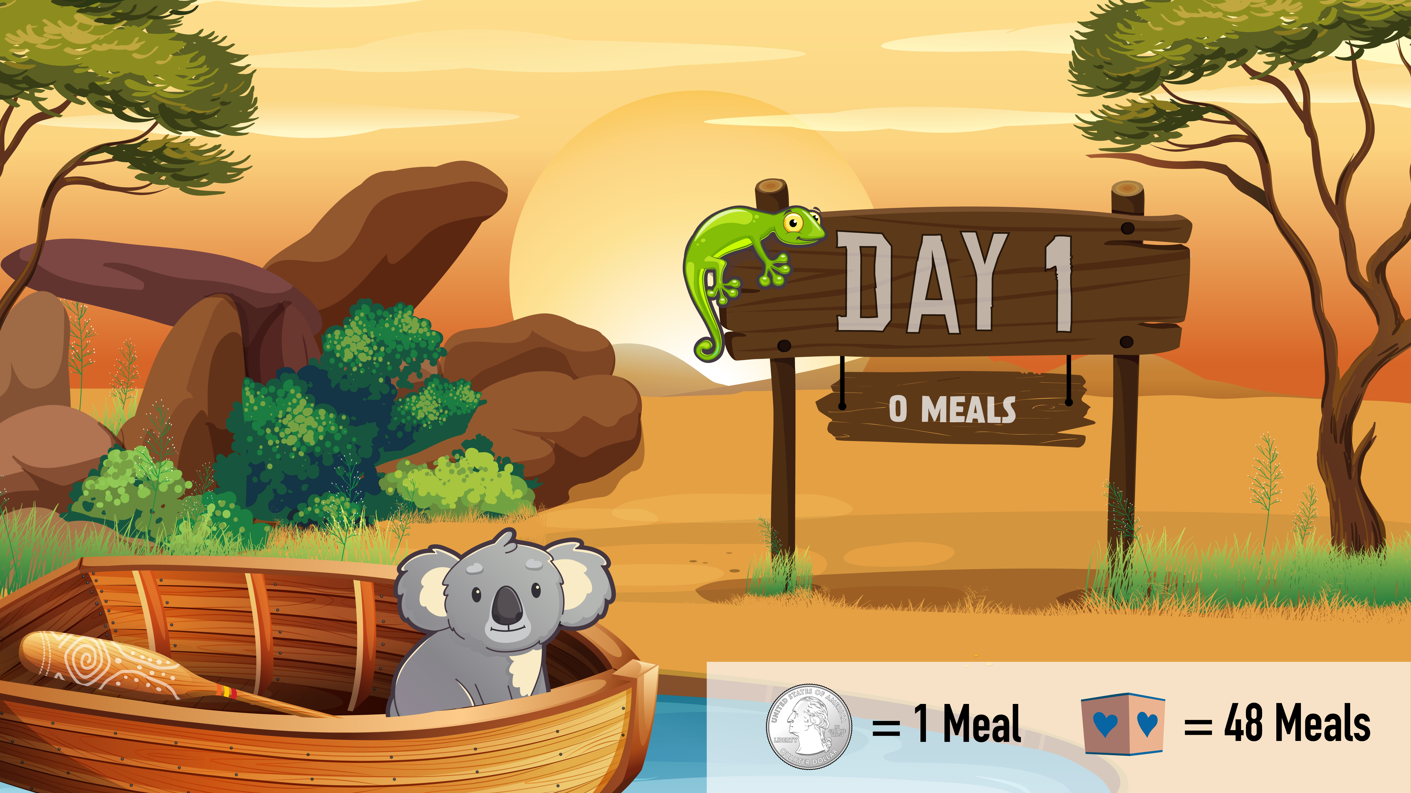

Slide 3

100 MEALS

Slide 4

245 MEALS

Slide 5

445 MEALS

Slide 6

1085 MEALS

