Slide 1


Slide 2
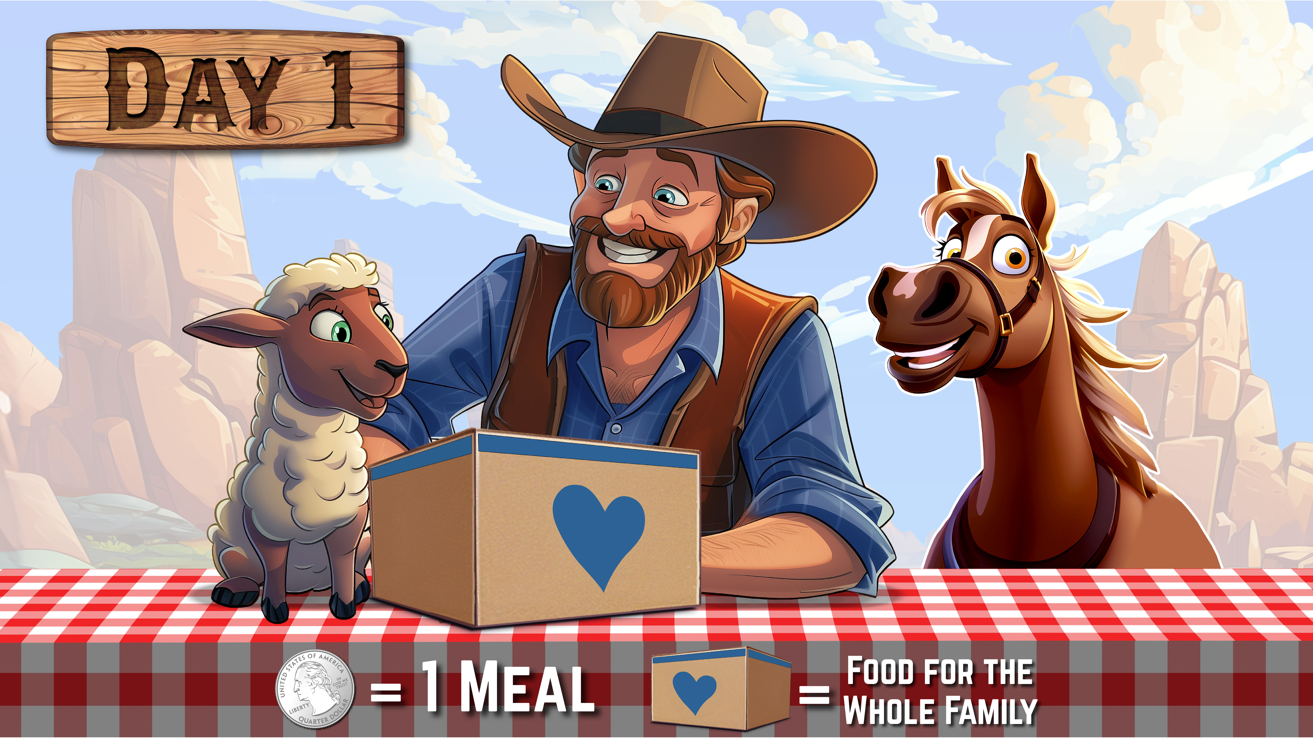

Slide 3

??? Meals

Slide 4

??? Meals

Slide 5

??? Meals

Slide 6

??? Meals

