Slide 1

Day 2

Slide 2


Slide 3
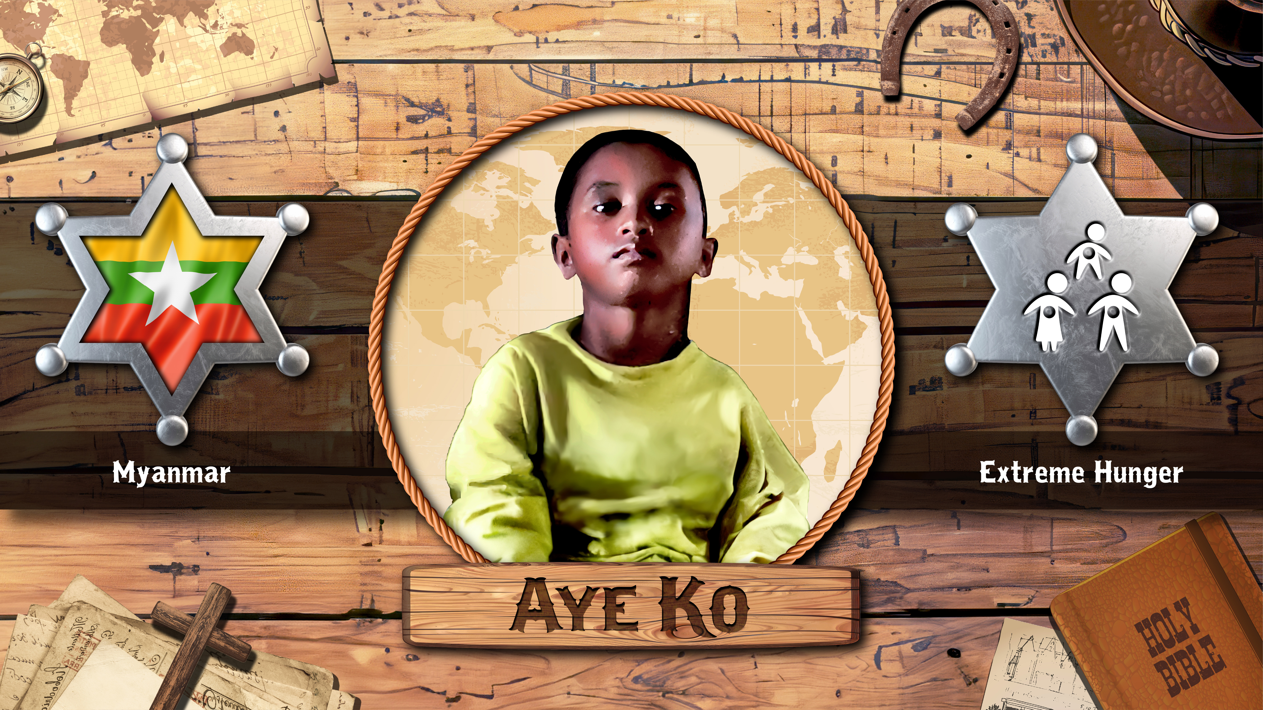

Slide 4
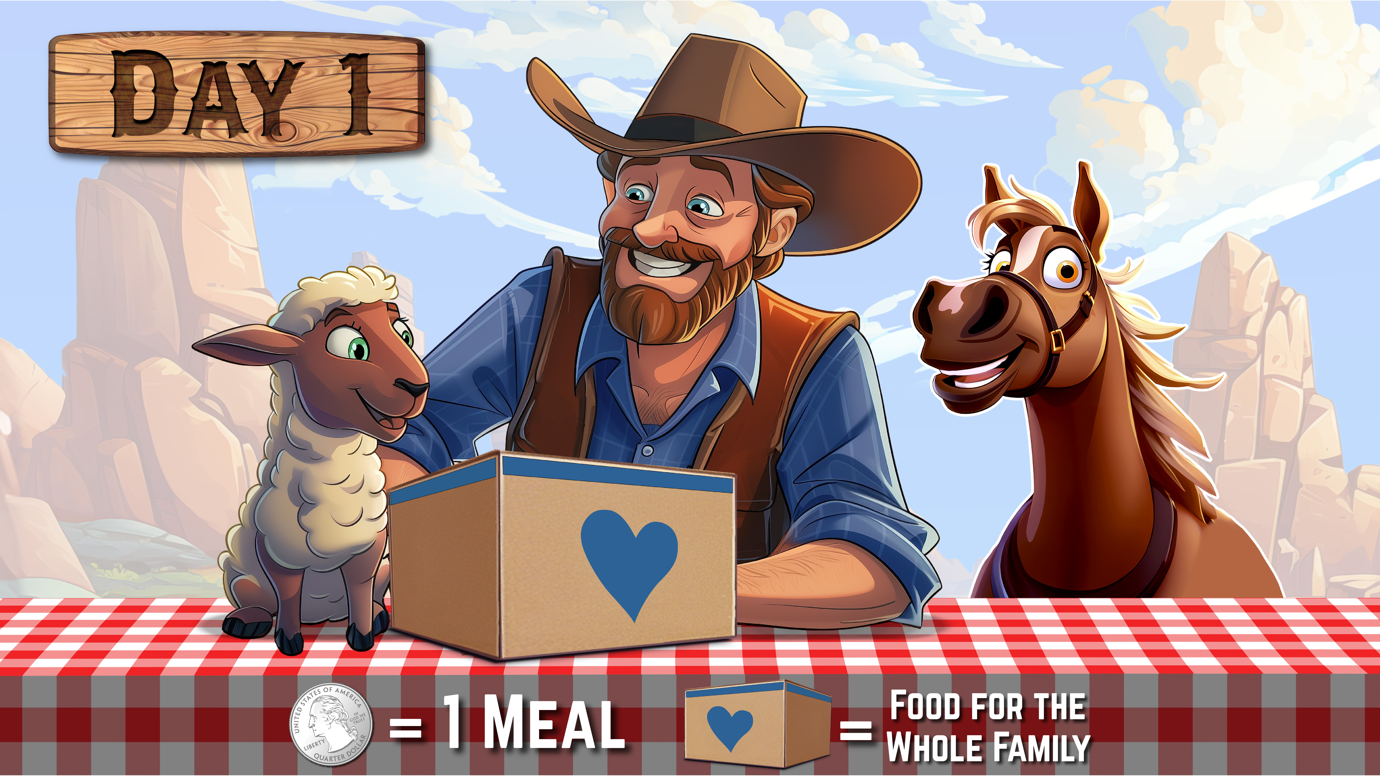

Slide 5
Children’s Hunger Fund Day 2

Slide 6
Day 2

Slide 8


Slide 9
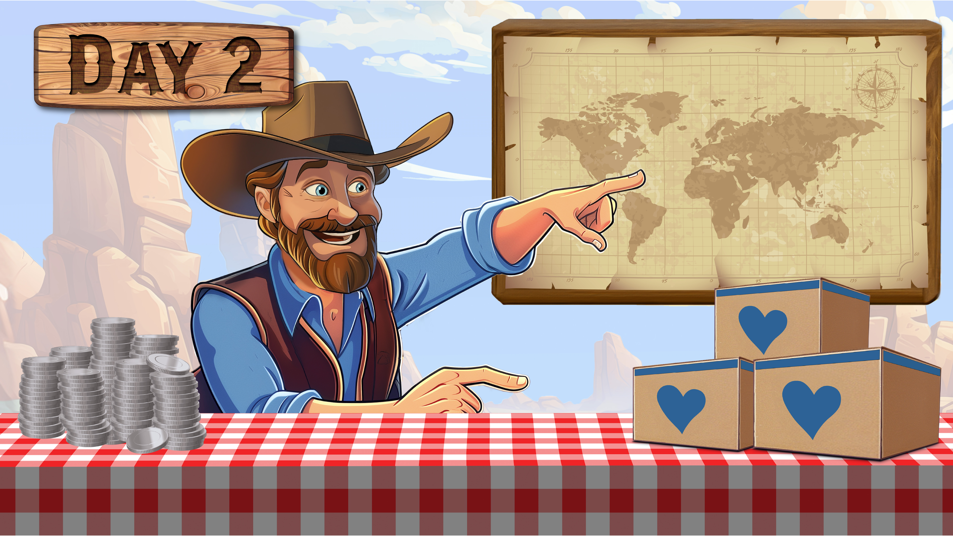
??? Meals

Slide 10
Children’s Hunger Fund Day 3

Slide 11
Day 2

Slide 13


Slide 14
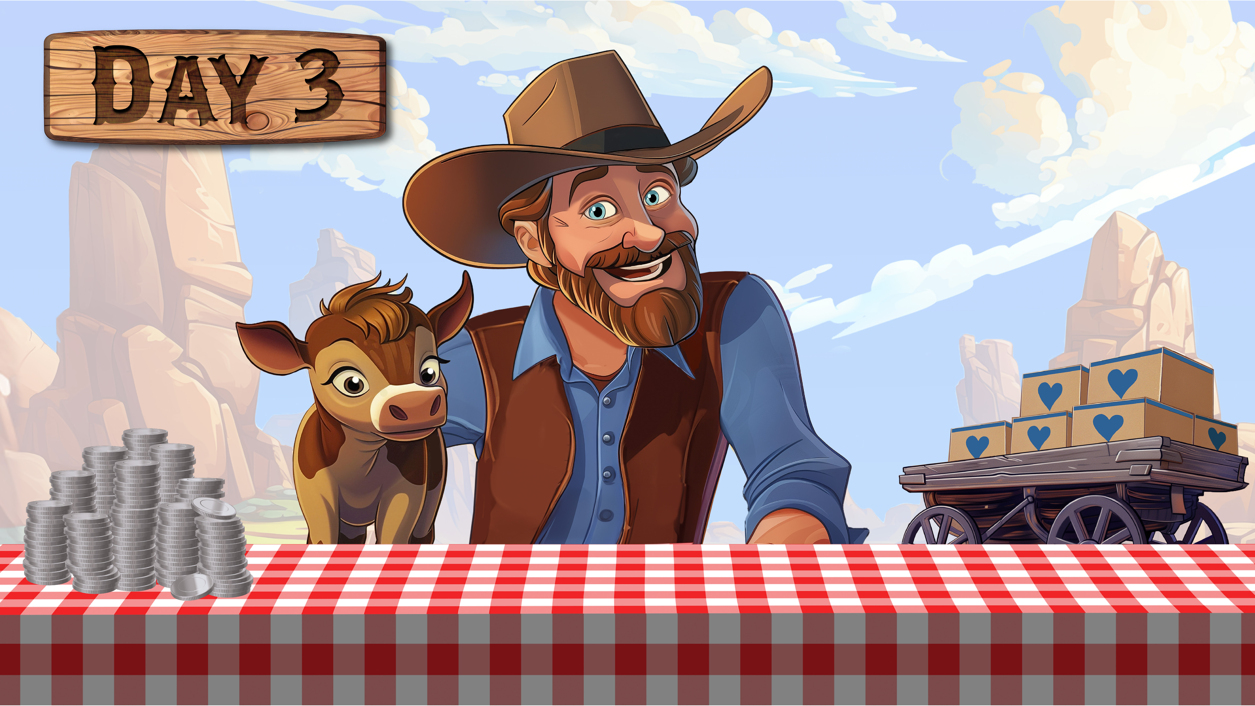
??? Meals

Slide 15
Children’s Hunger Fund Day 4

Slide 16
Day 2

Slide 18
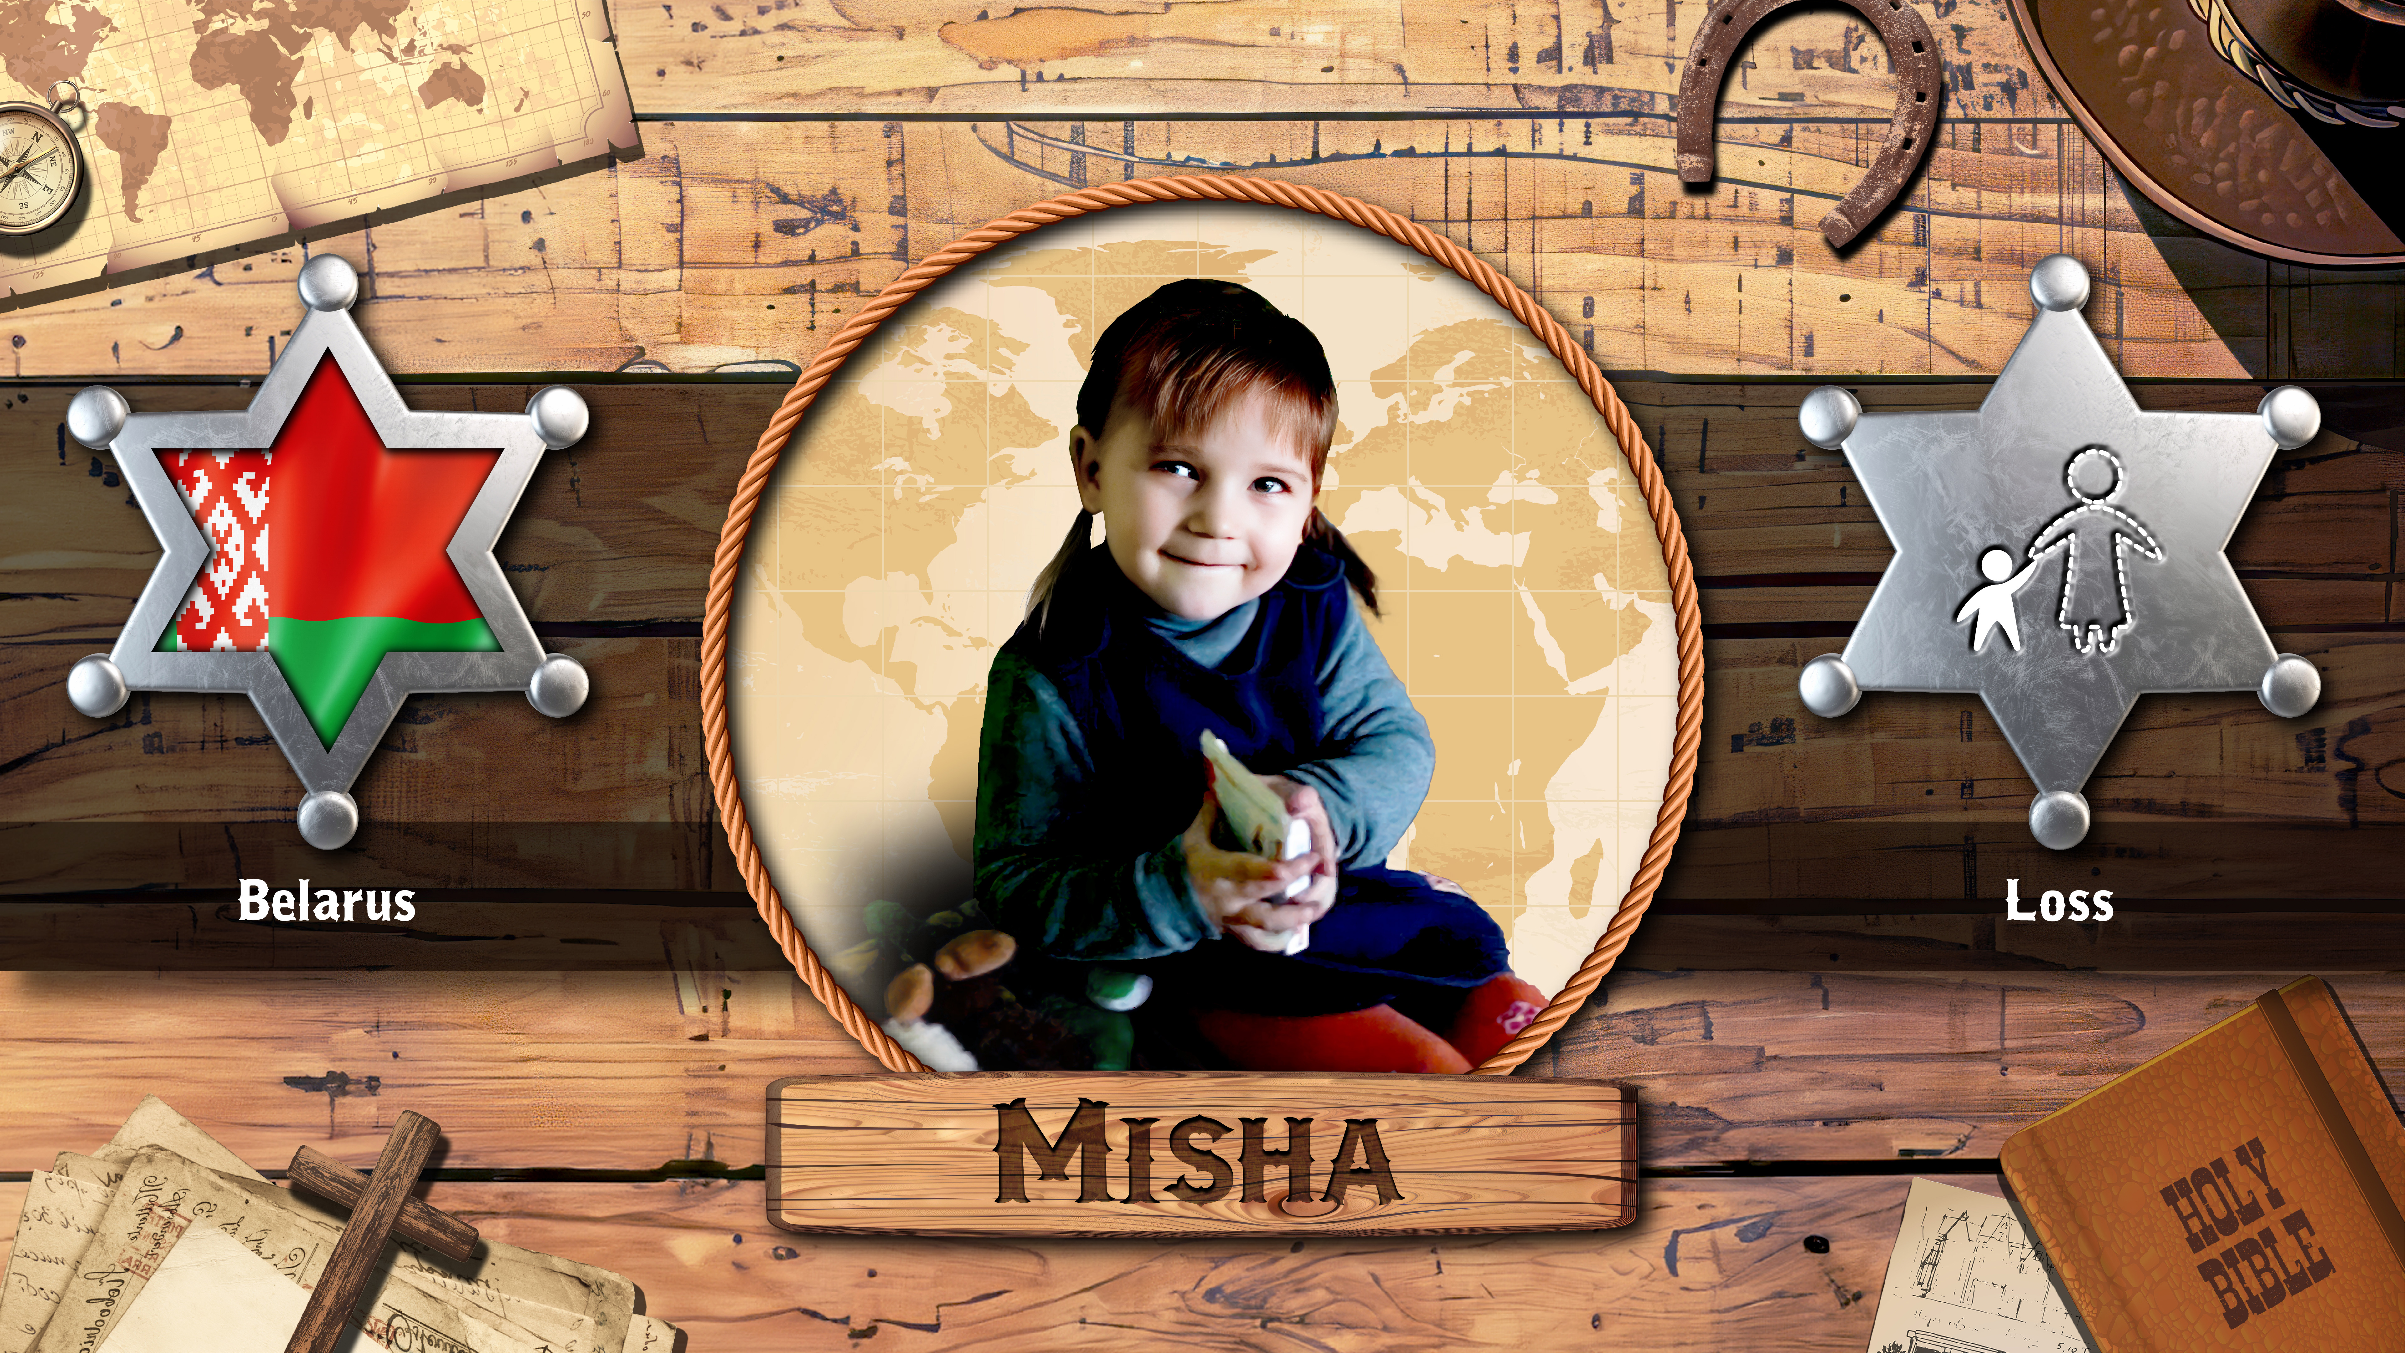

Slide 19
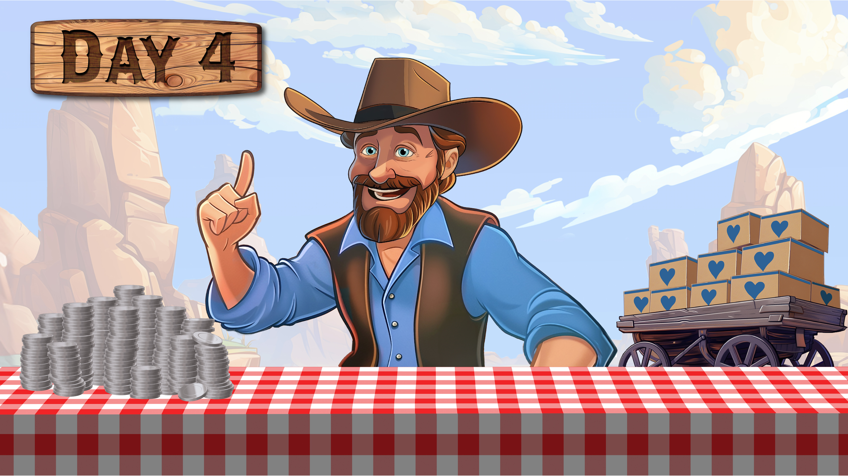
??? Meals

Slide 20
Children’s Hunger Fund Day 5

Slide 21
Day 2

Slide 23
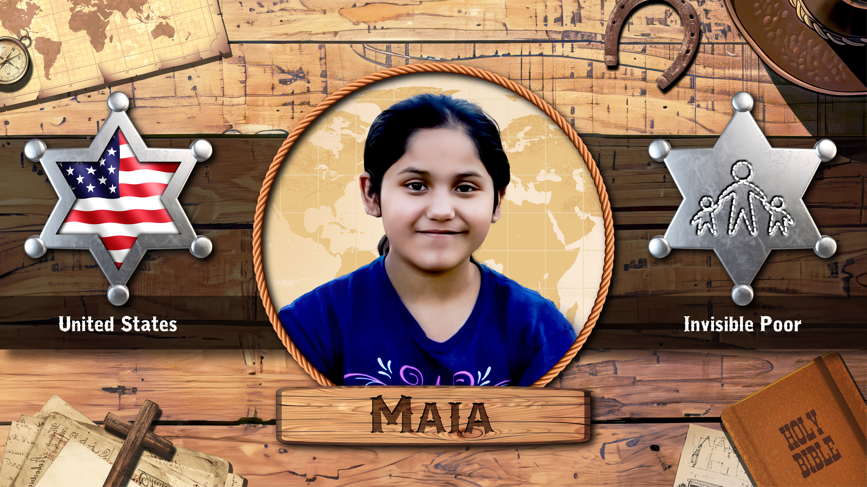

Slide 24
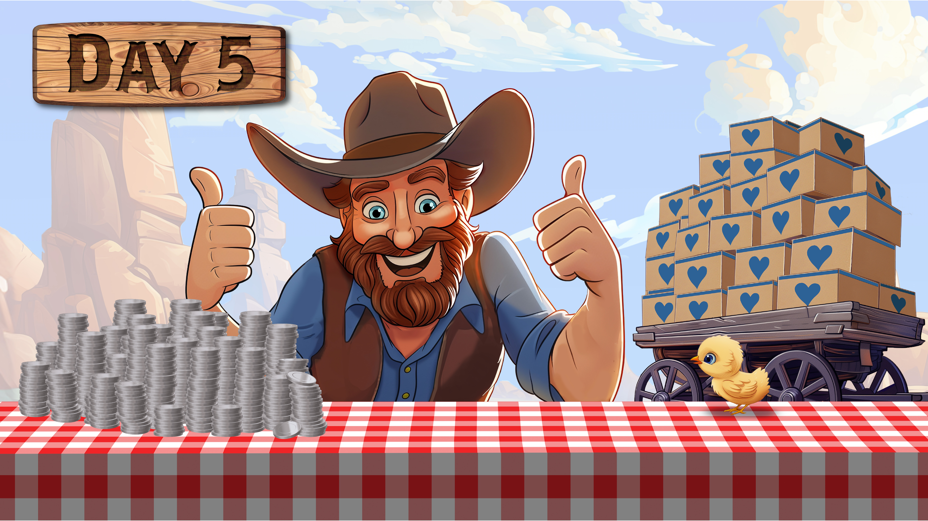
??? Meals

