Slide 1


Slide 2


Slide 3


Slide 4
Insert video

Slide 5


Slide 6


Slide 7


Slide 8
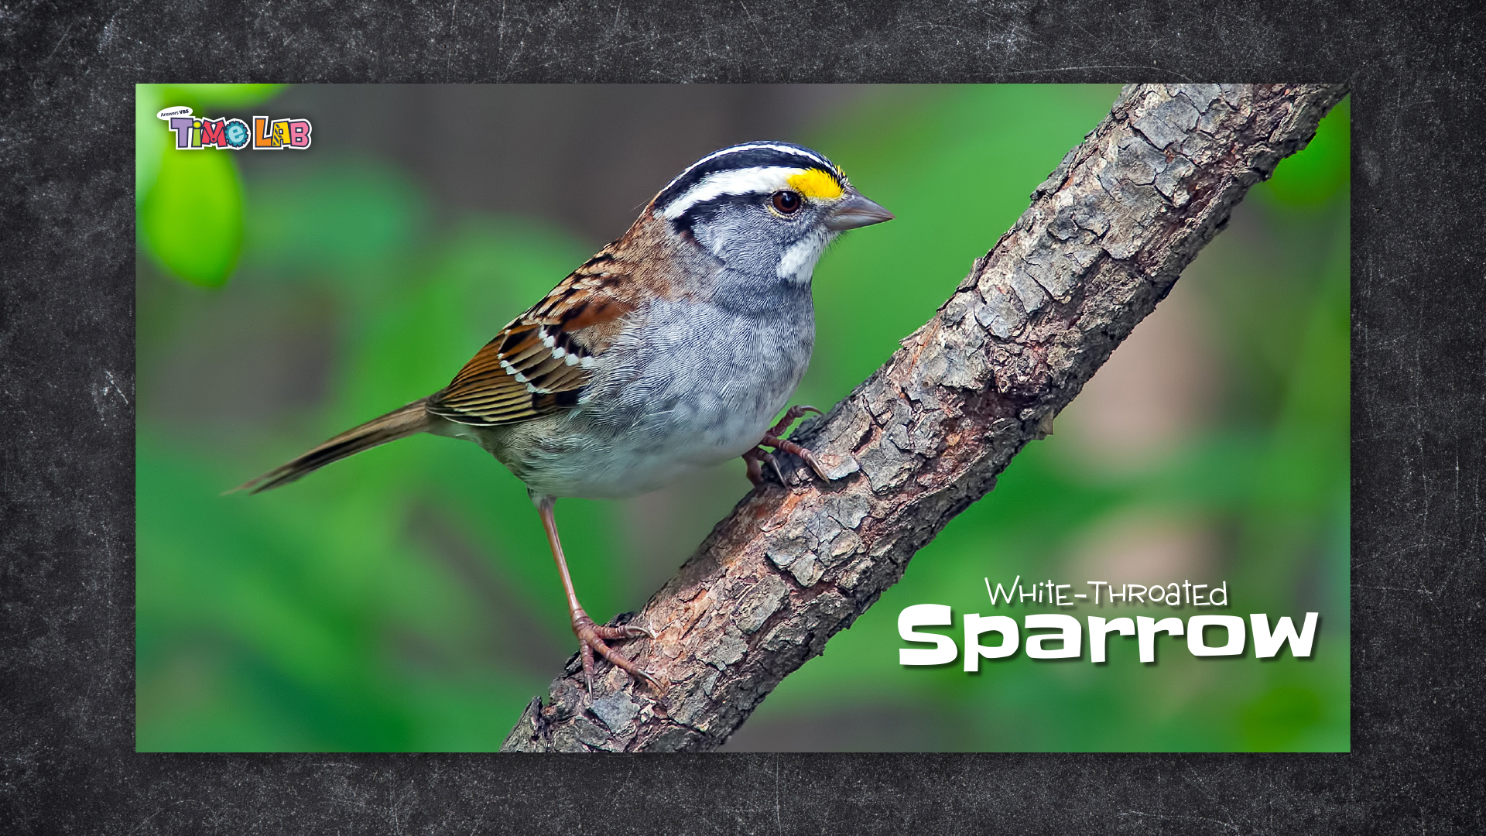

Slide 9


Slide 10
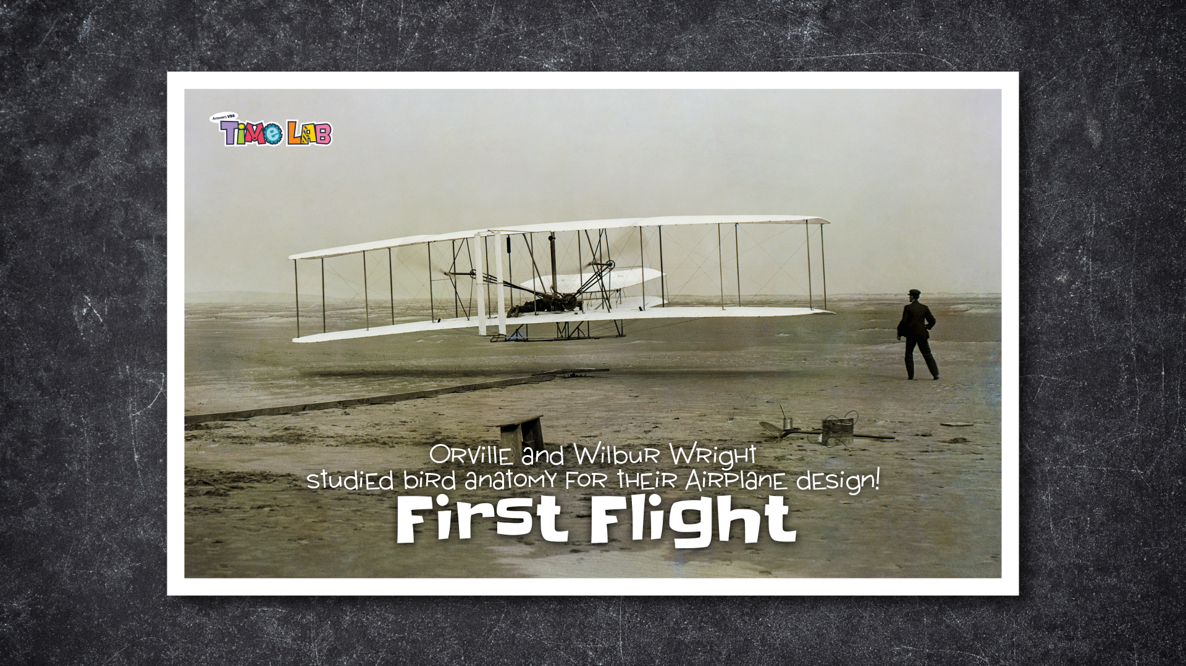

Slide 13


Slide 14
Insert CHF Video

Slide 15
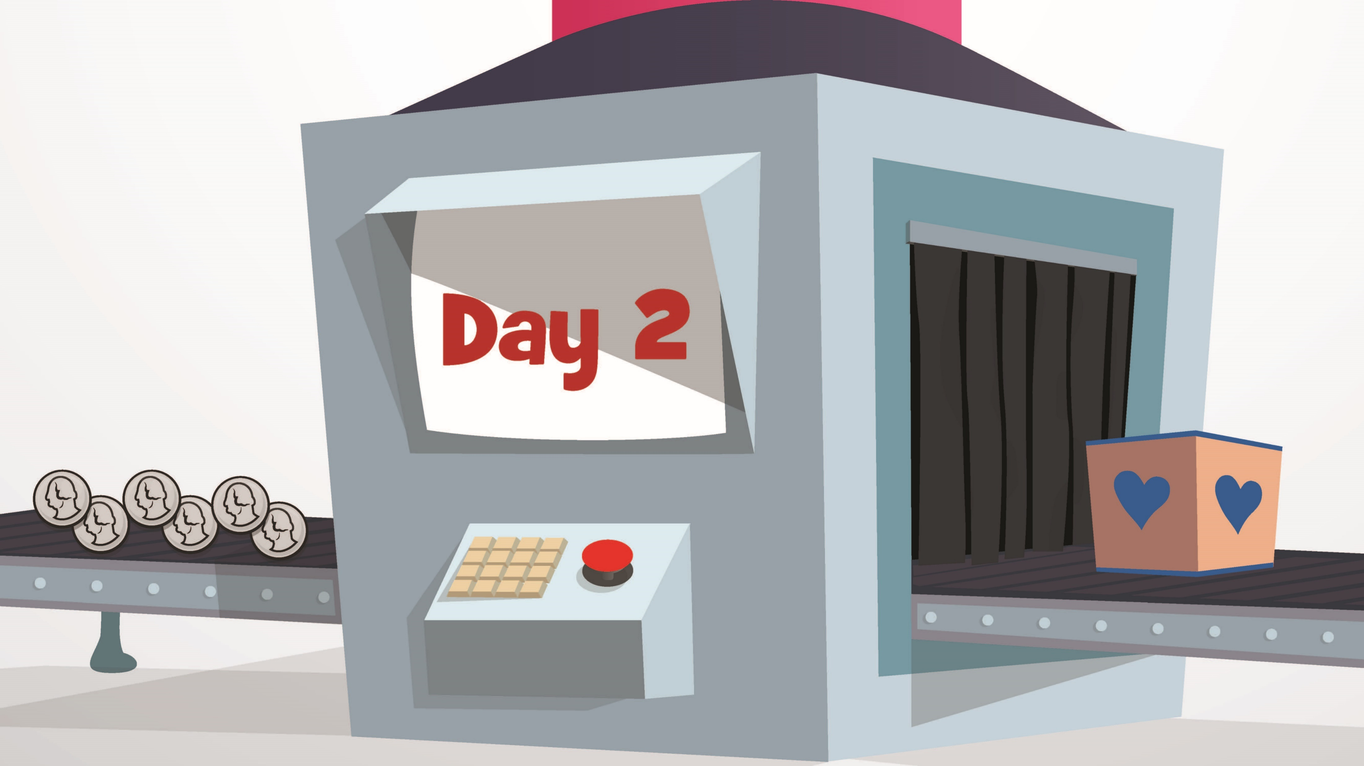

Slide 17


Slide 18
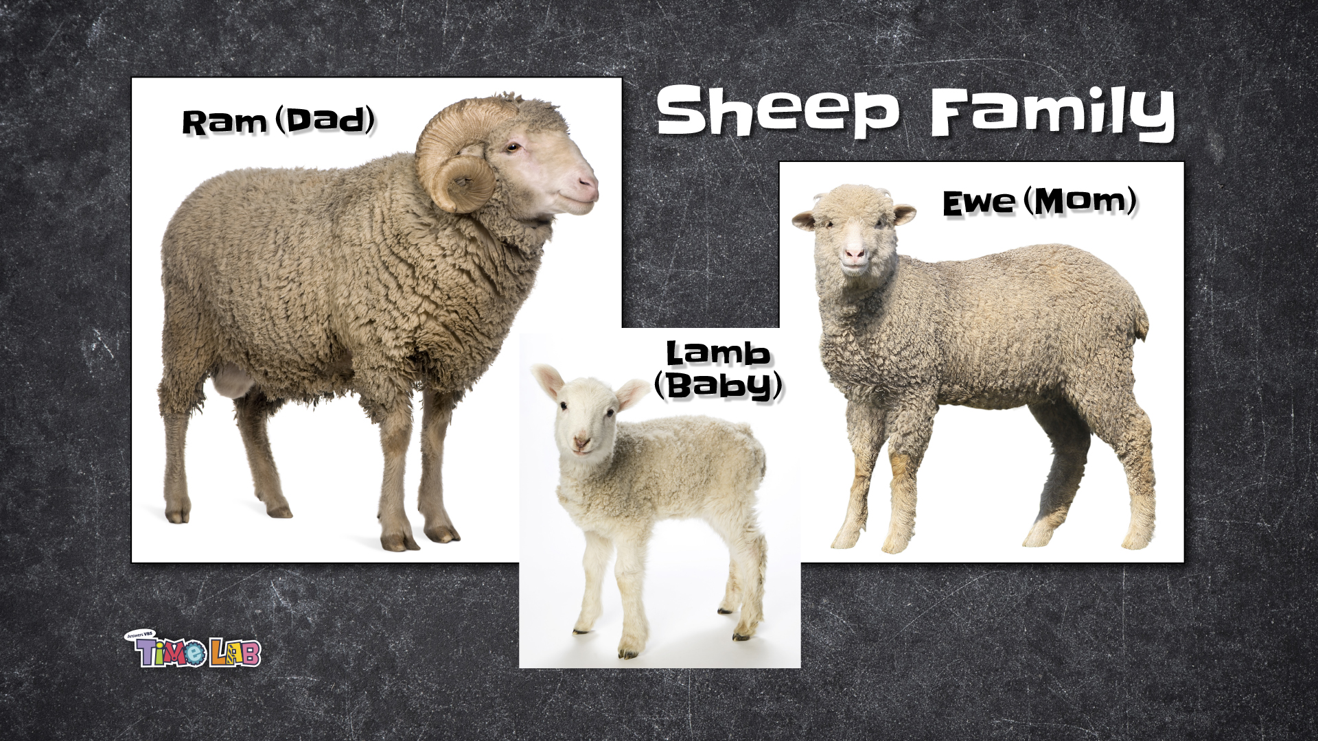

Slide 19


Slide 20


Slide 21
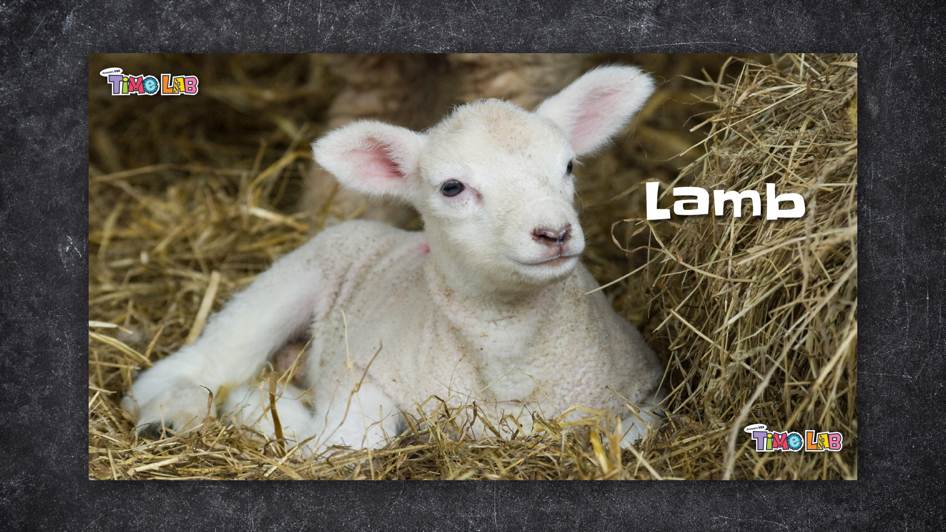

Slide 24


Slide 25
Insert CHF video

Slide 26
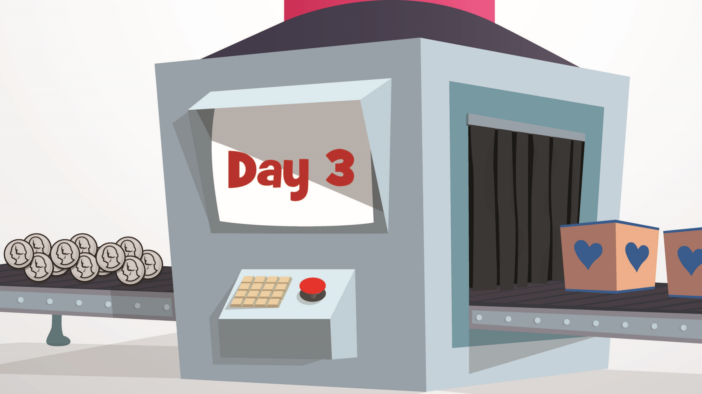

Slide 28


Slide 29
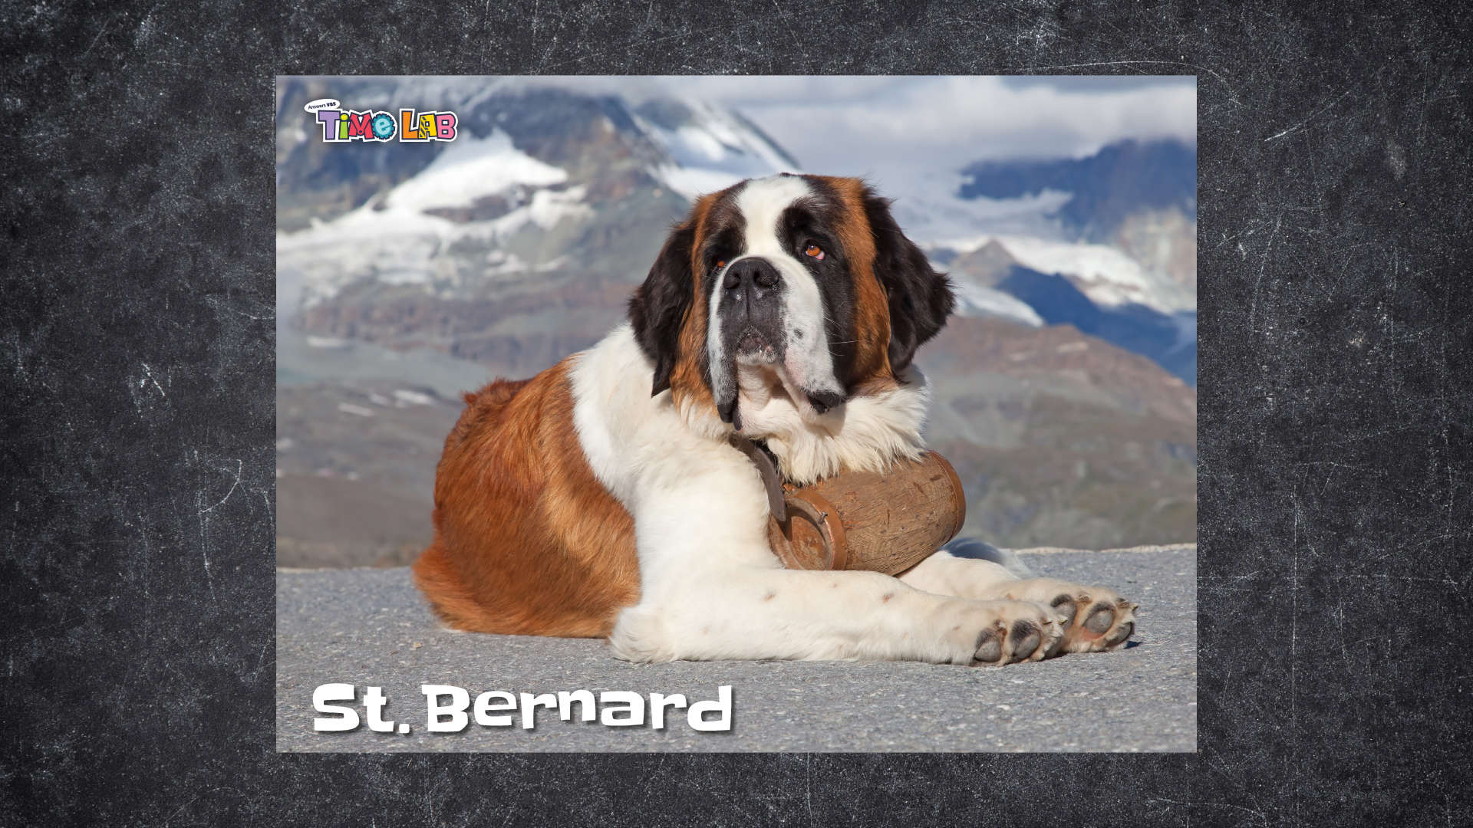

Slide 30
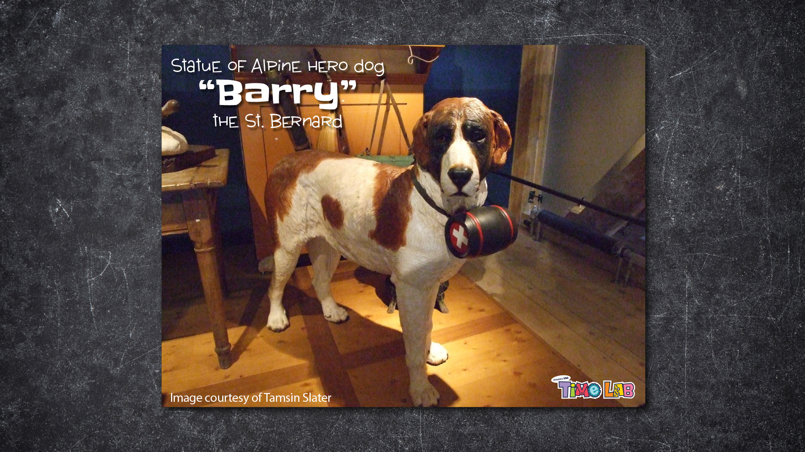

Slide 33


Slide 34
Insert CHF Video

Slide 35
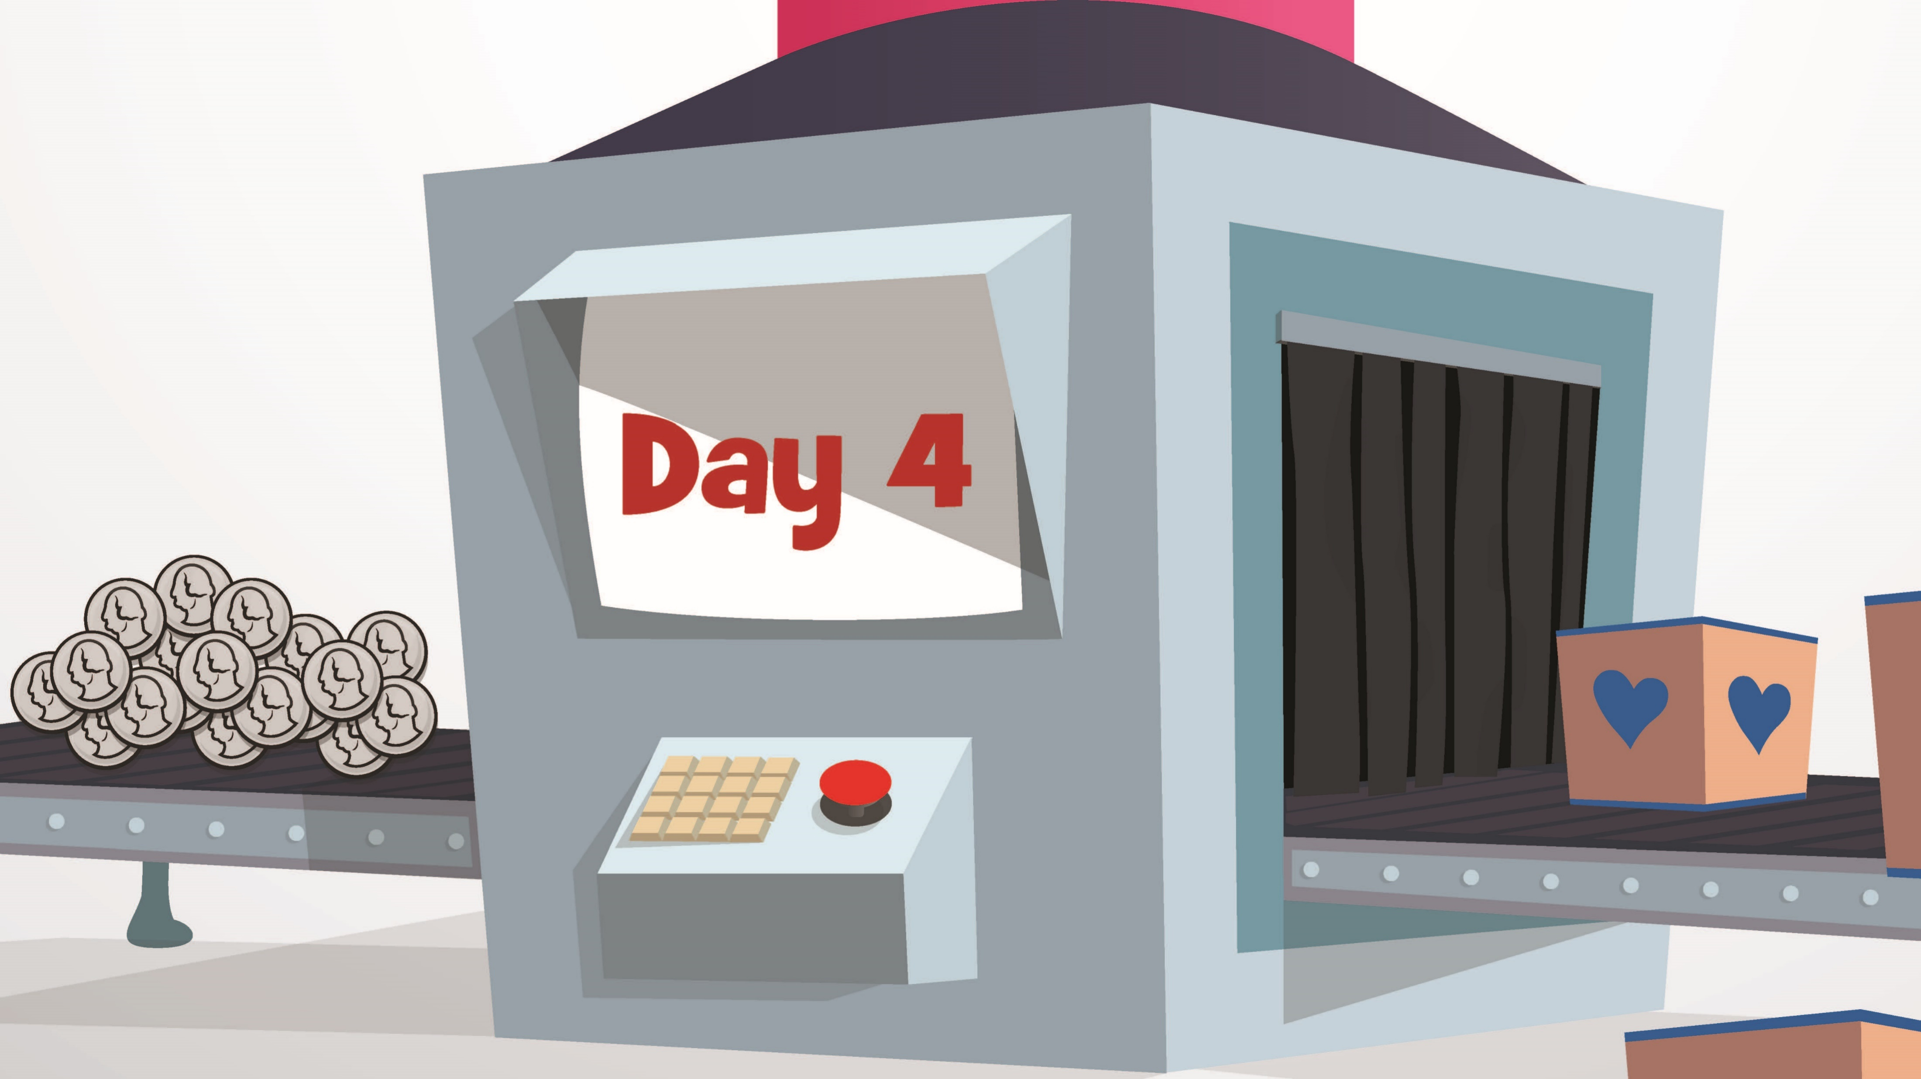

Slide 37


Slide 38


Slide 39


Slide 42


Slide 43
Insert CHF video

Slide 44


Slide 46


Slide 47
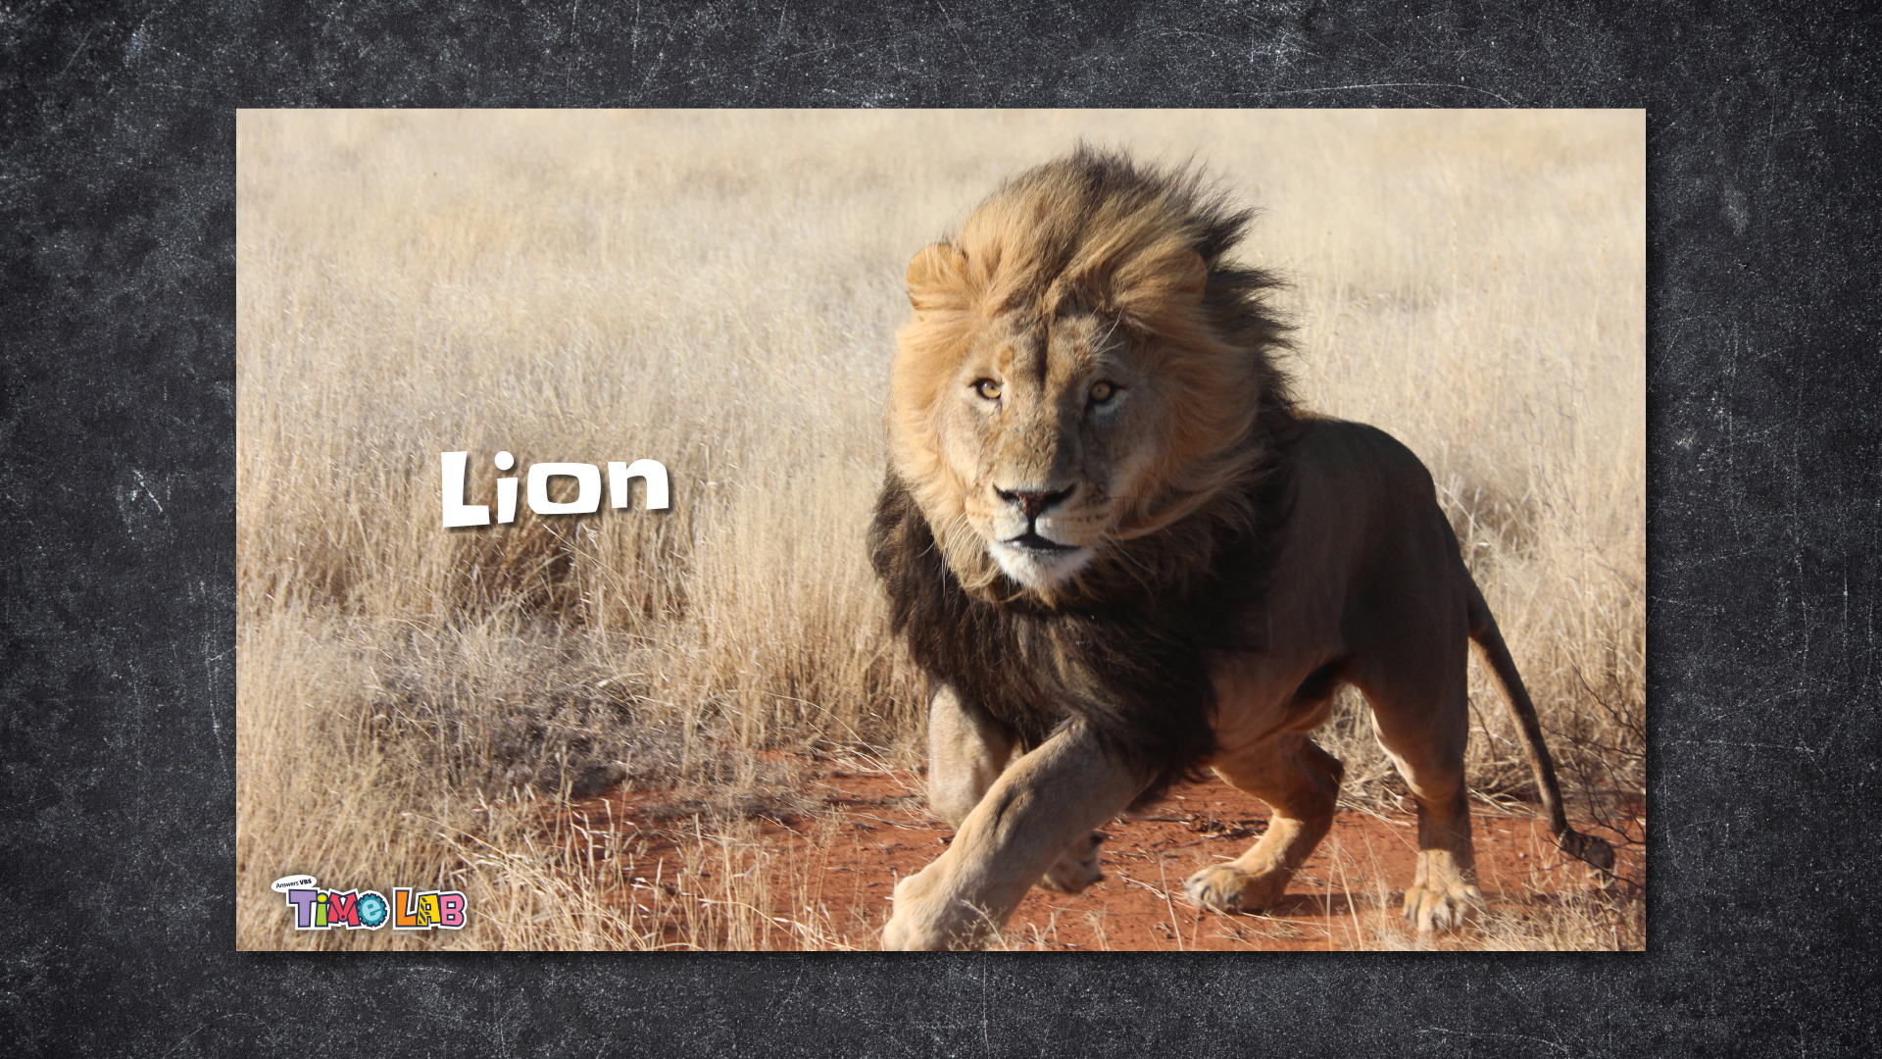

Slide 48


