Slide 1


Slide 2


Slide 3


123,456
Meals

Slide 6
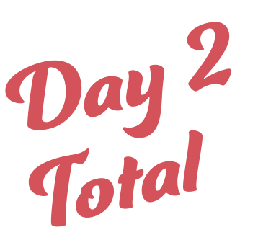
123,456
Meals

Slide 9
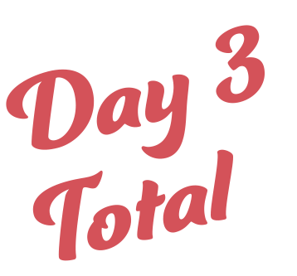
123,456
Meals

Slide 12
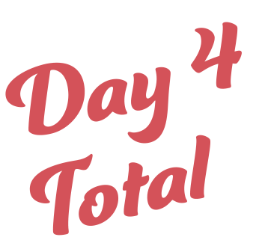
123,456
Meals

Slide 15

123,456
Meals

