Slide 1
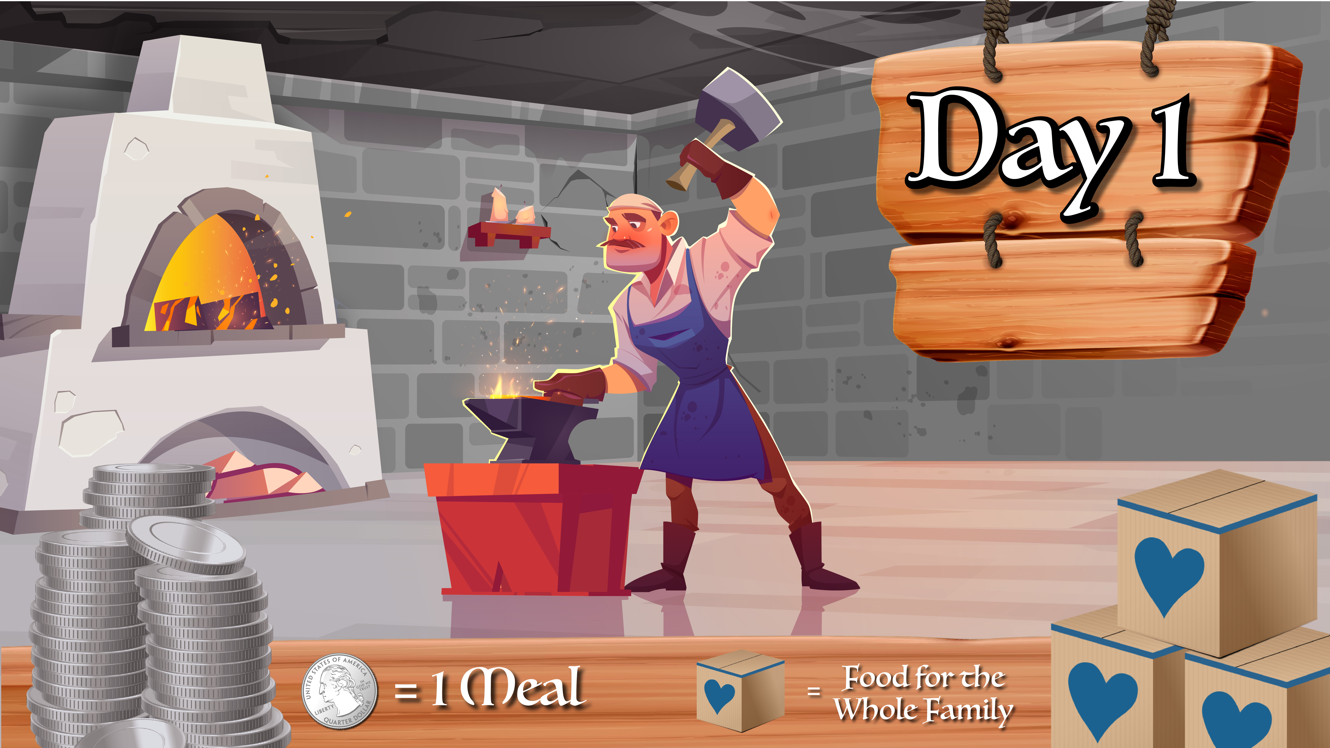

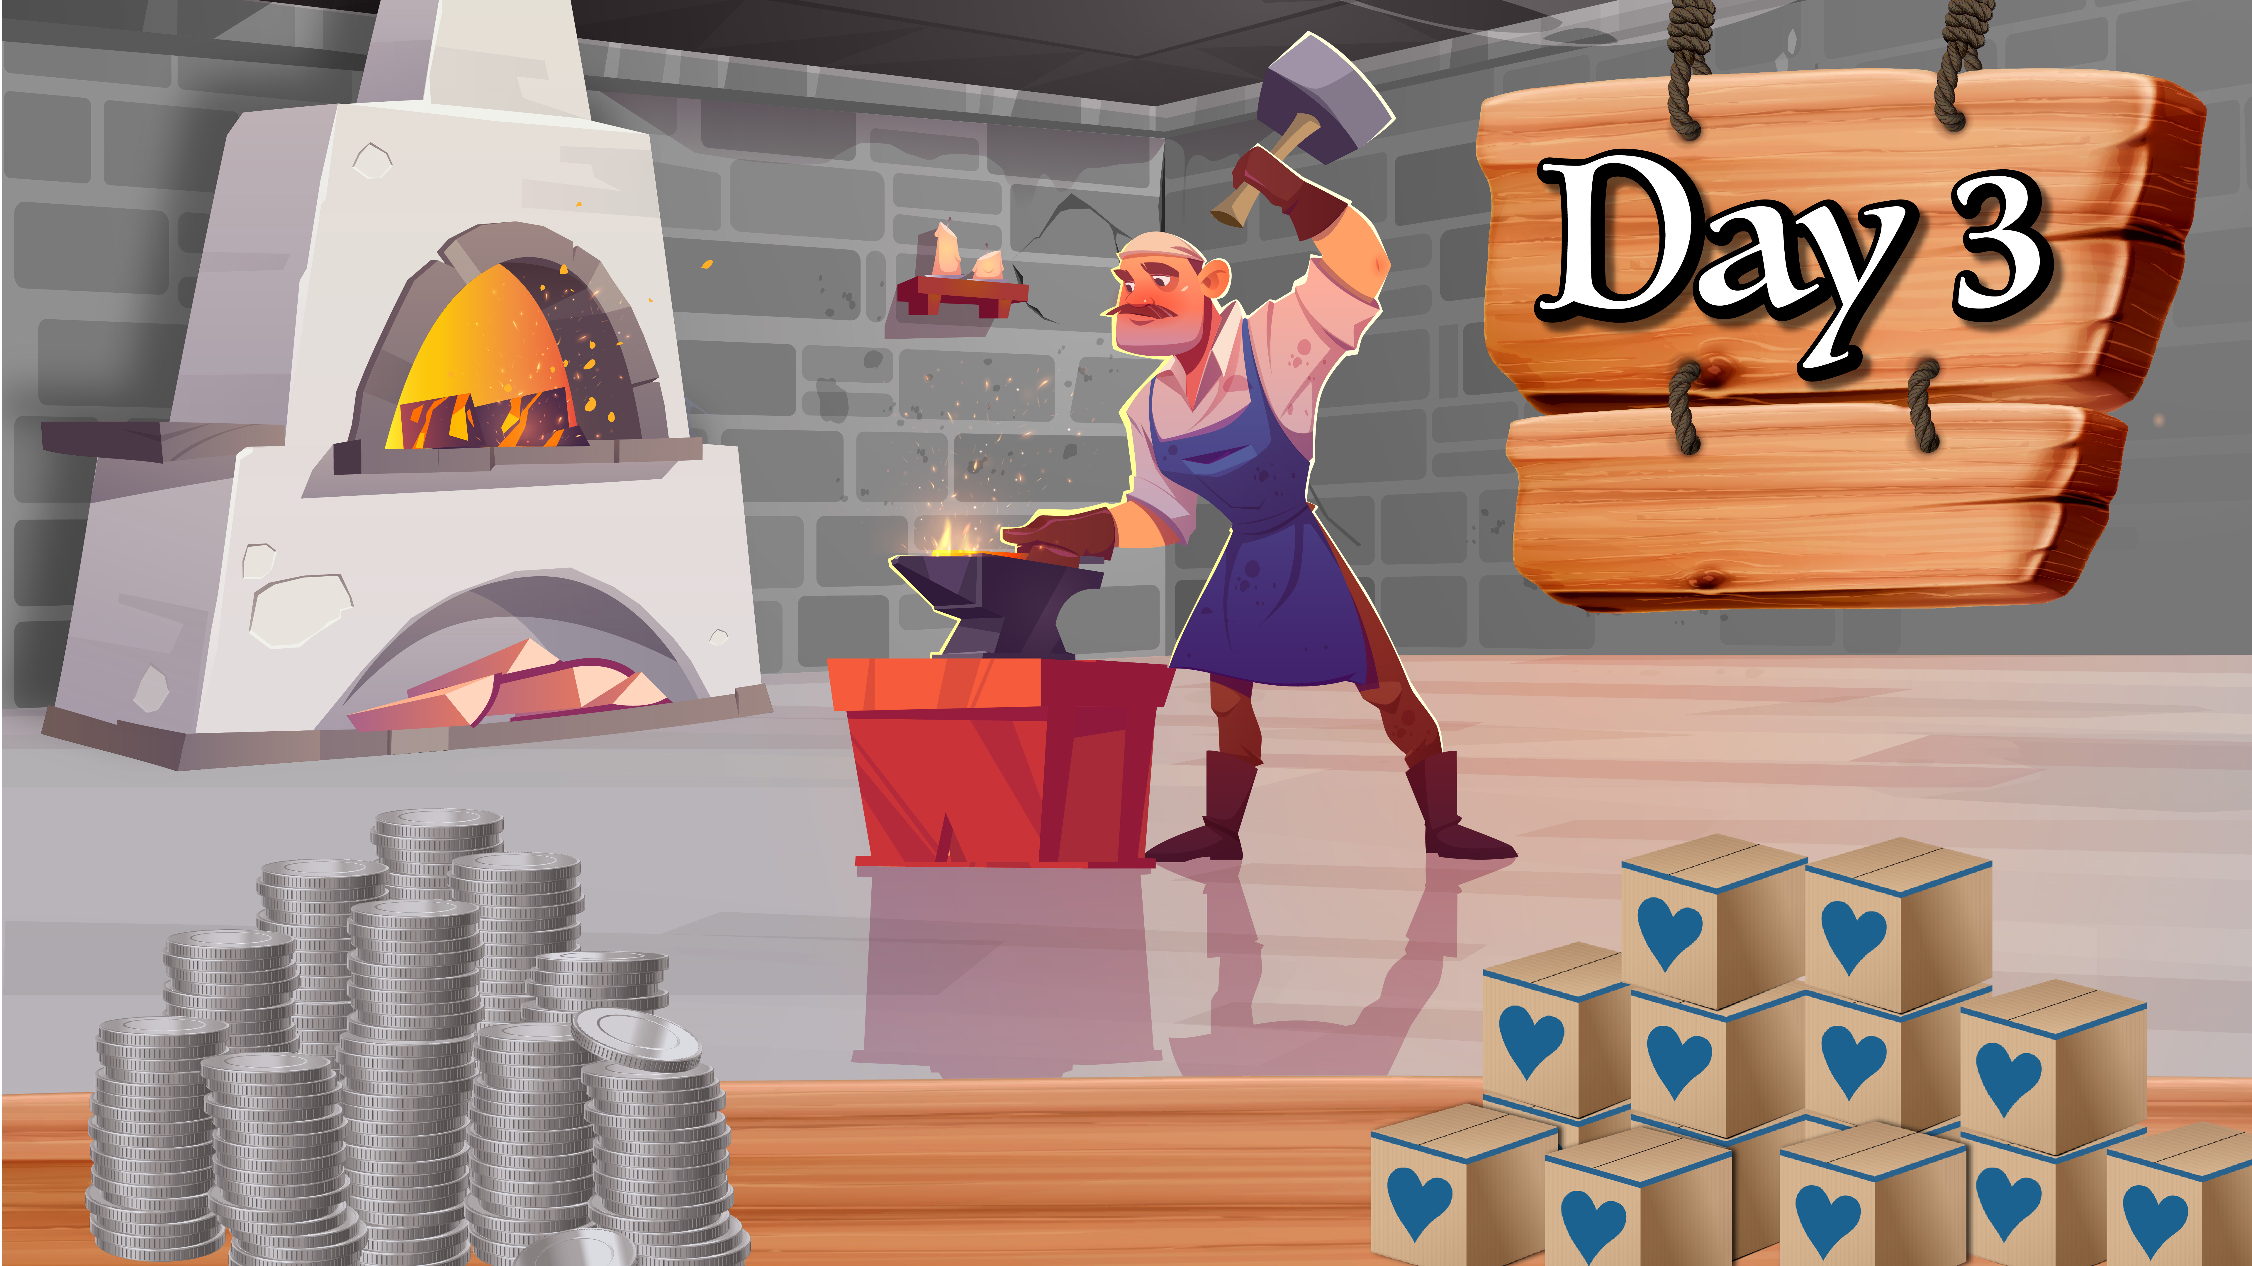




Slide 2
??? Meals

Slide 3
??? Meals

Slide 4
??? Meals

Slide 5
??? Meals

Slide 6
??? Meals

