Slide 1

Jokes and Trivia

Slide 2

Jokes and Trivia

Slide 3
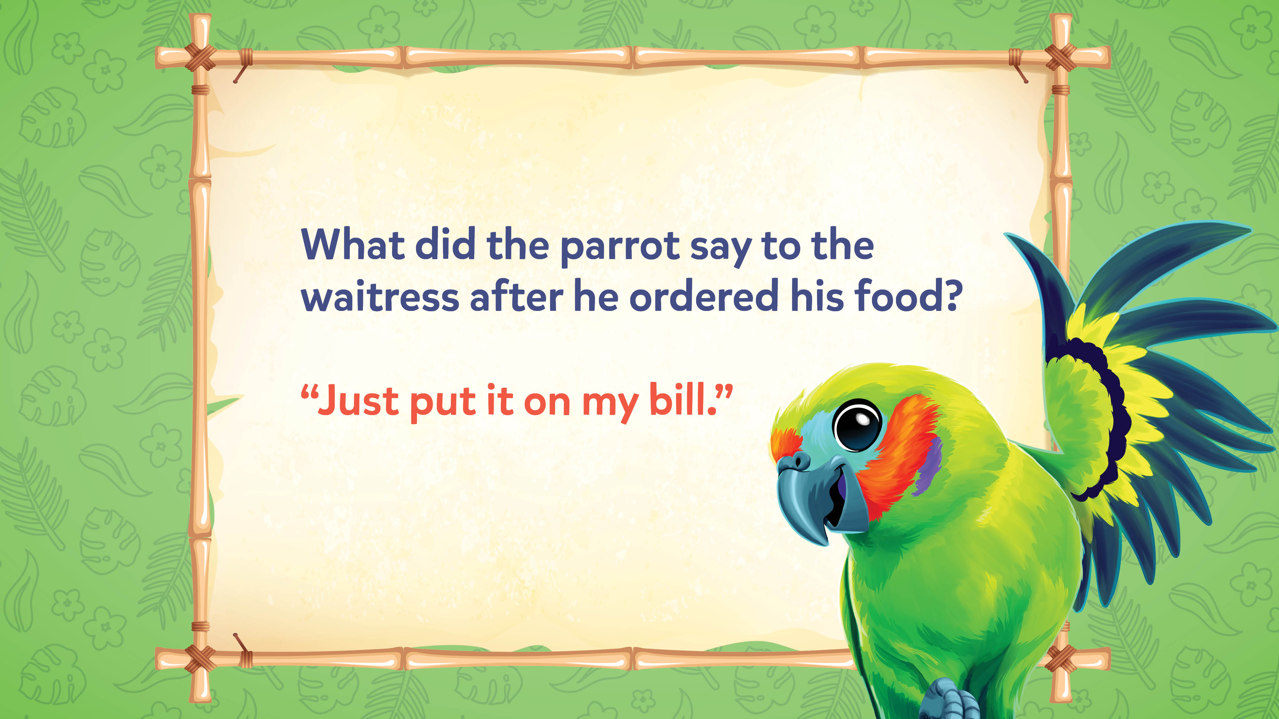
Jokes and Trivia

Slide 4
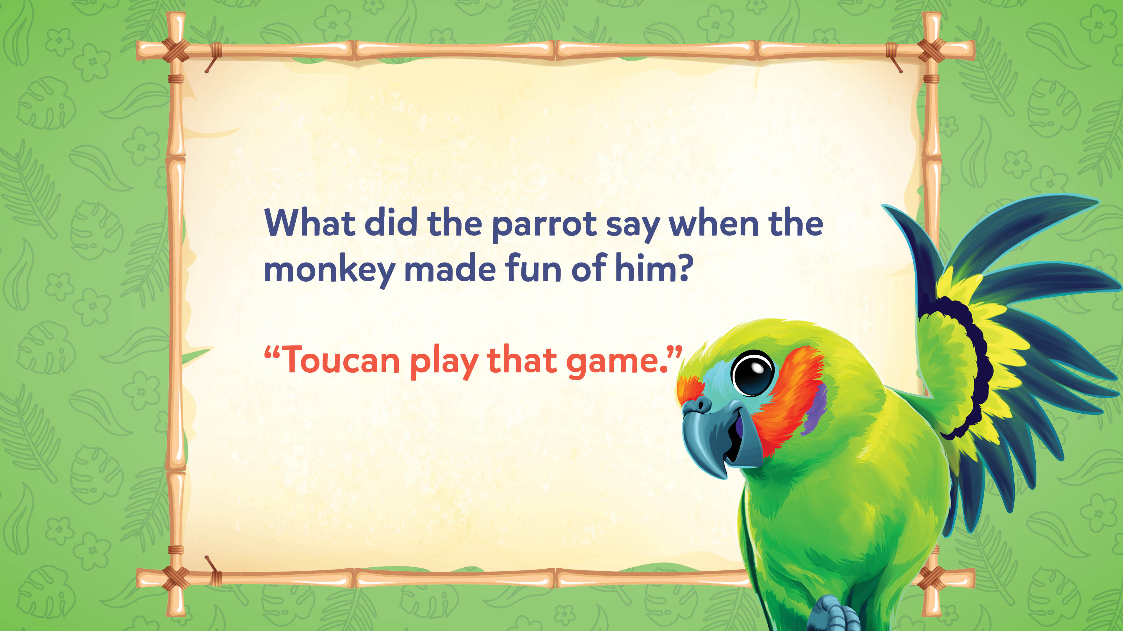
Jokes and Trivia

Slide 5
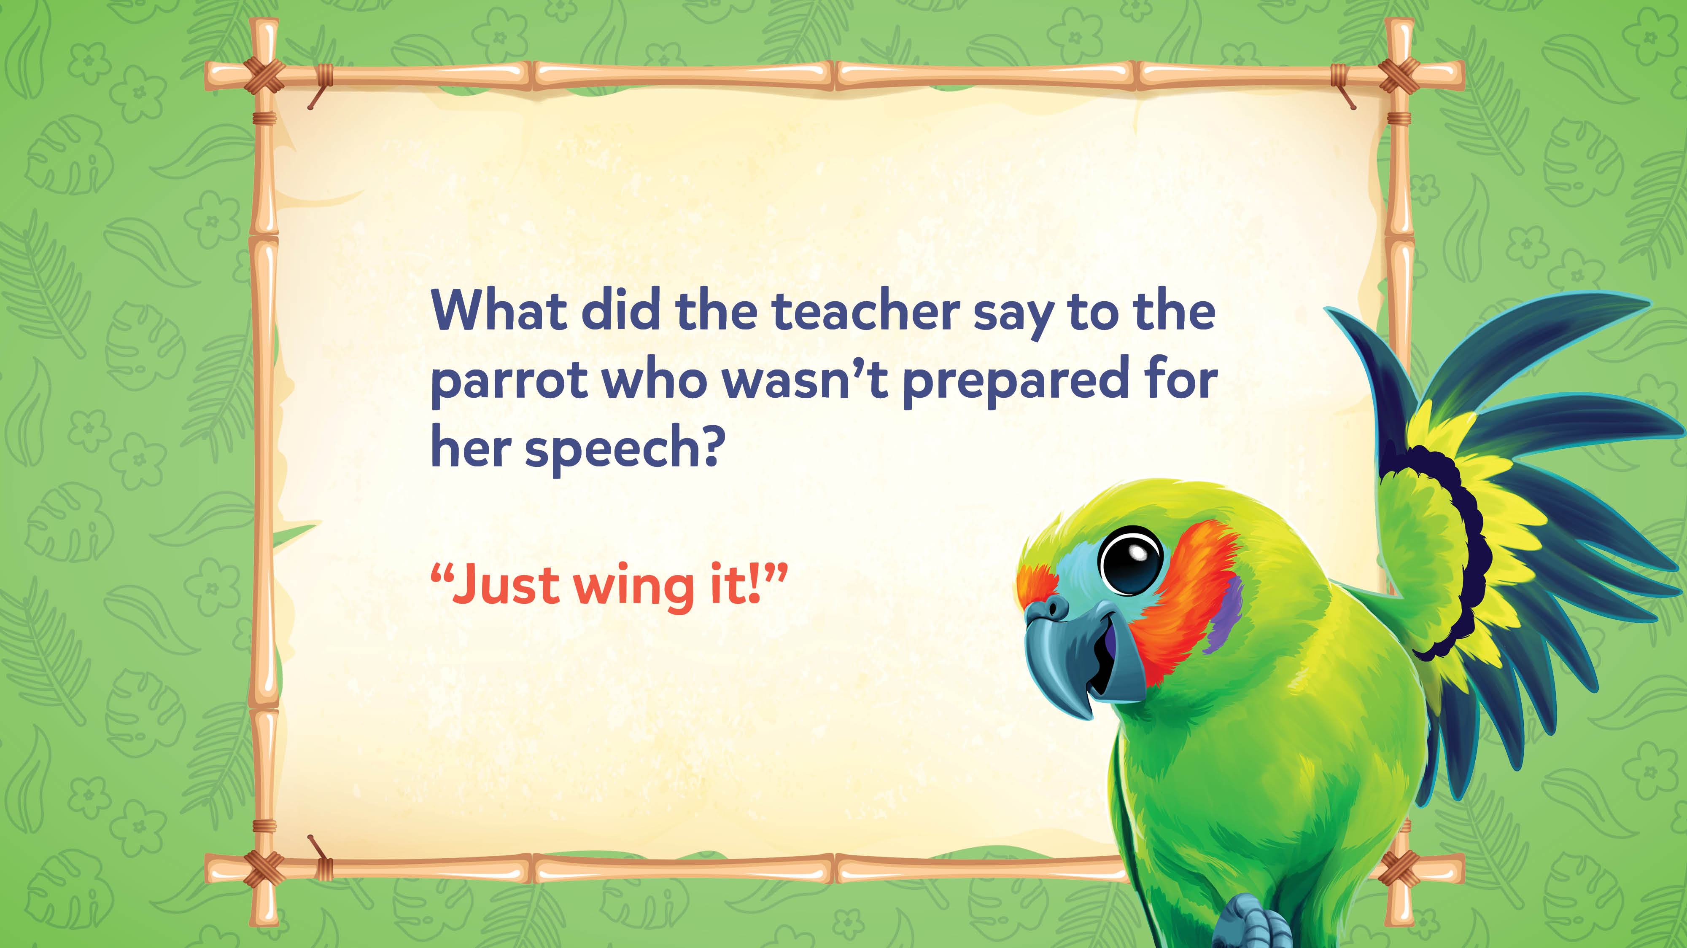
Jokes and Trivia

Slide 6
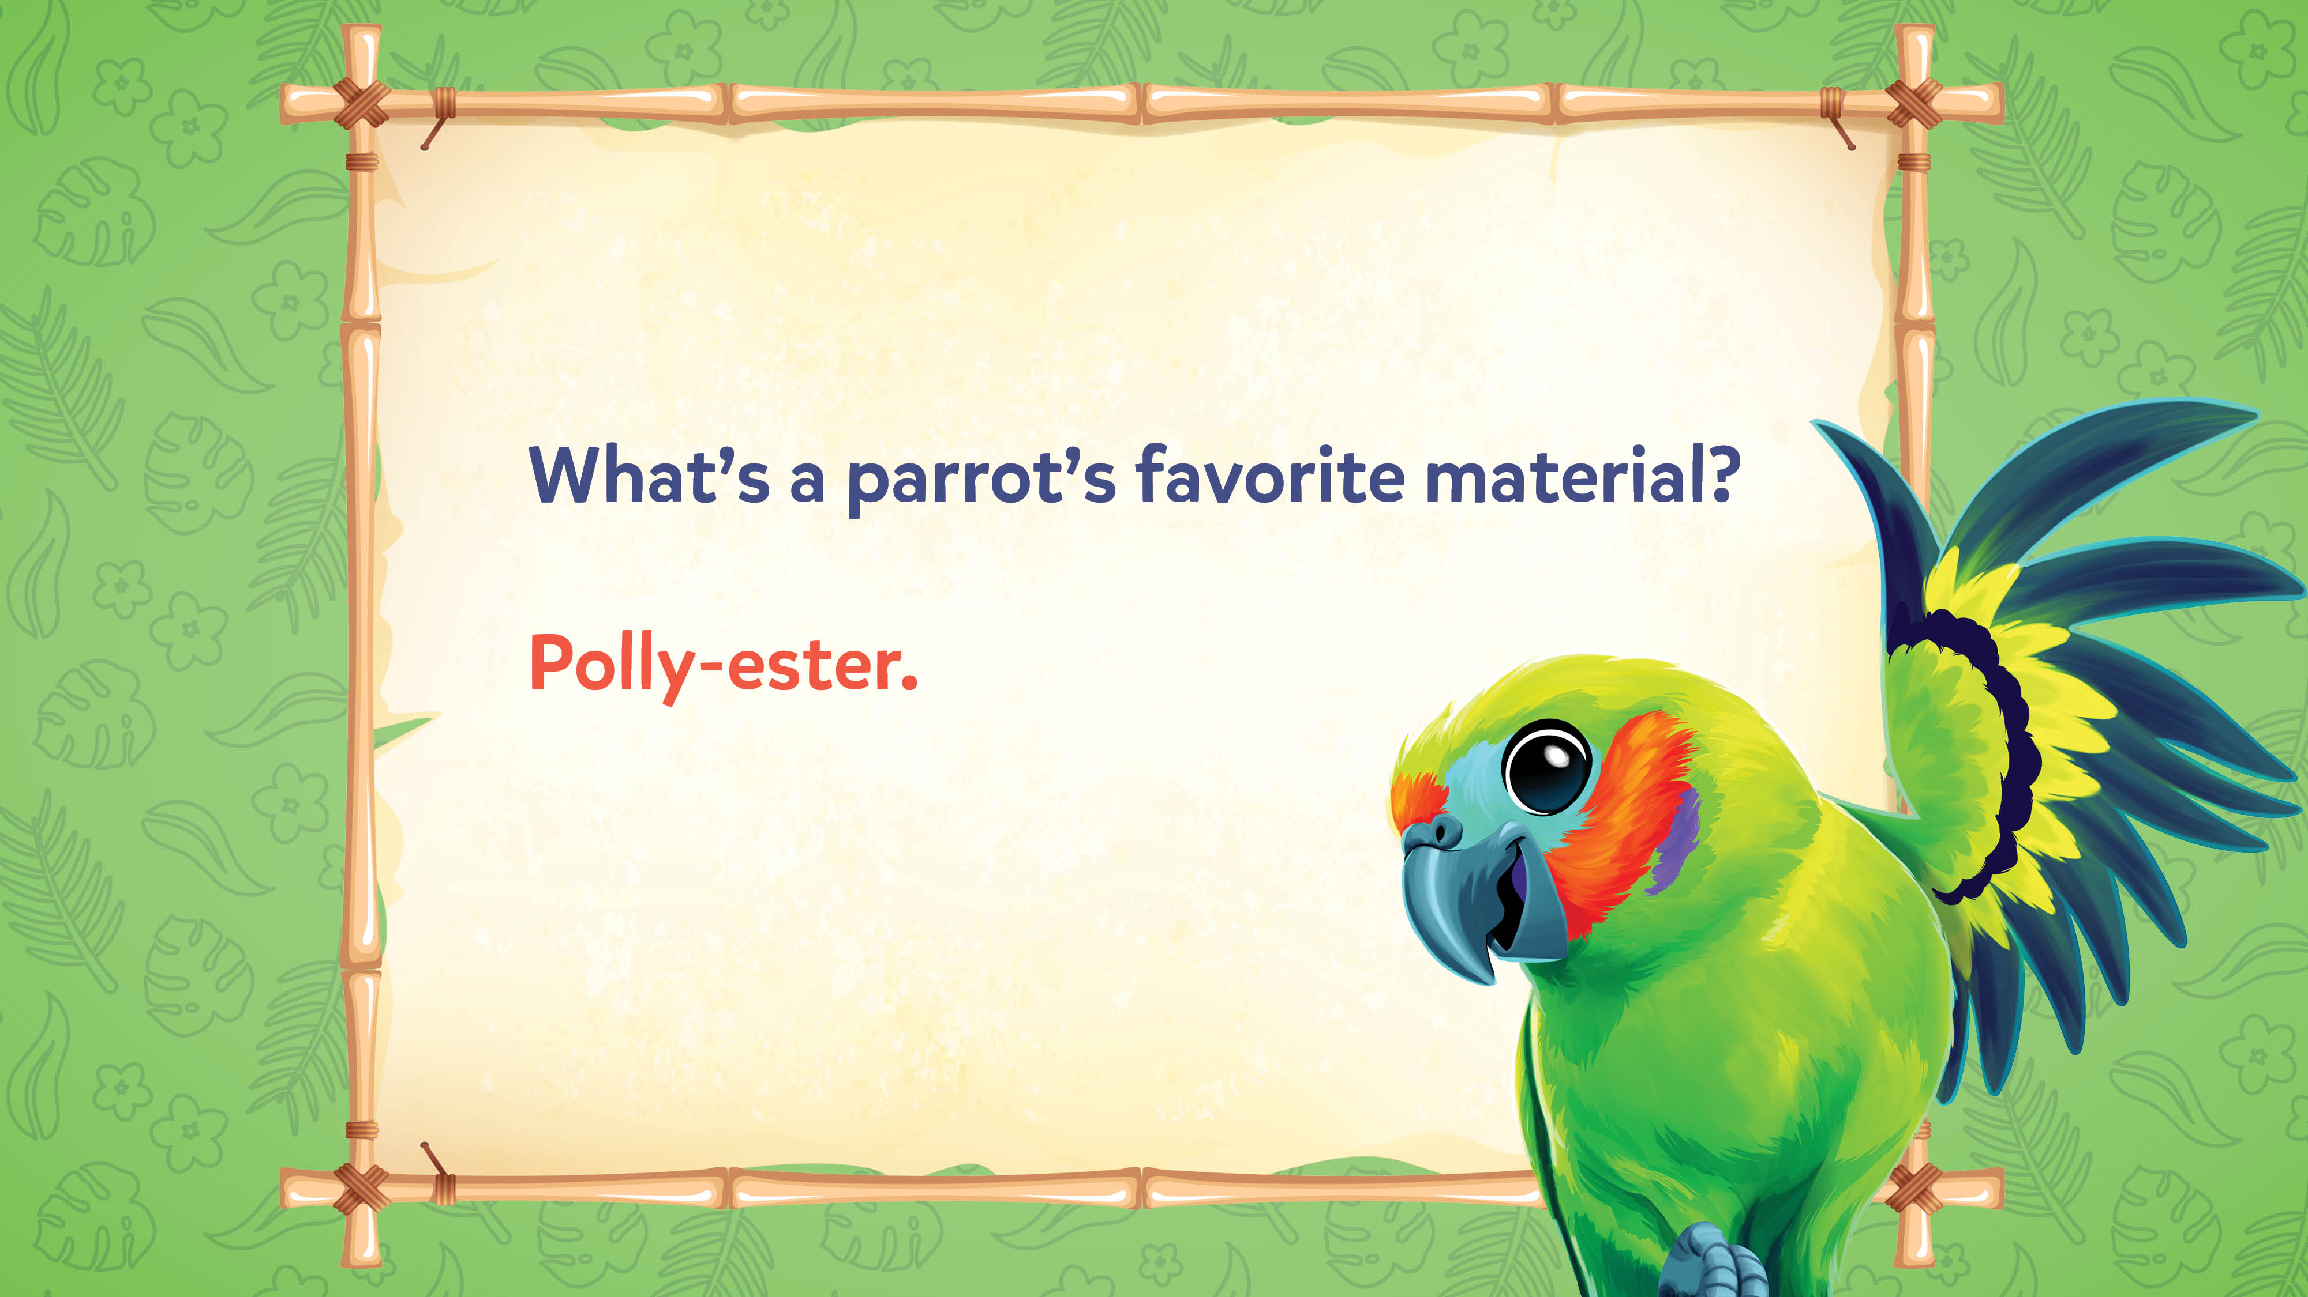
Jokes and Trivia

Slide 7
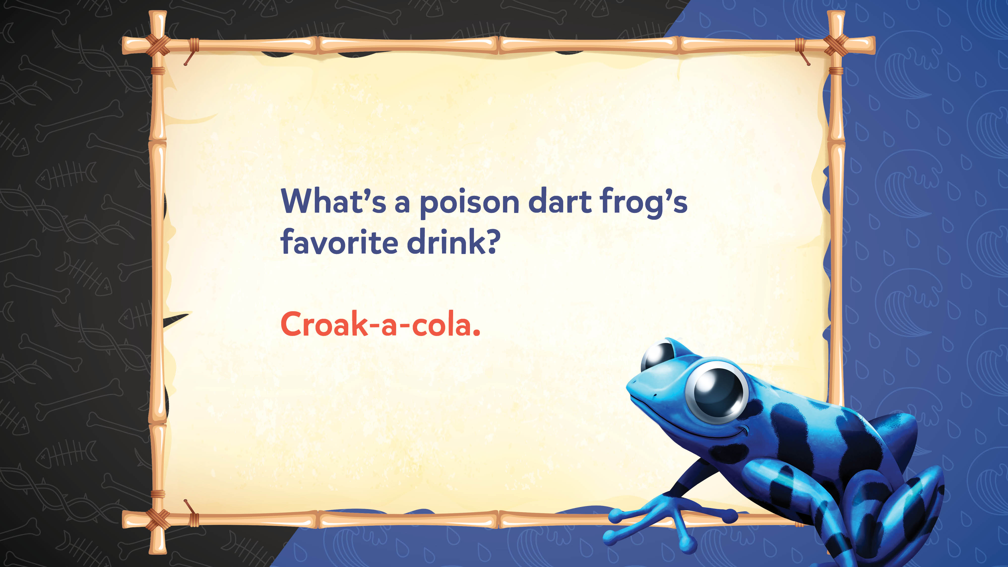
Jokes and Trivia

Slide 8
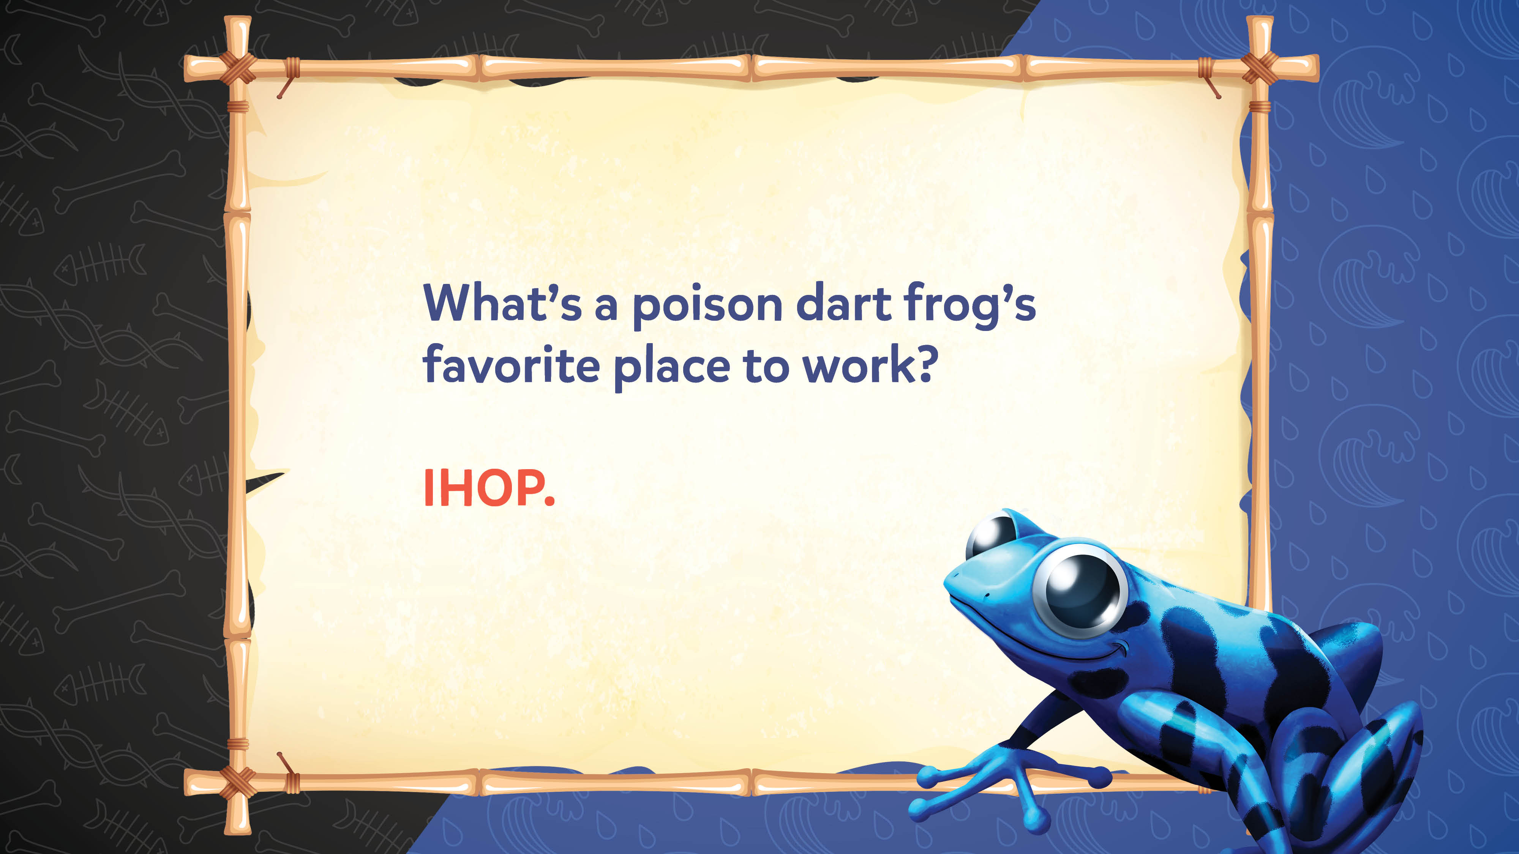
Jokes and Trivia

Slide 9
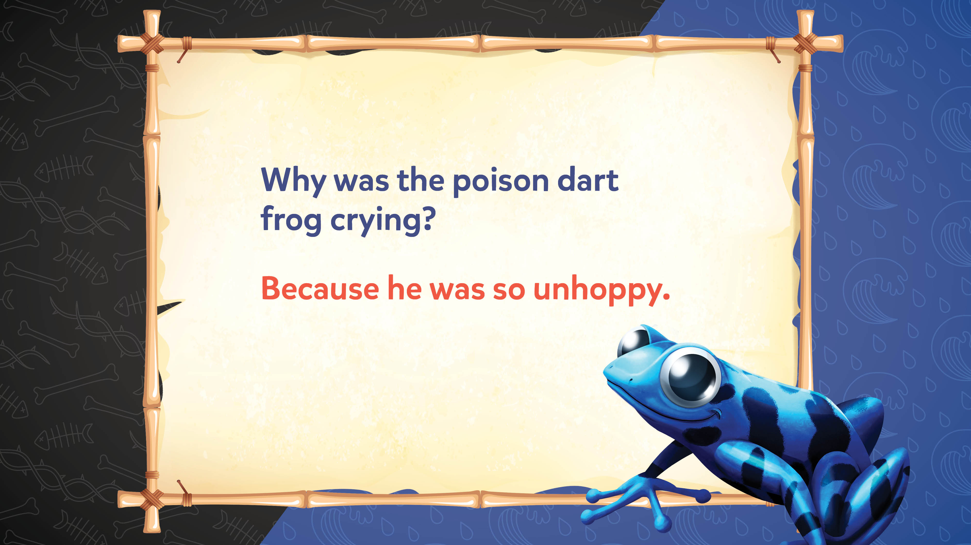
Jokes and Trivia

Slide 10
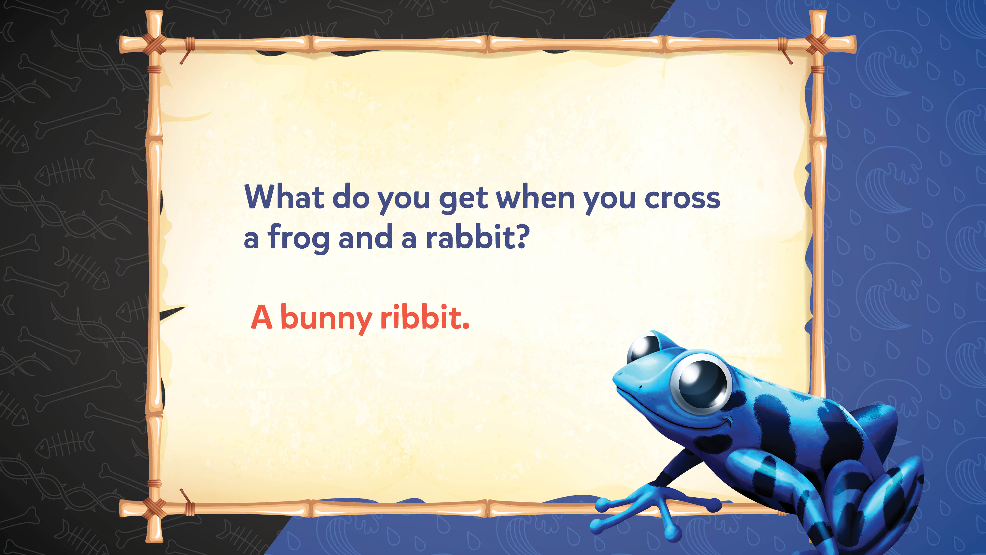
Jokes and Trivia

Slide 11
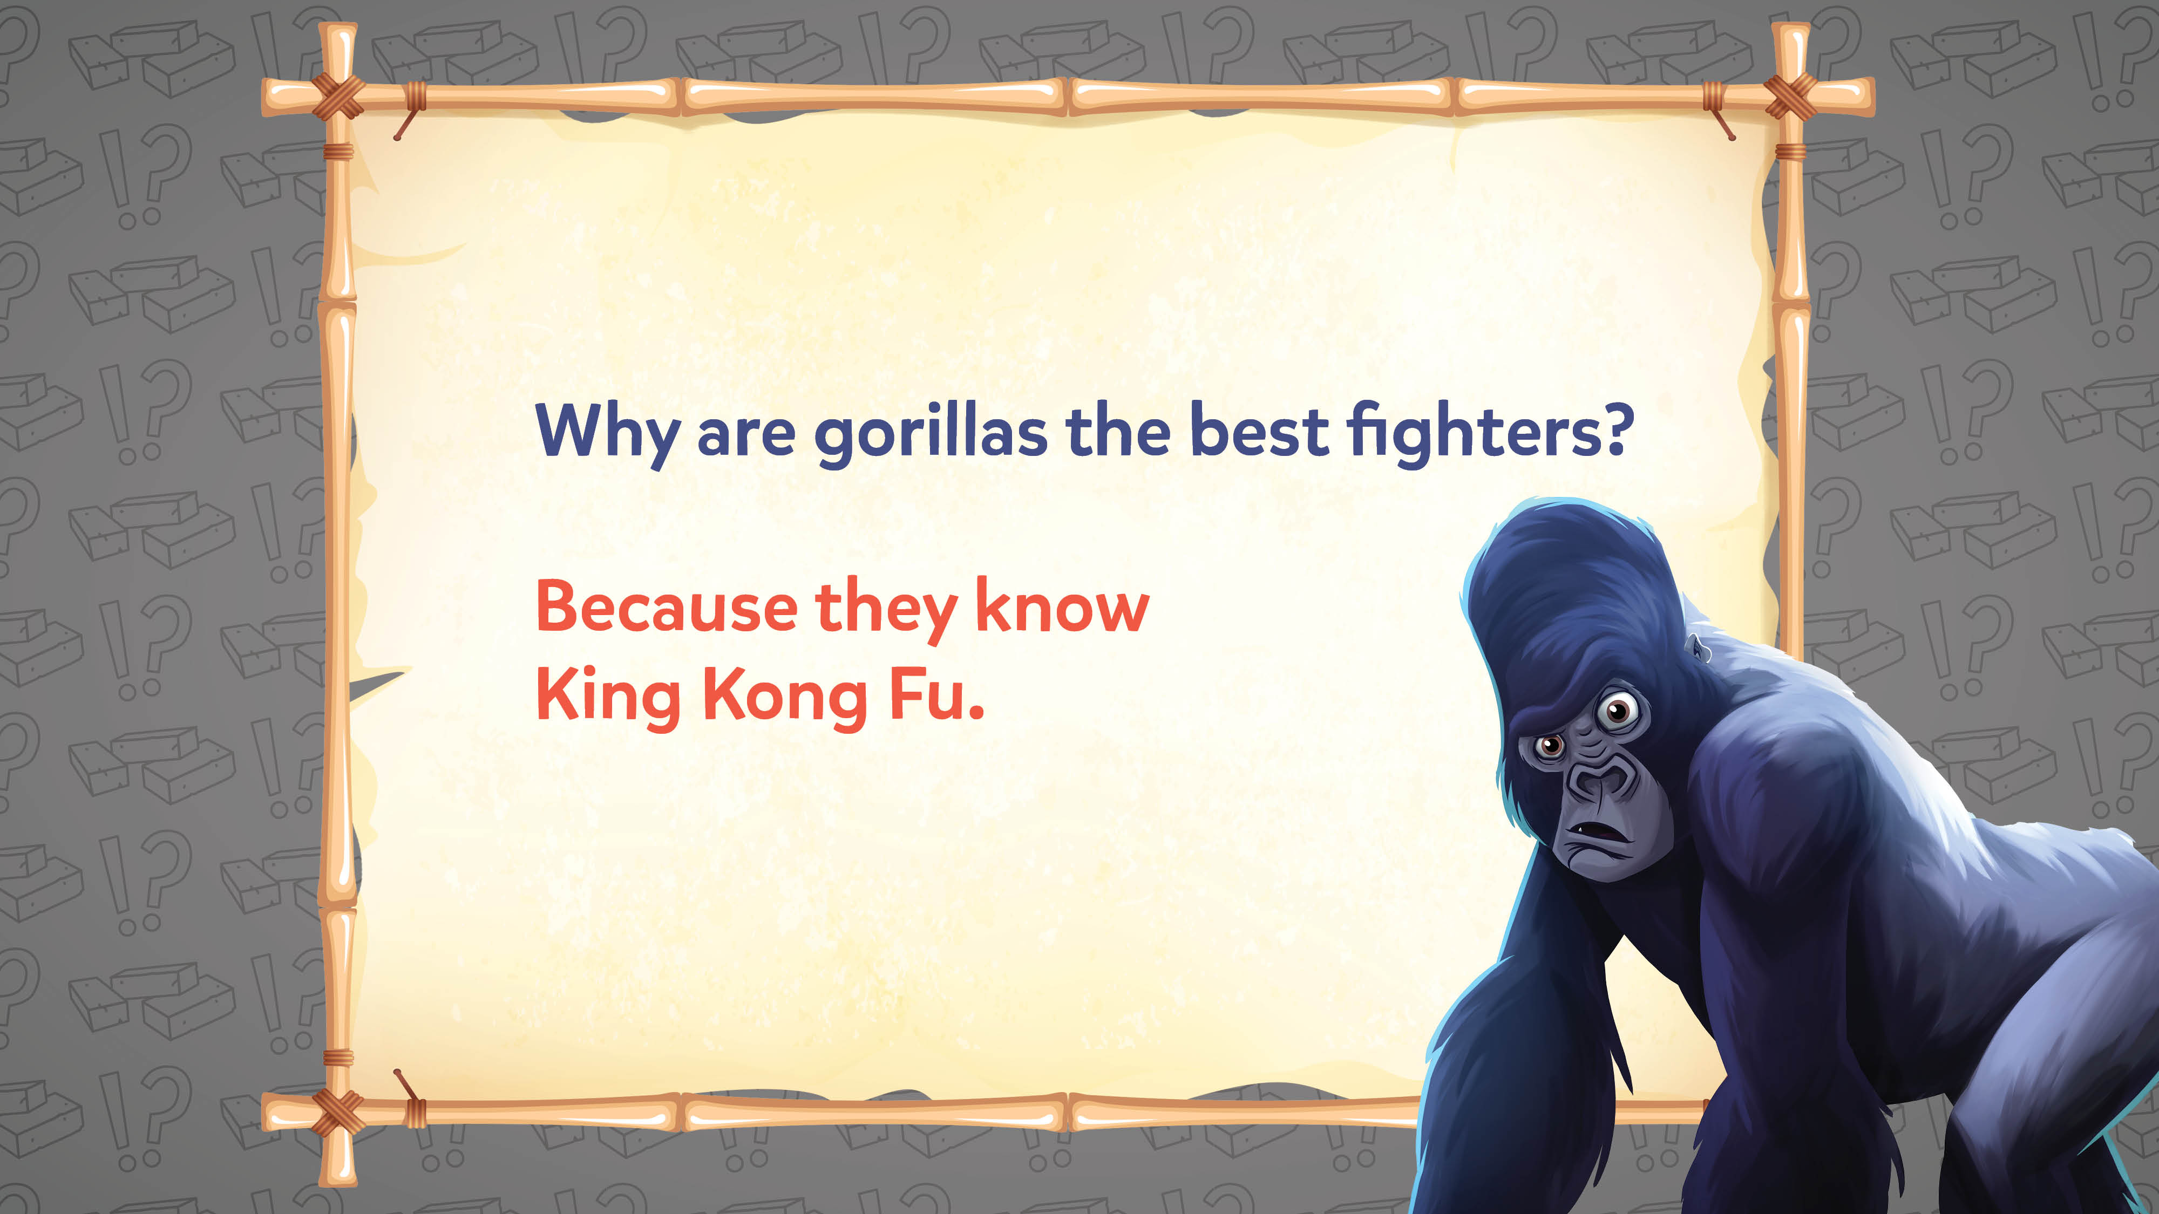
Jokes and Trivia

Slide 12
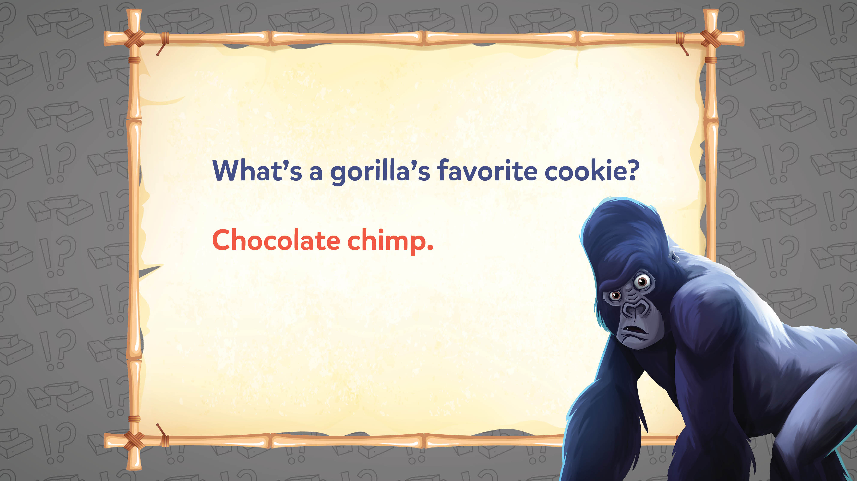
Jokes and Trivia

Slide 13

Jokes and Trivia

Slide 14
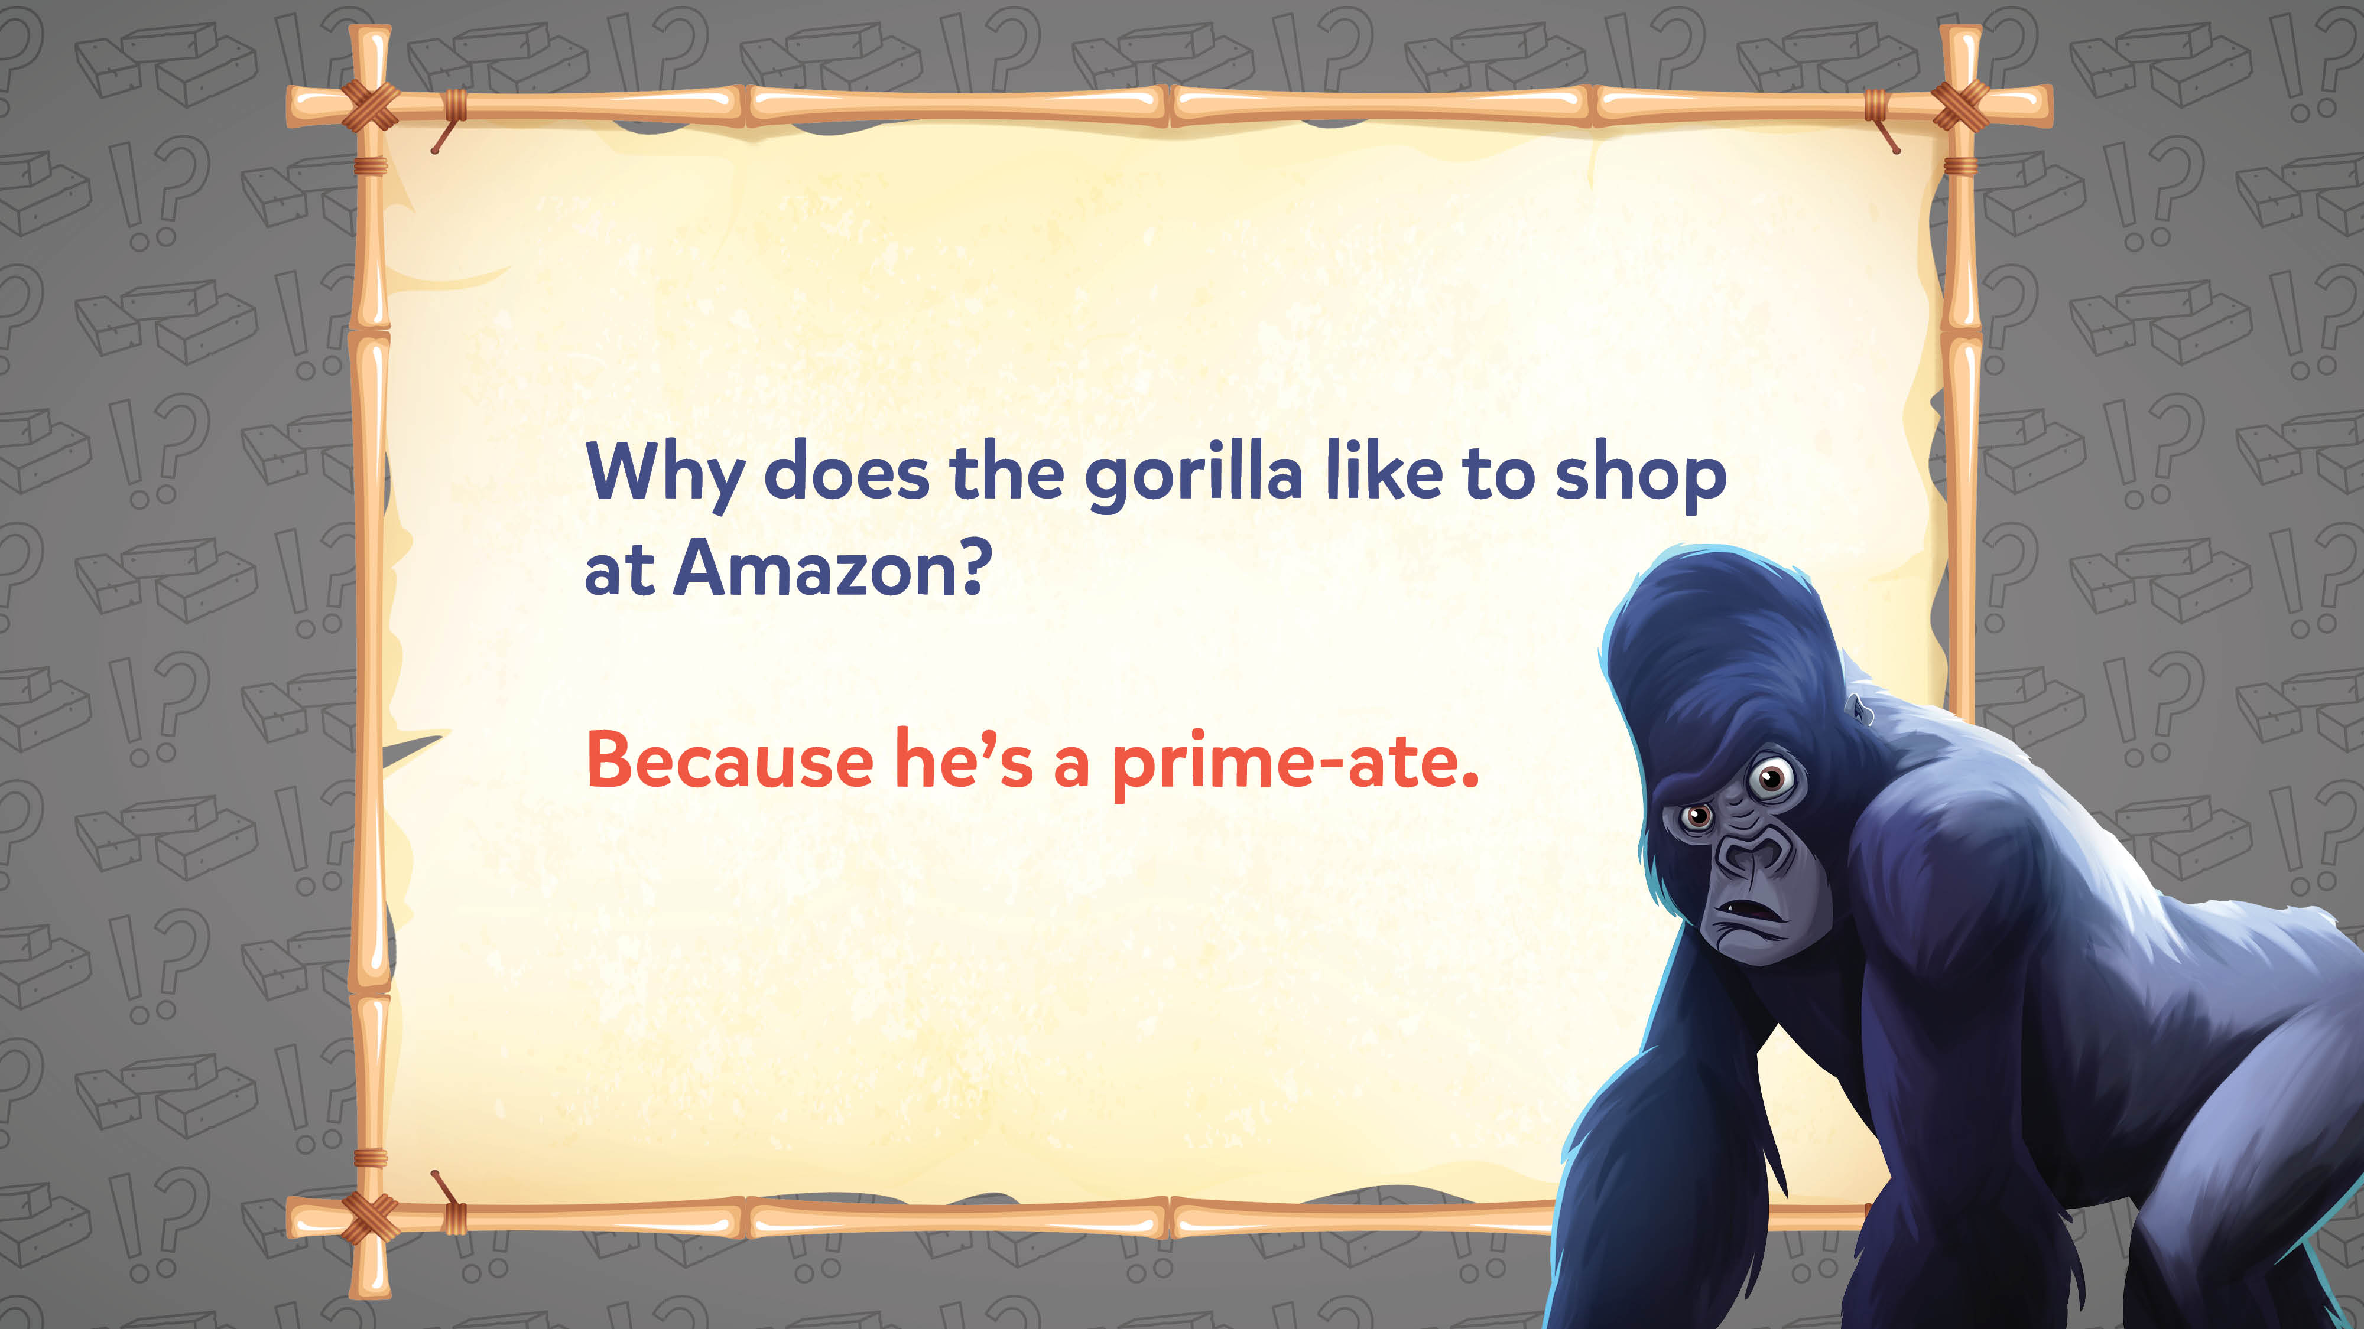
Jokes and Trivia

Slide 15
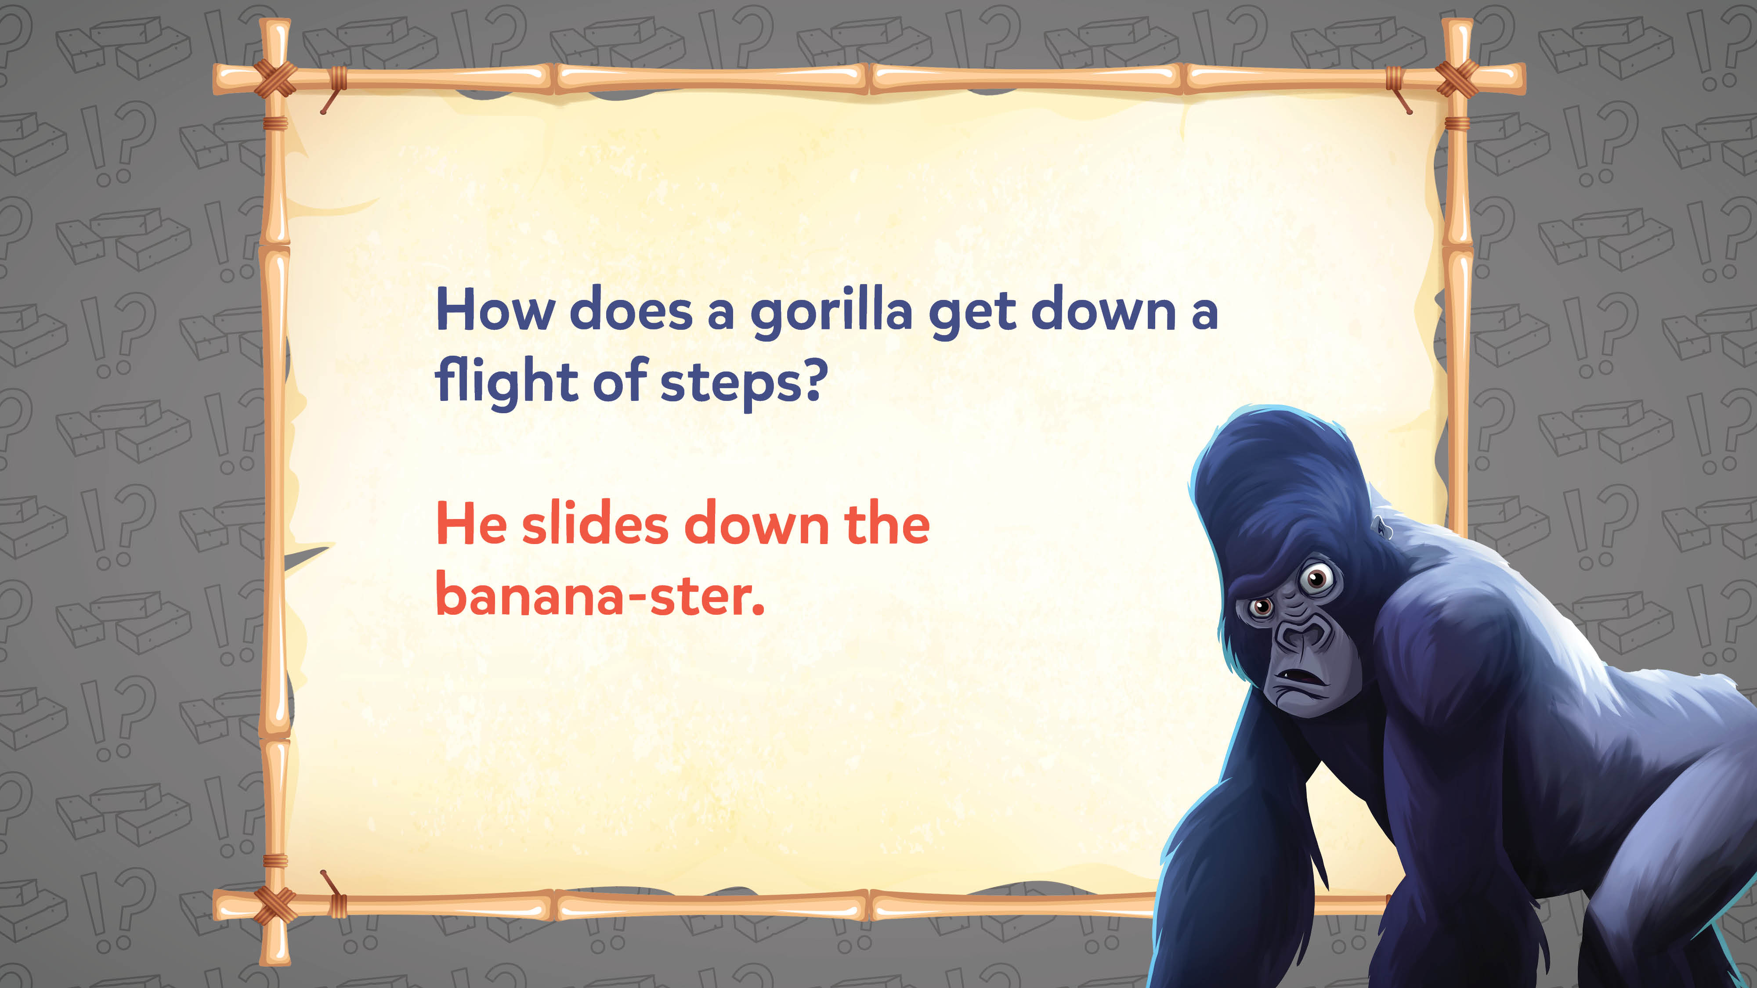
Jokes and Trivia

Slide 16
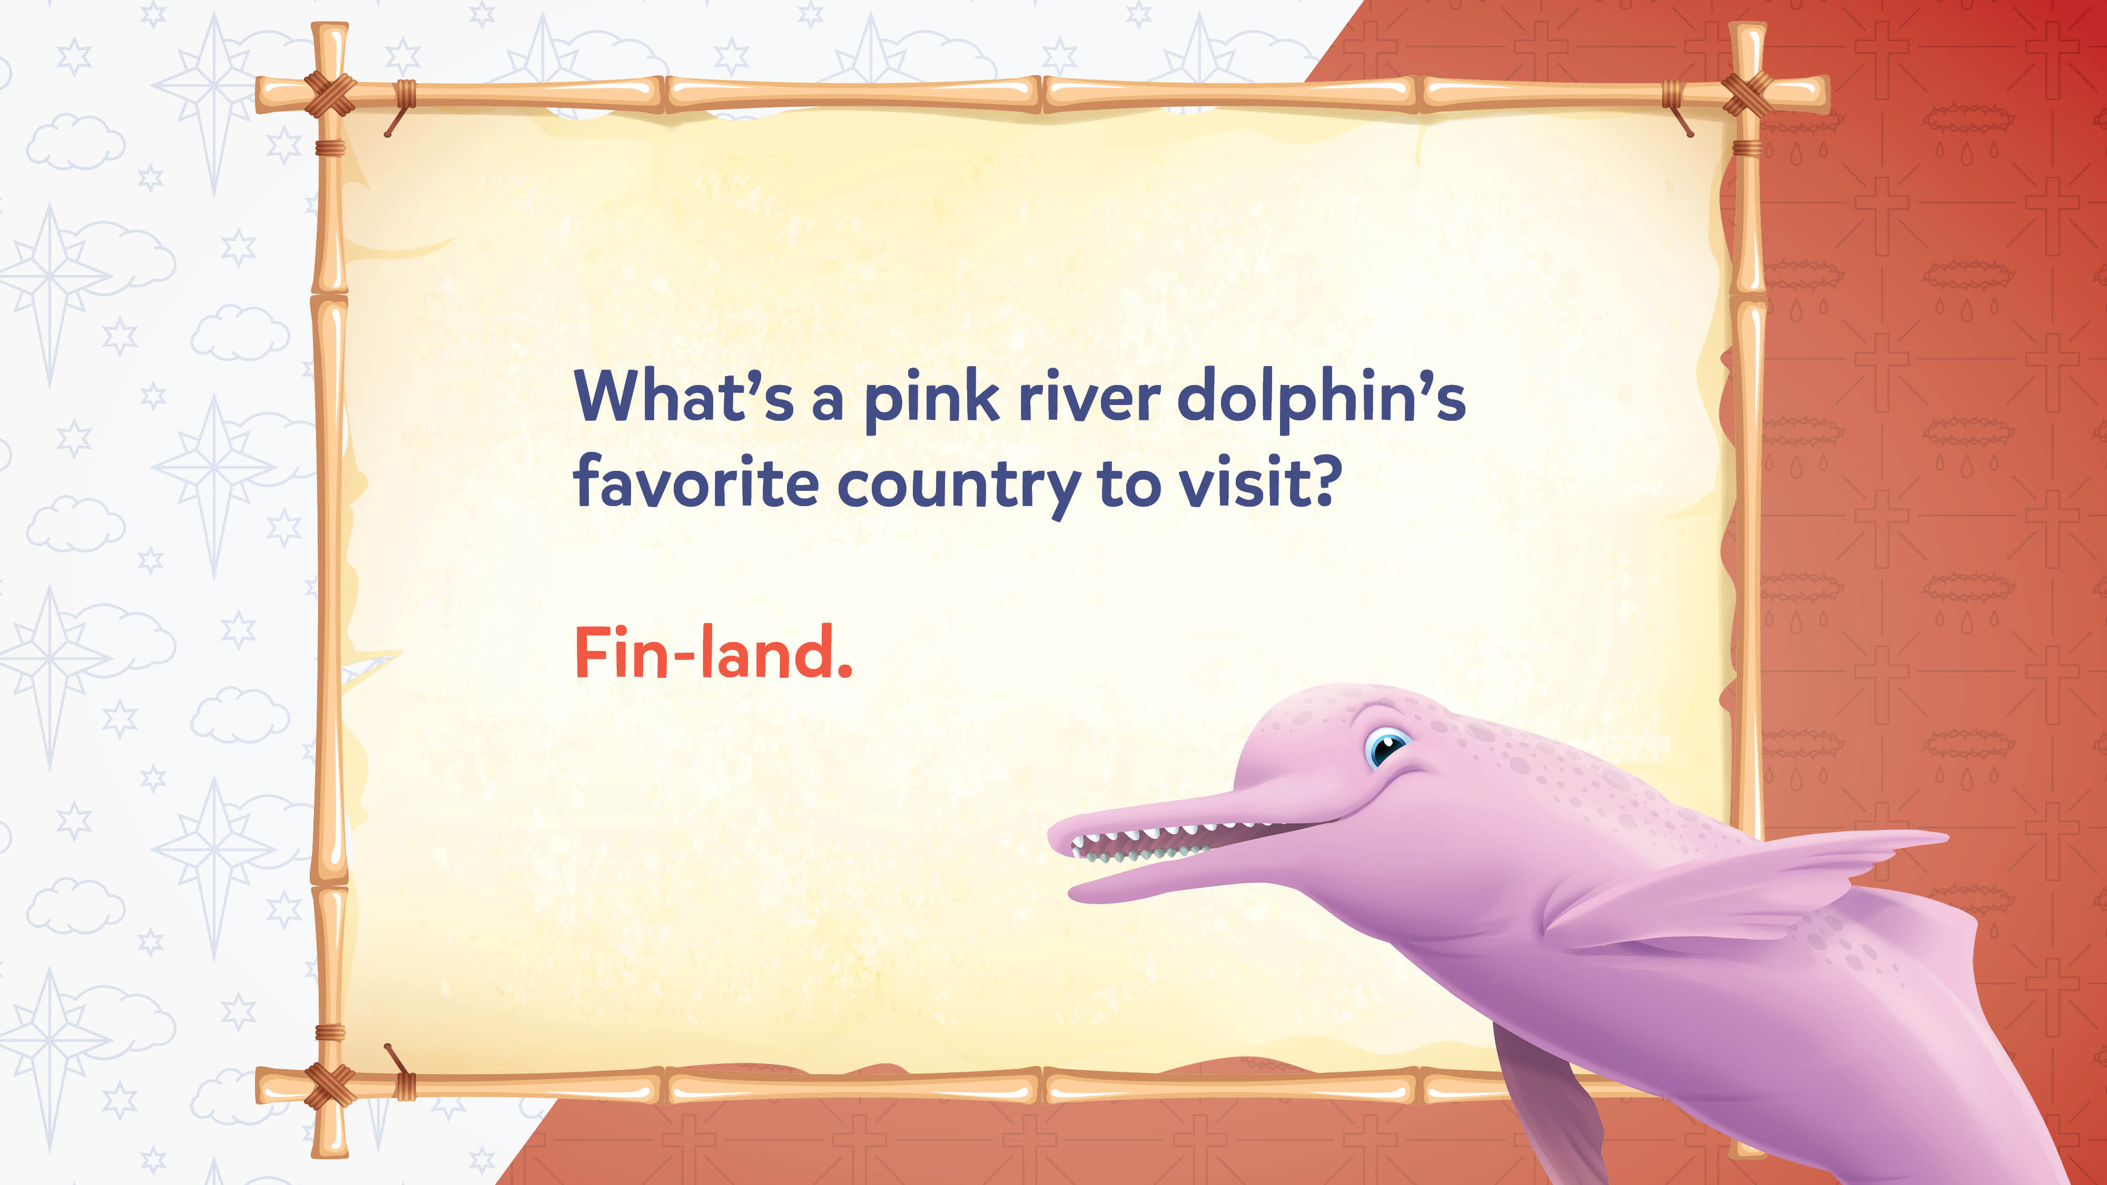
Jokes and Trivia

Slide 17

Jokes and Trivia

Slide 18
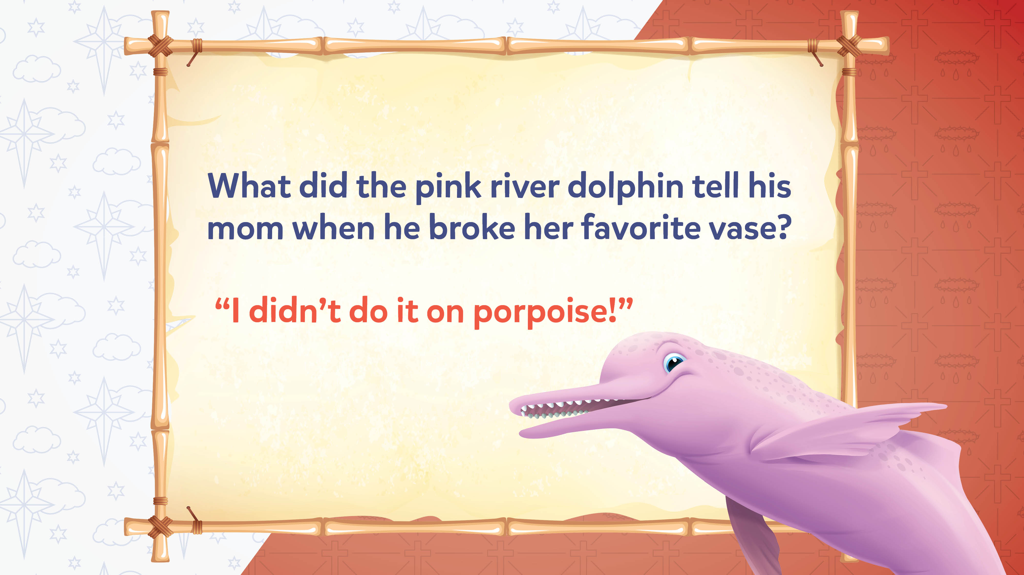
Jokes and Trivia

Slide 19
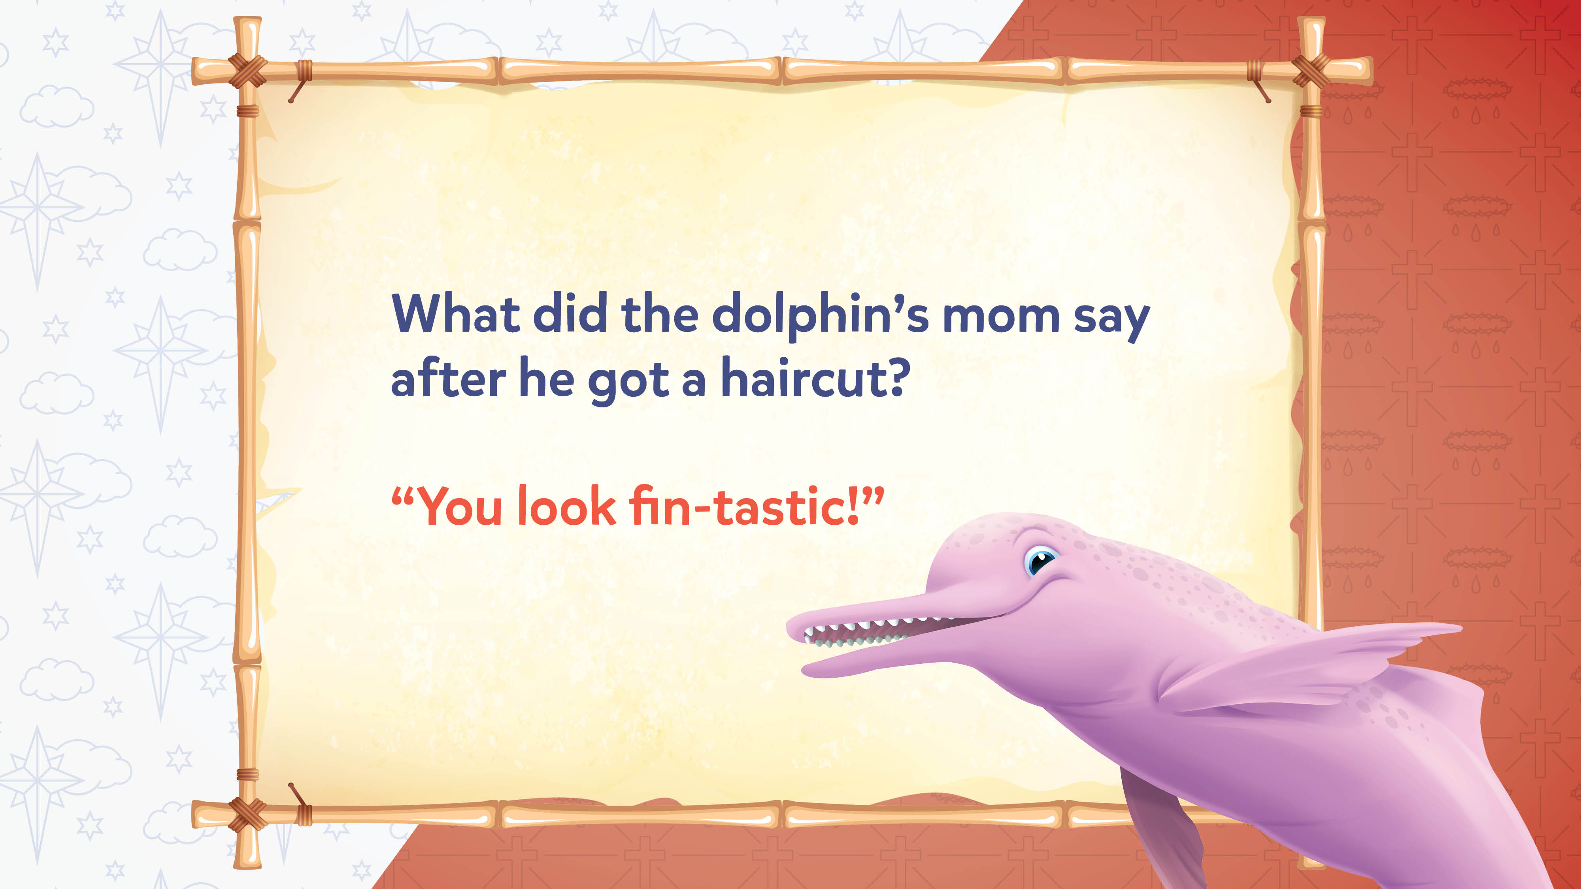
Jokes and Trivia

Slide 20
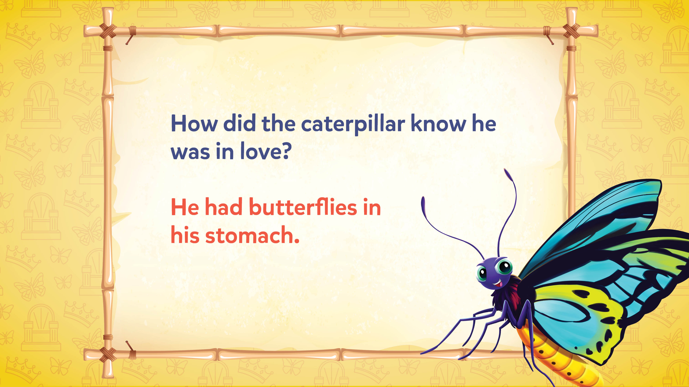
Jokes and Trivia

Slide 21
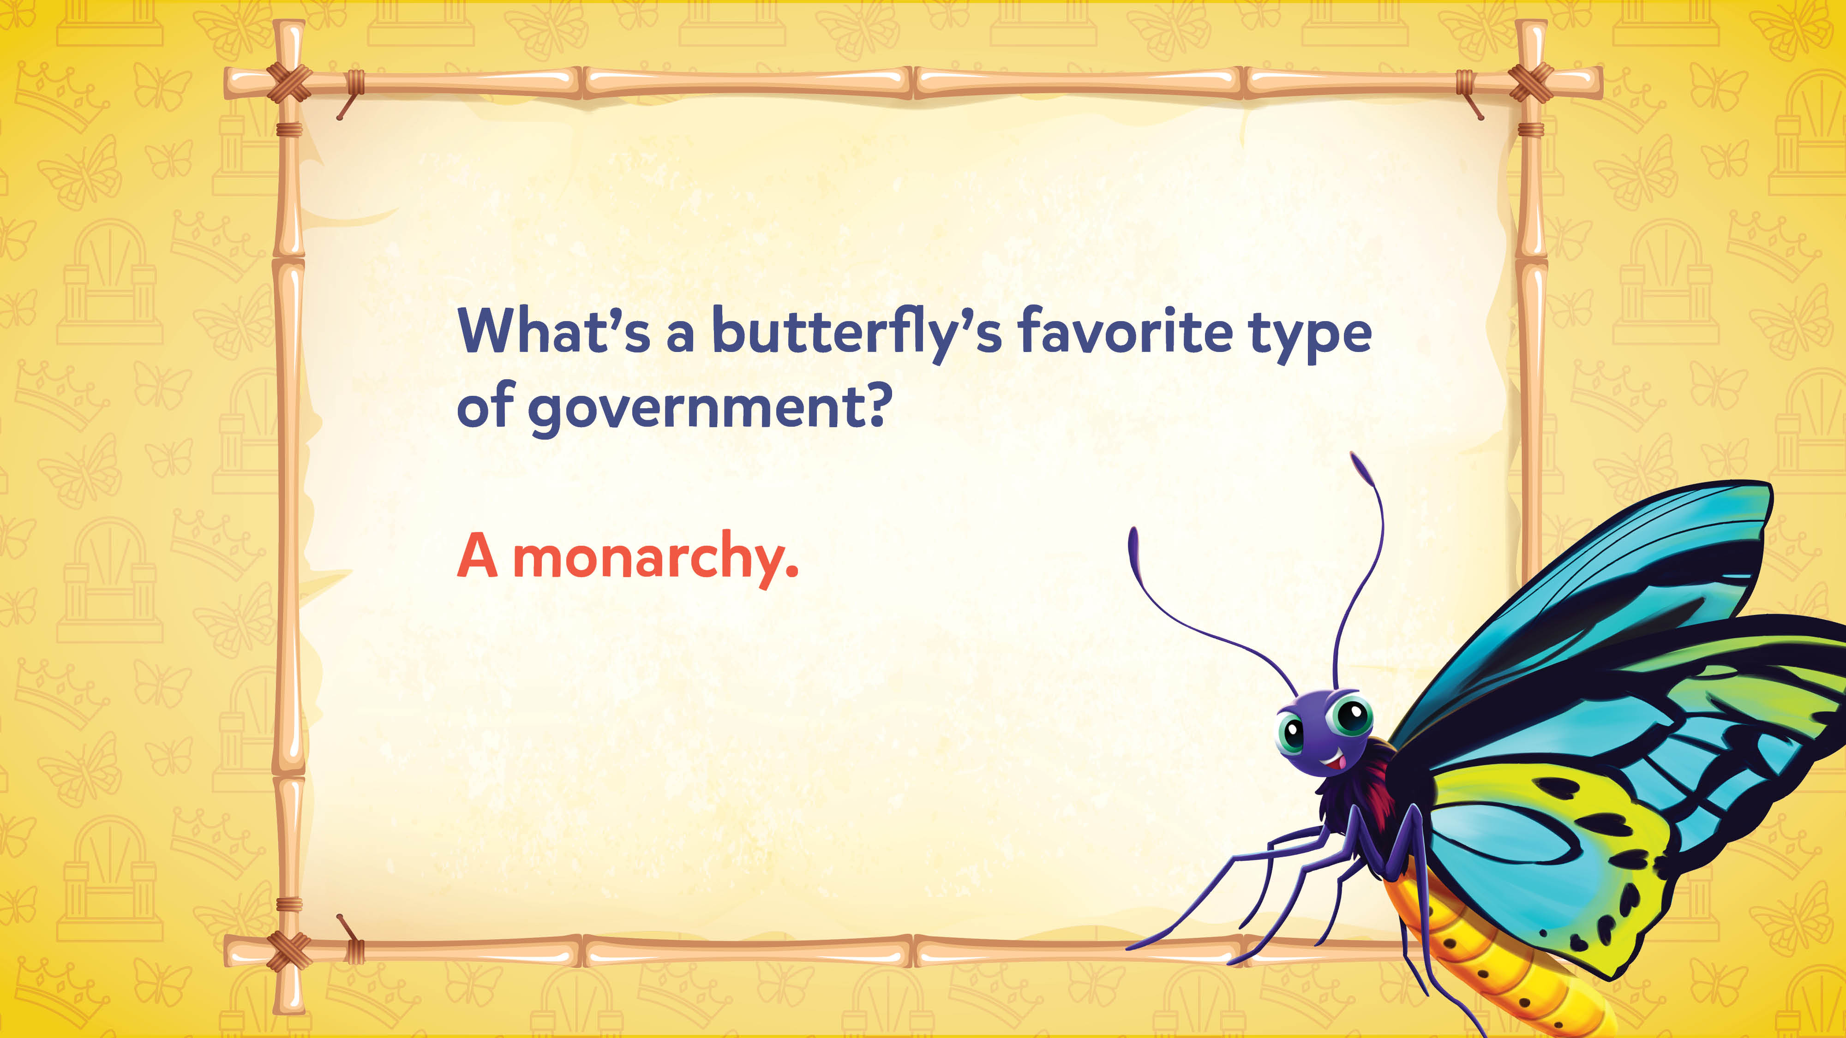
Jokes and Trivia

Slide 22
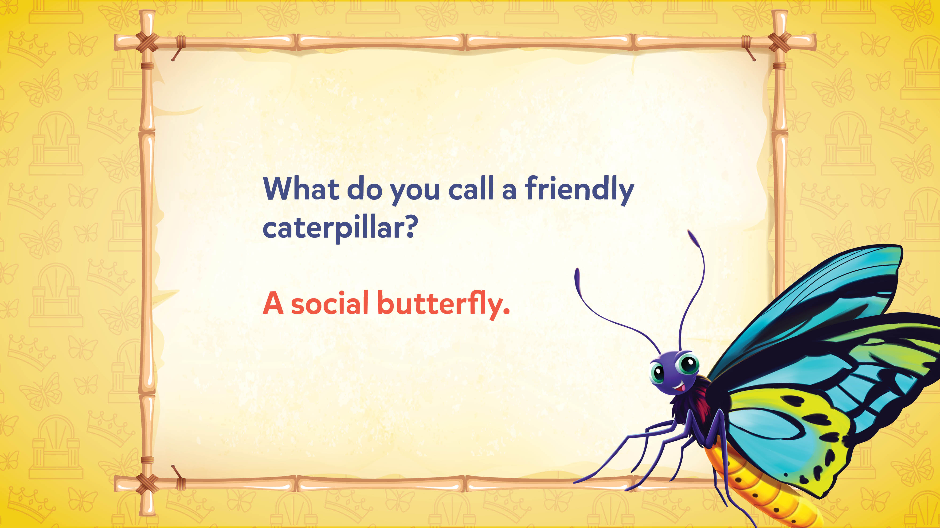
Jokes and Trivia

Slide 23

Jokes and Trivia

Slide 24
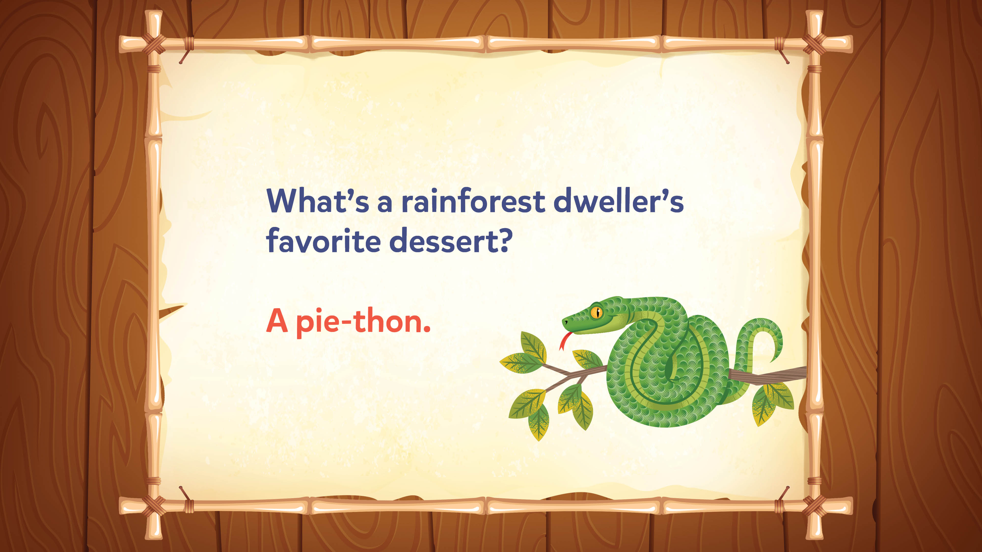
Jokes and Trivia

Slide 25
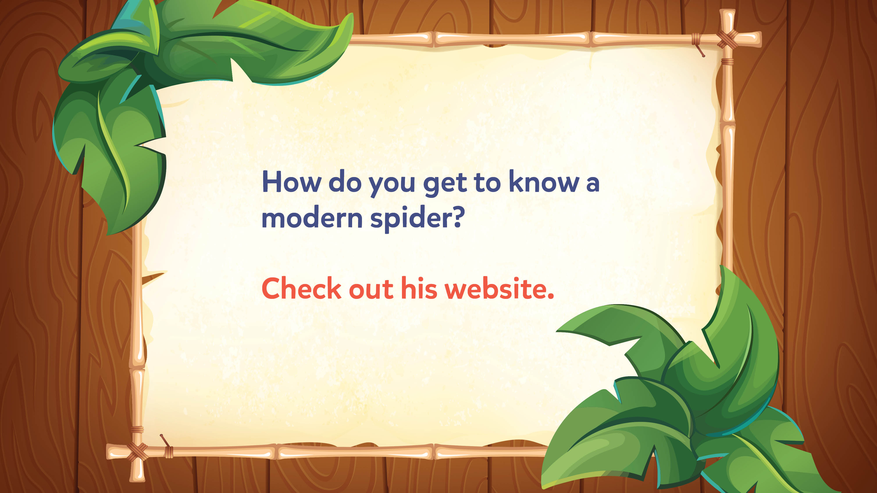
Jokes and Trivia

Slide 26
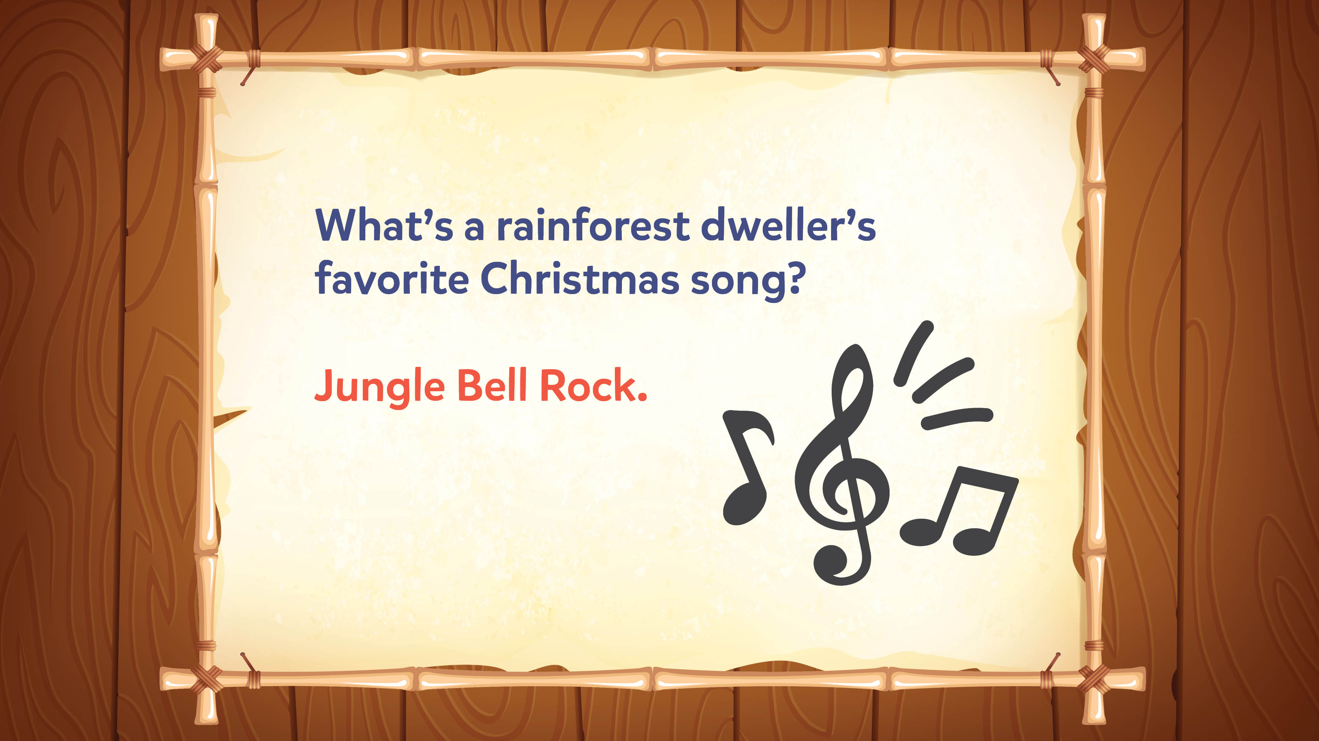
Jokes and Trivia

Slide 27

Jokes and Trivia

Slide 28
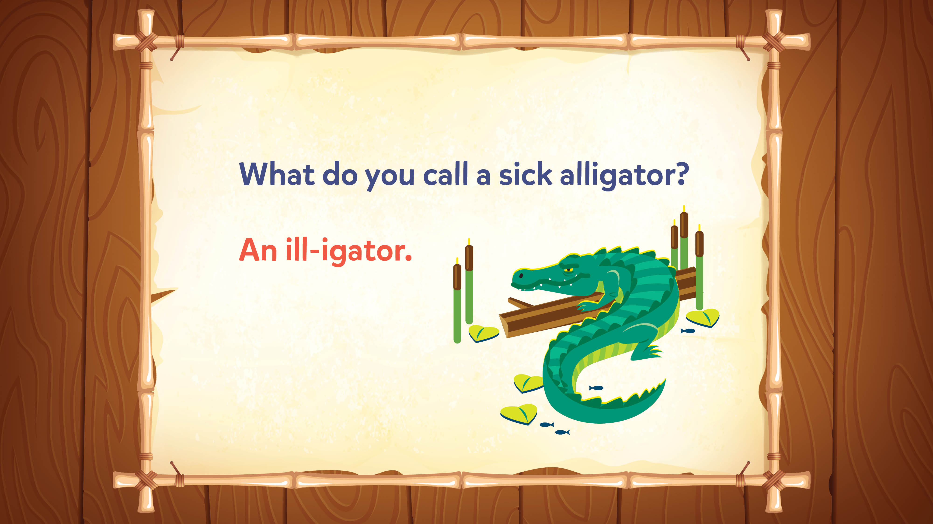
Jokes and Trivia

Slide 29
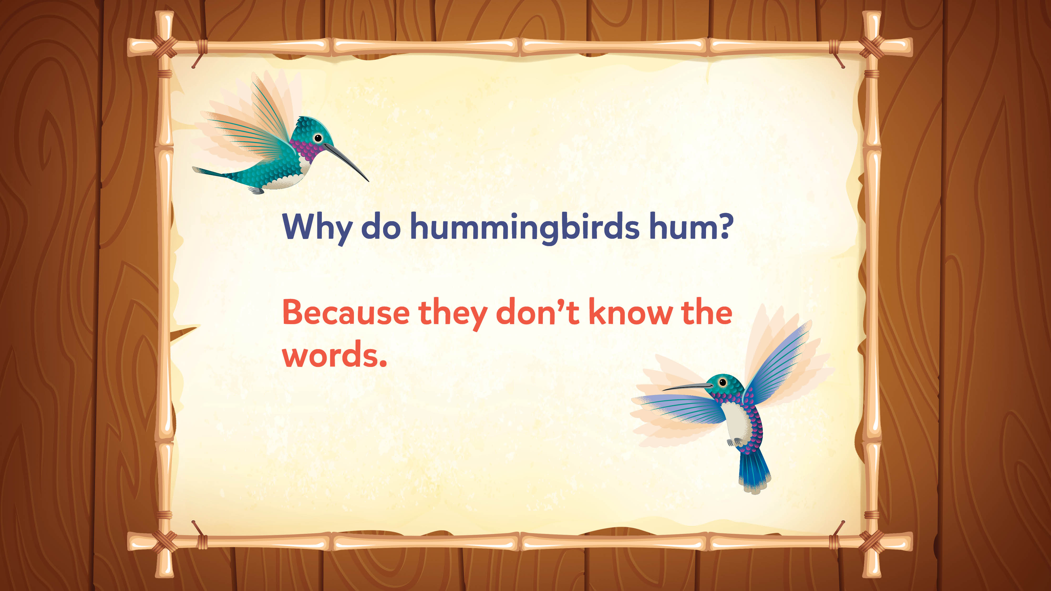
Jokes and Trivia

Slide 30
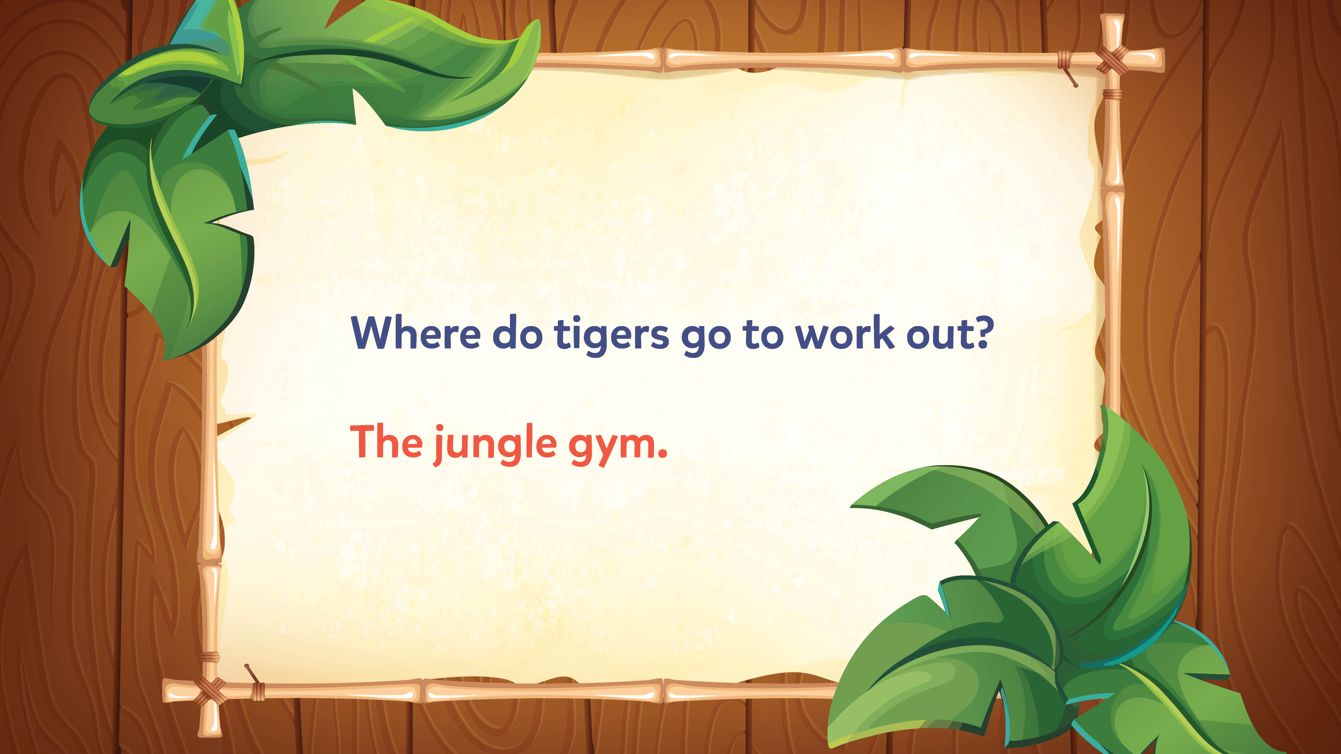
Jokes and Trivia

Slide 31
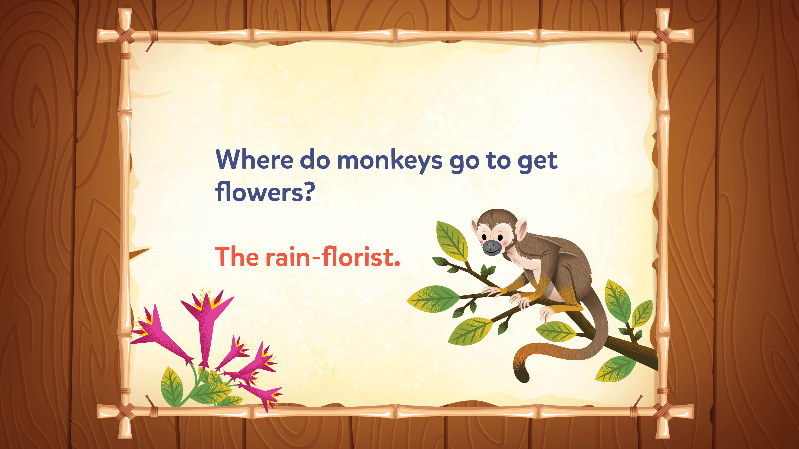
Jokes and Trivia

Slide 32
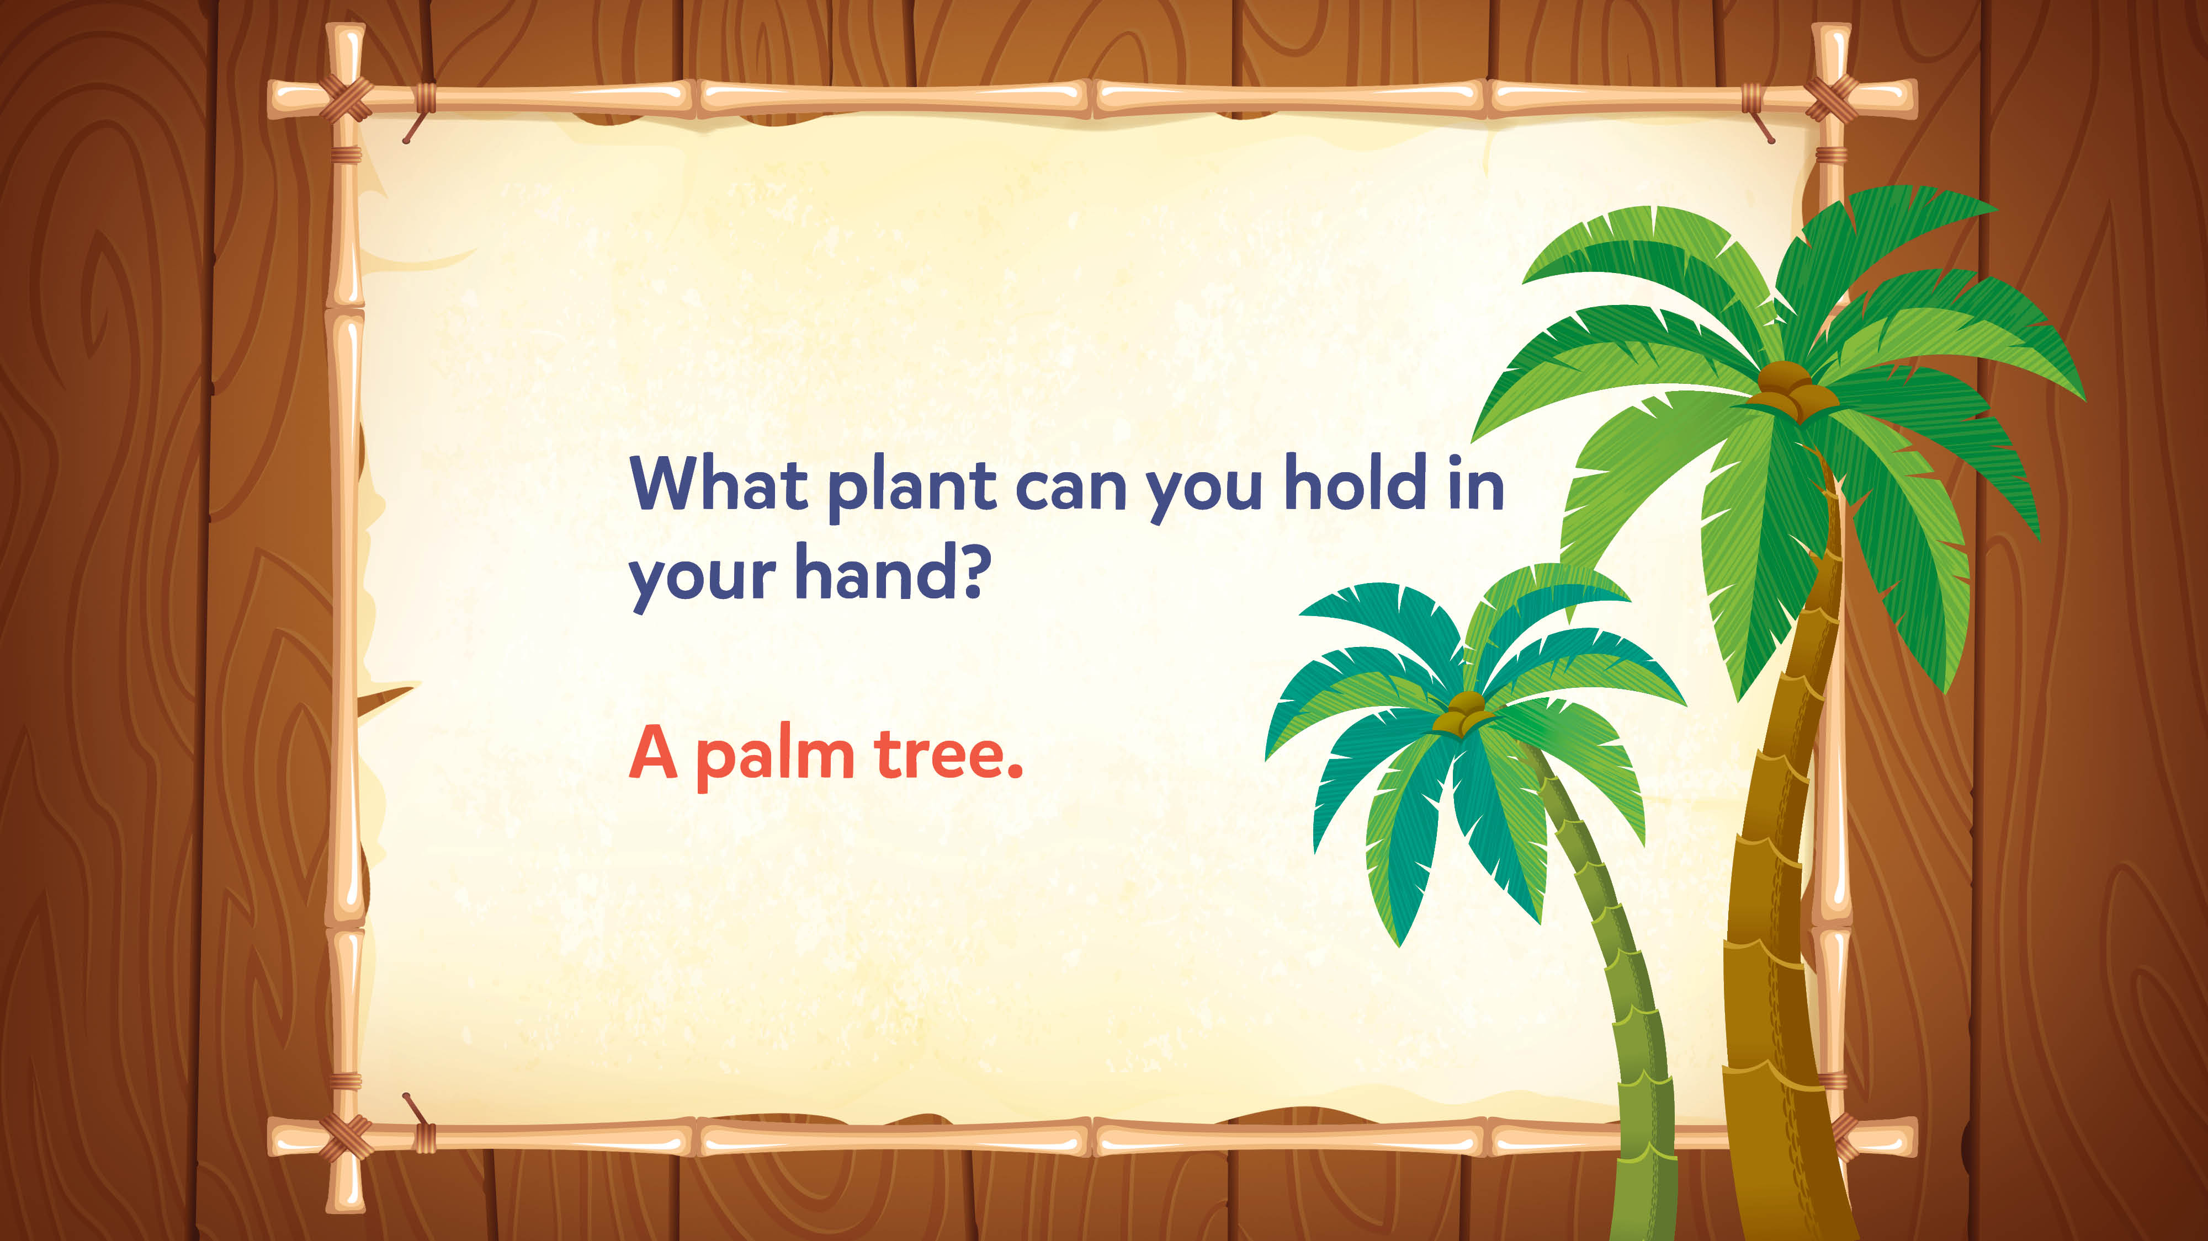
Jokes and Trivia

Slide 33
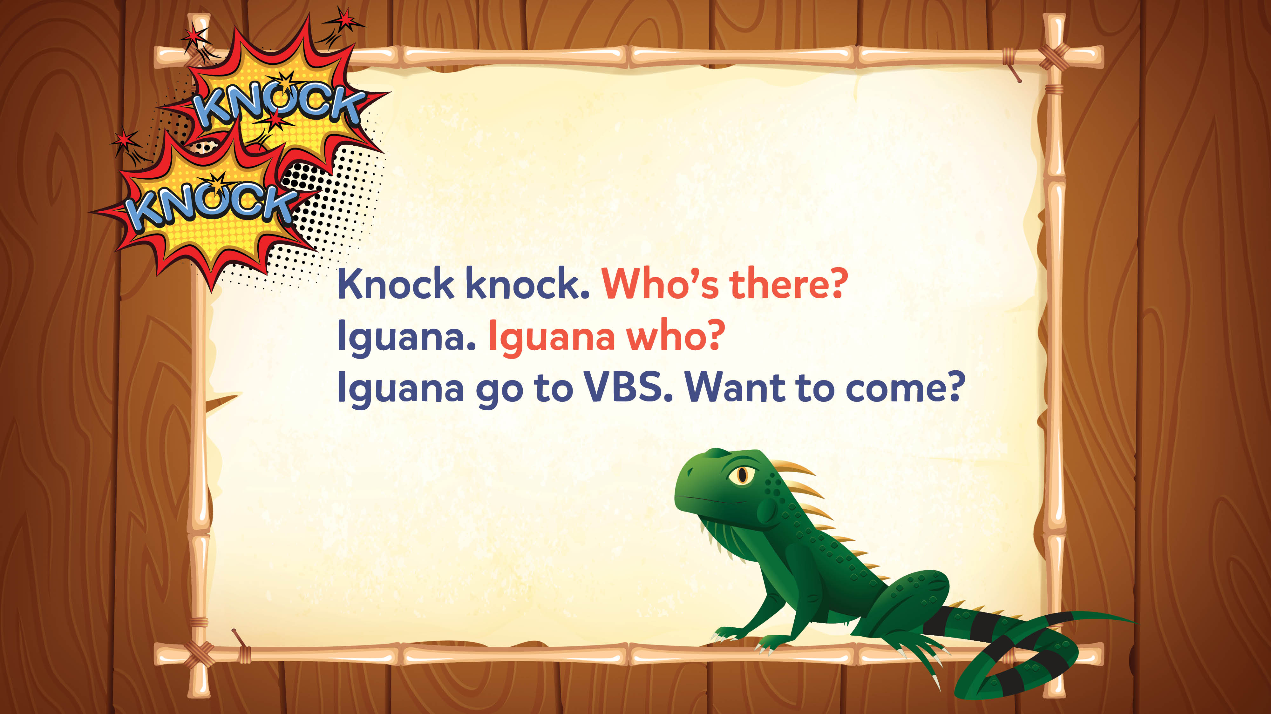
Jokes and Trivia

Slide 34
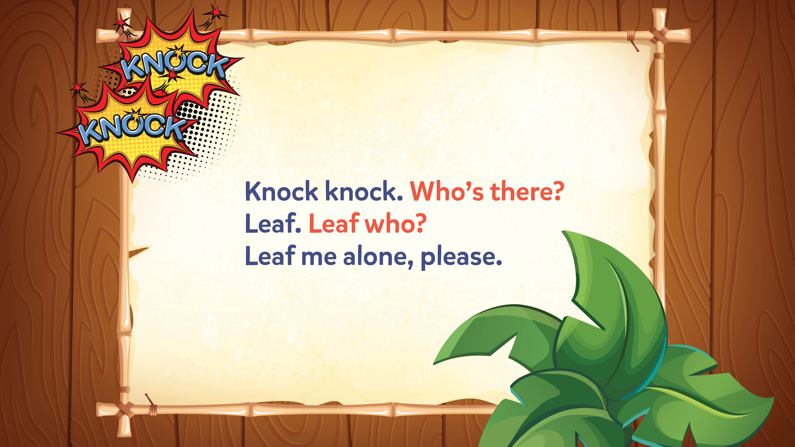
Jokes and Trivia

Slide 35
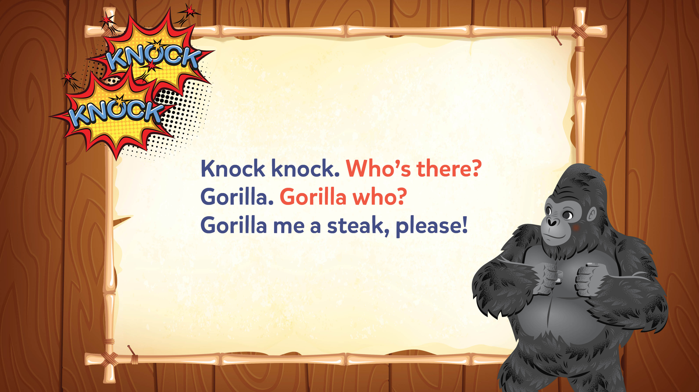
Jokes and Trivia

Slide 36
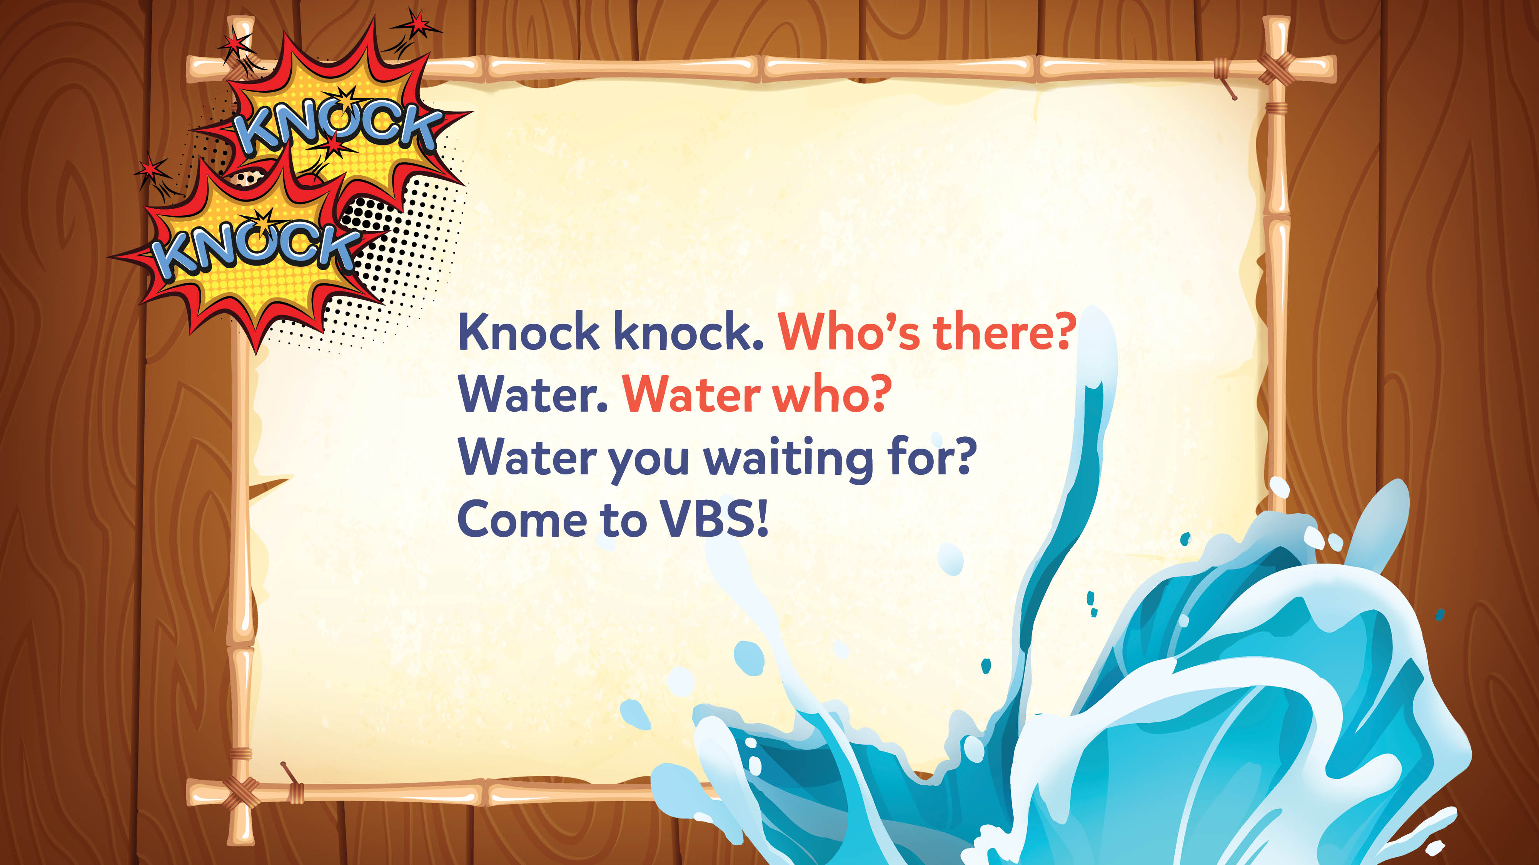
Jokes and Trivia

Slide 37
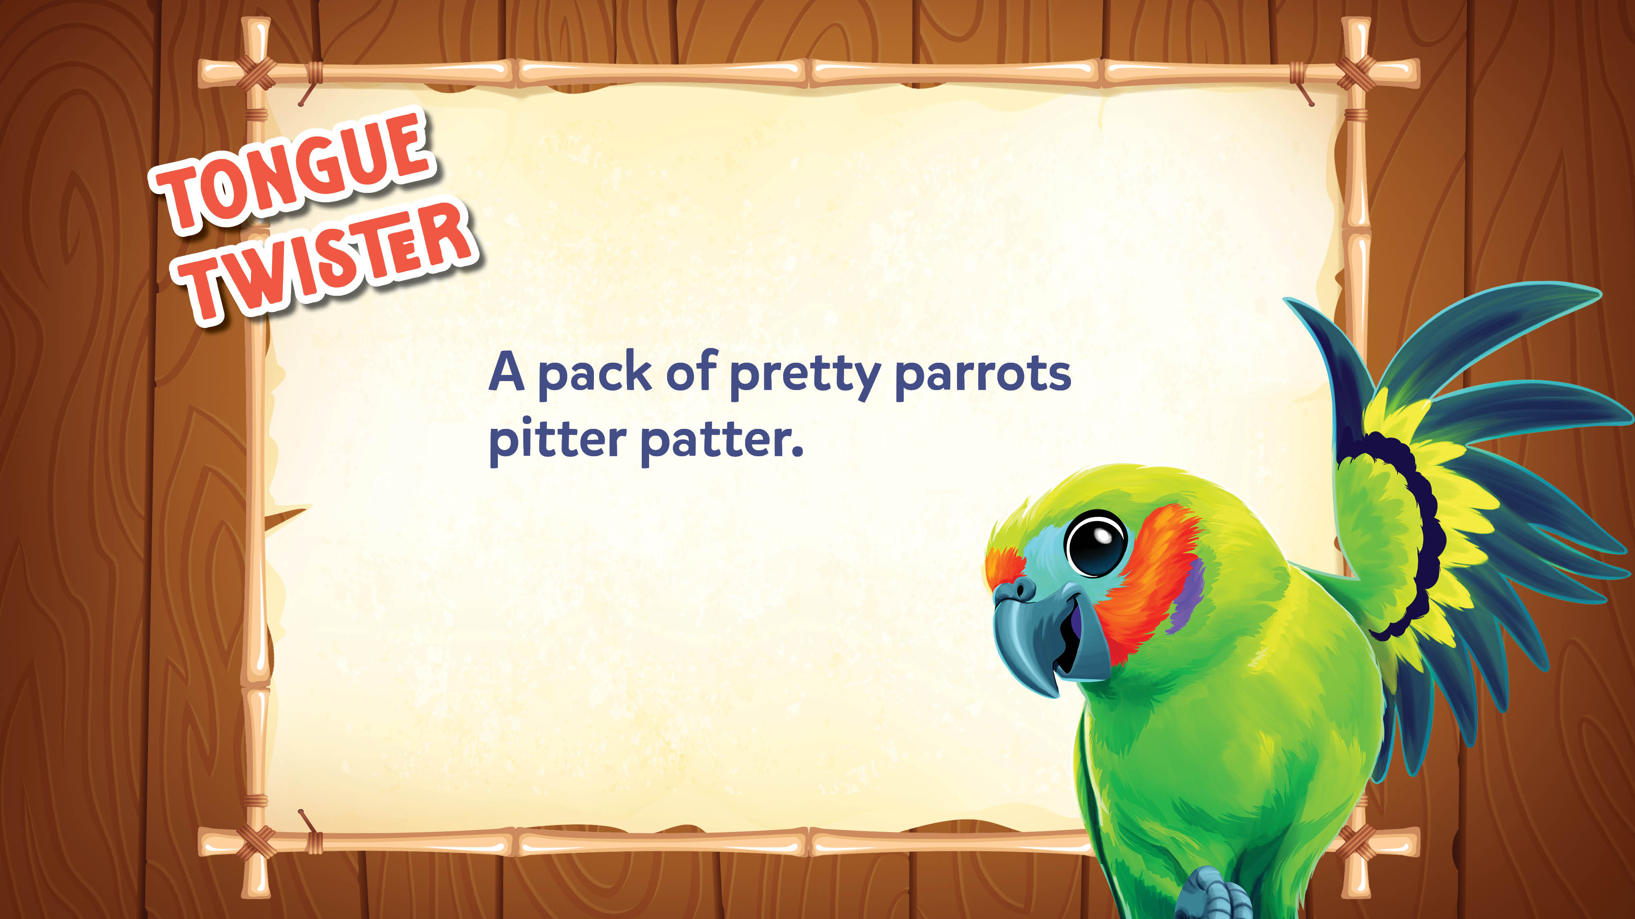
Jokes and Trivia

Slide 38
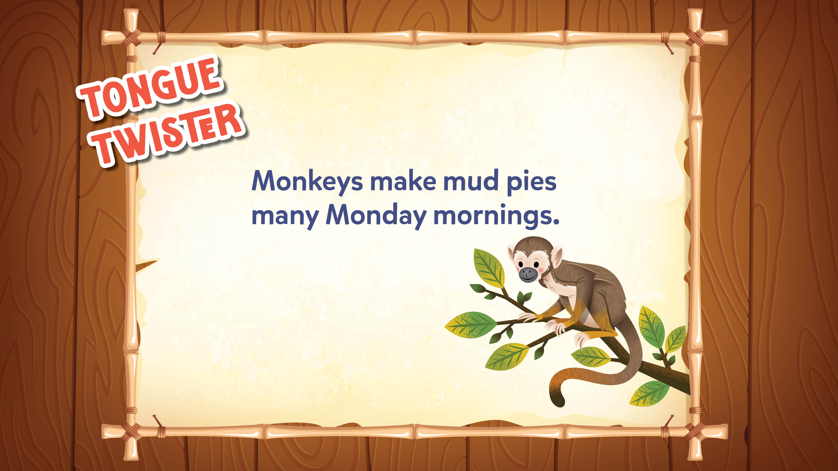
Jokes and Trivia

Slide 39
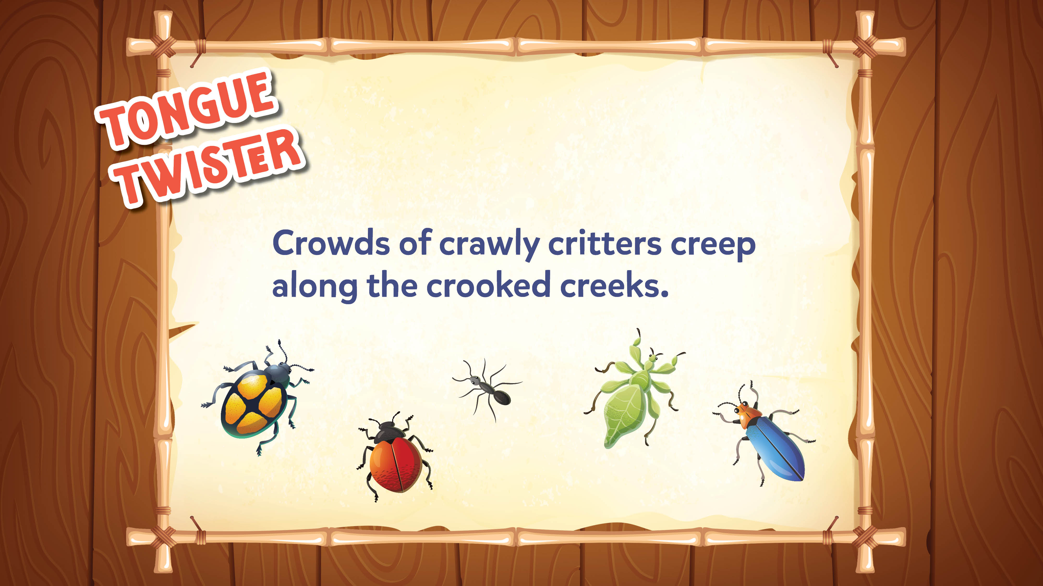
Jokes and Trivia

Slide 40
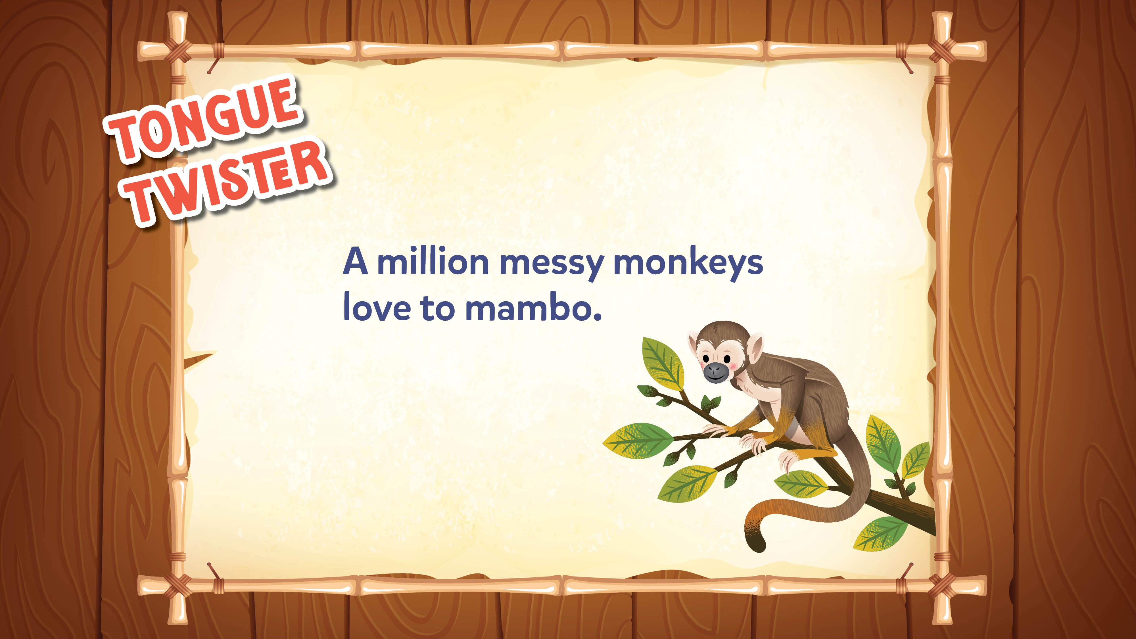
Jokes and Trivia

Slide 41
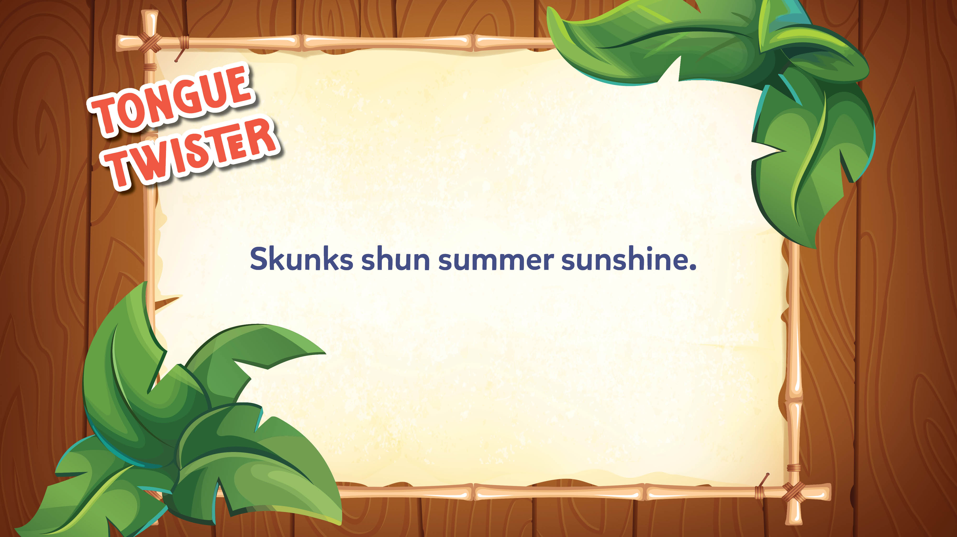
Jokes and Trivia

Slide 42

Jokes and Trivia

Slide 43
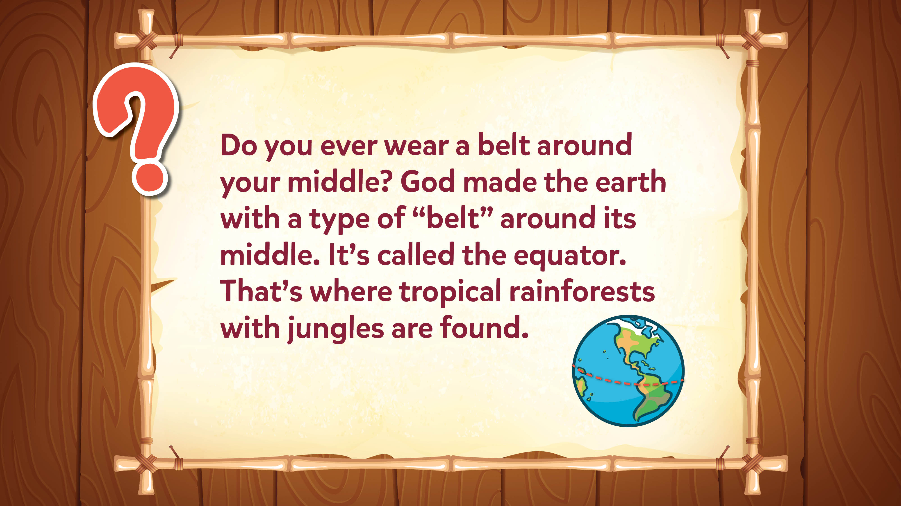
Jokes and Trivia

Slide 44
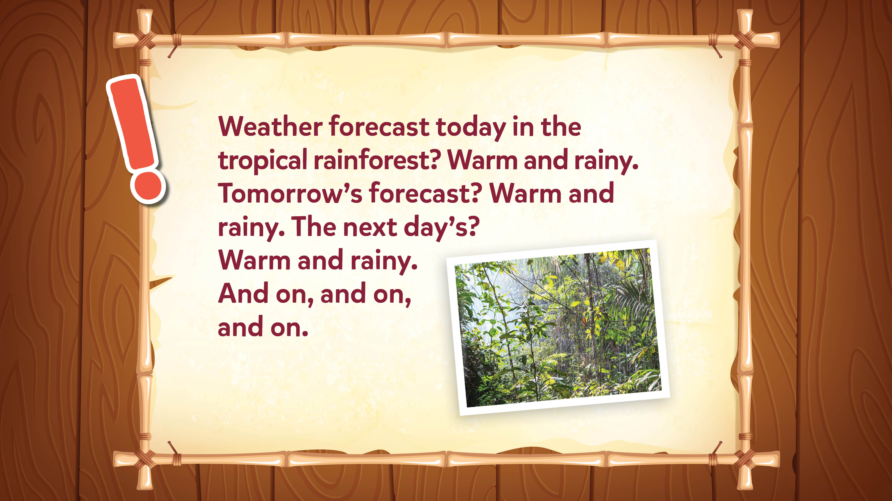
Jokes and Trivia

Slide 45
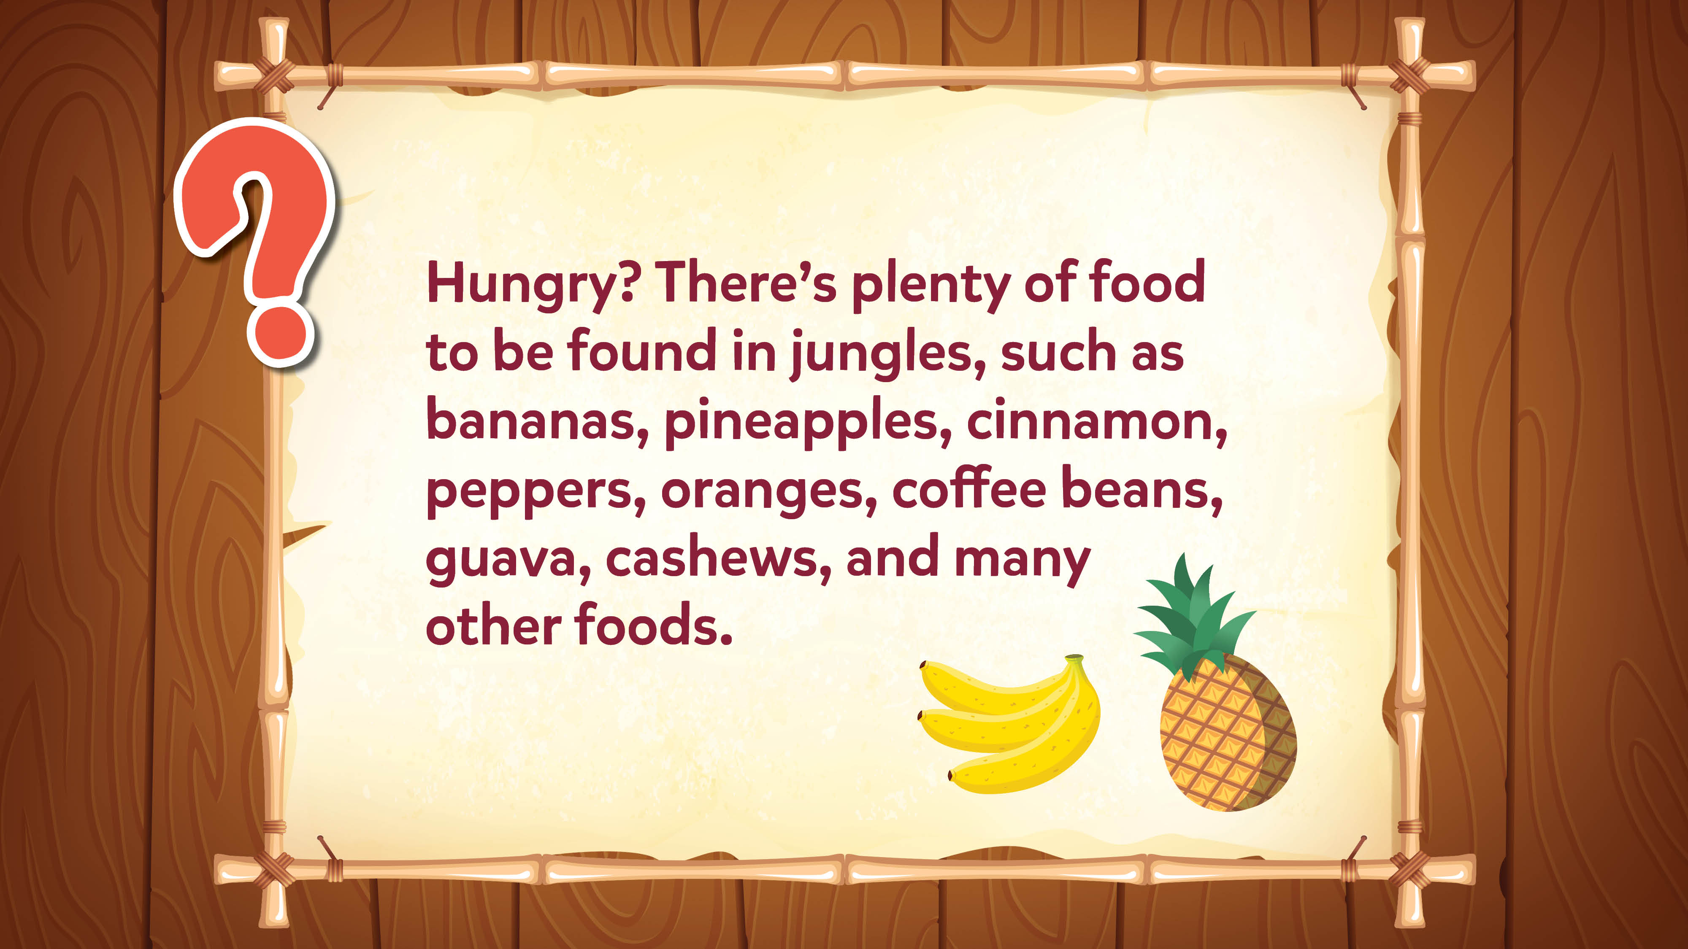
Jokes and Trivia

Slide 46
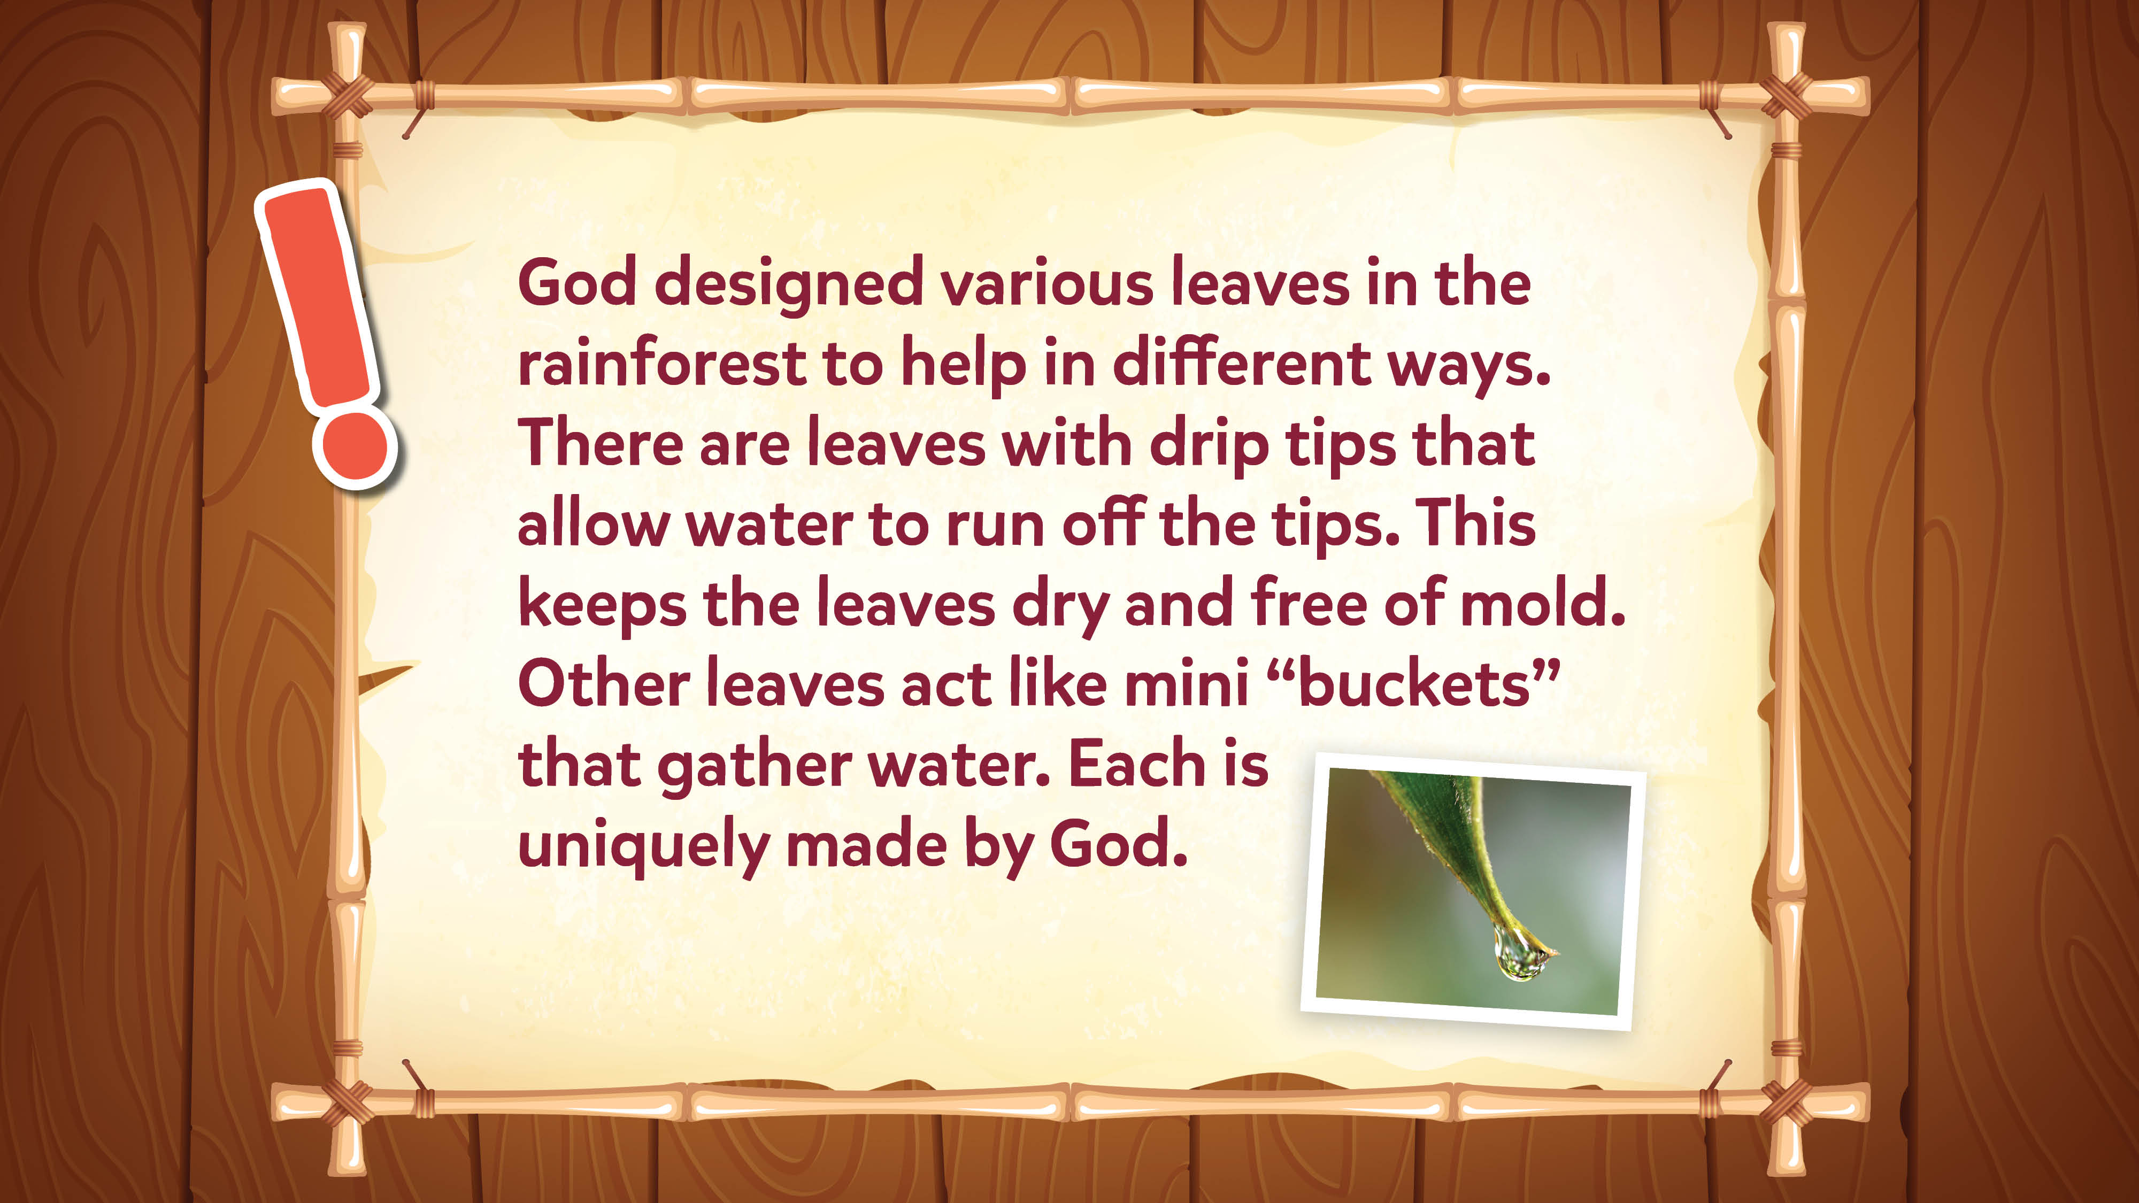
Jokes and Trivia

Slide 47
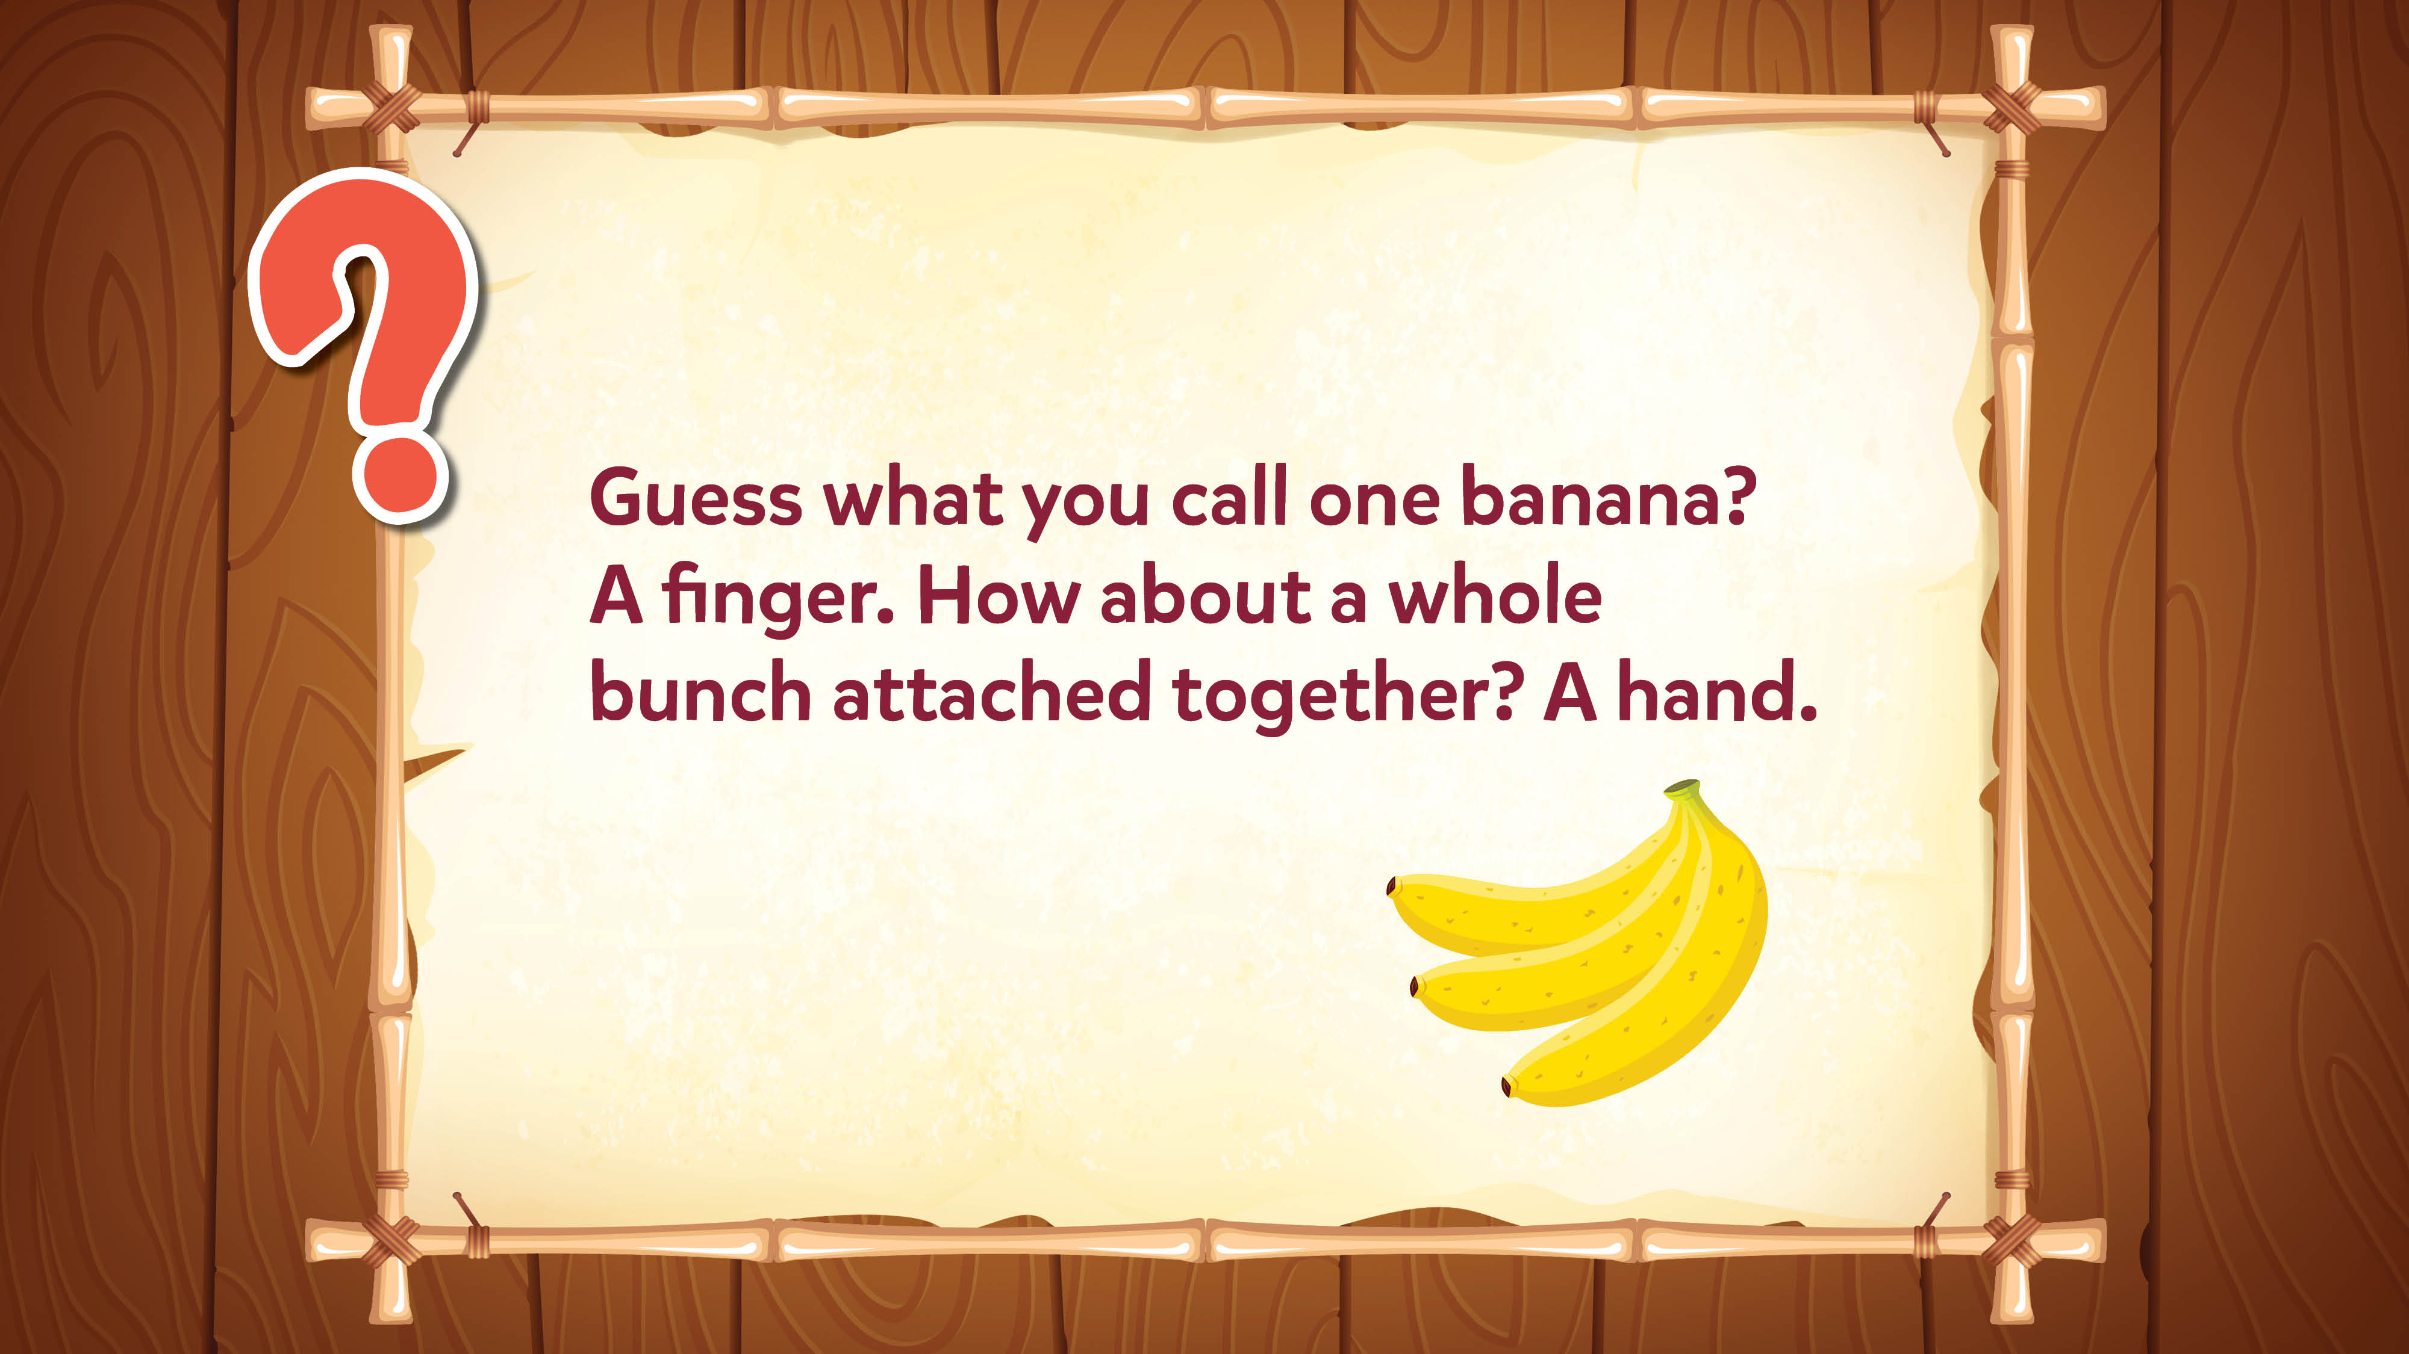
Jokes and Trivia

Slide 48
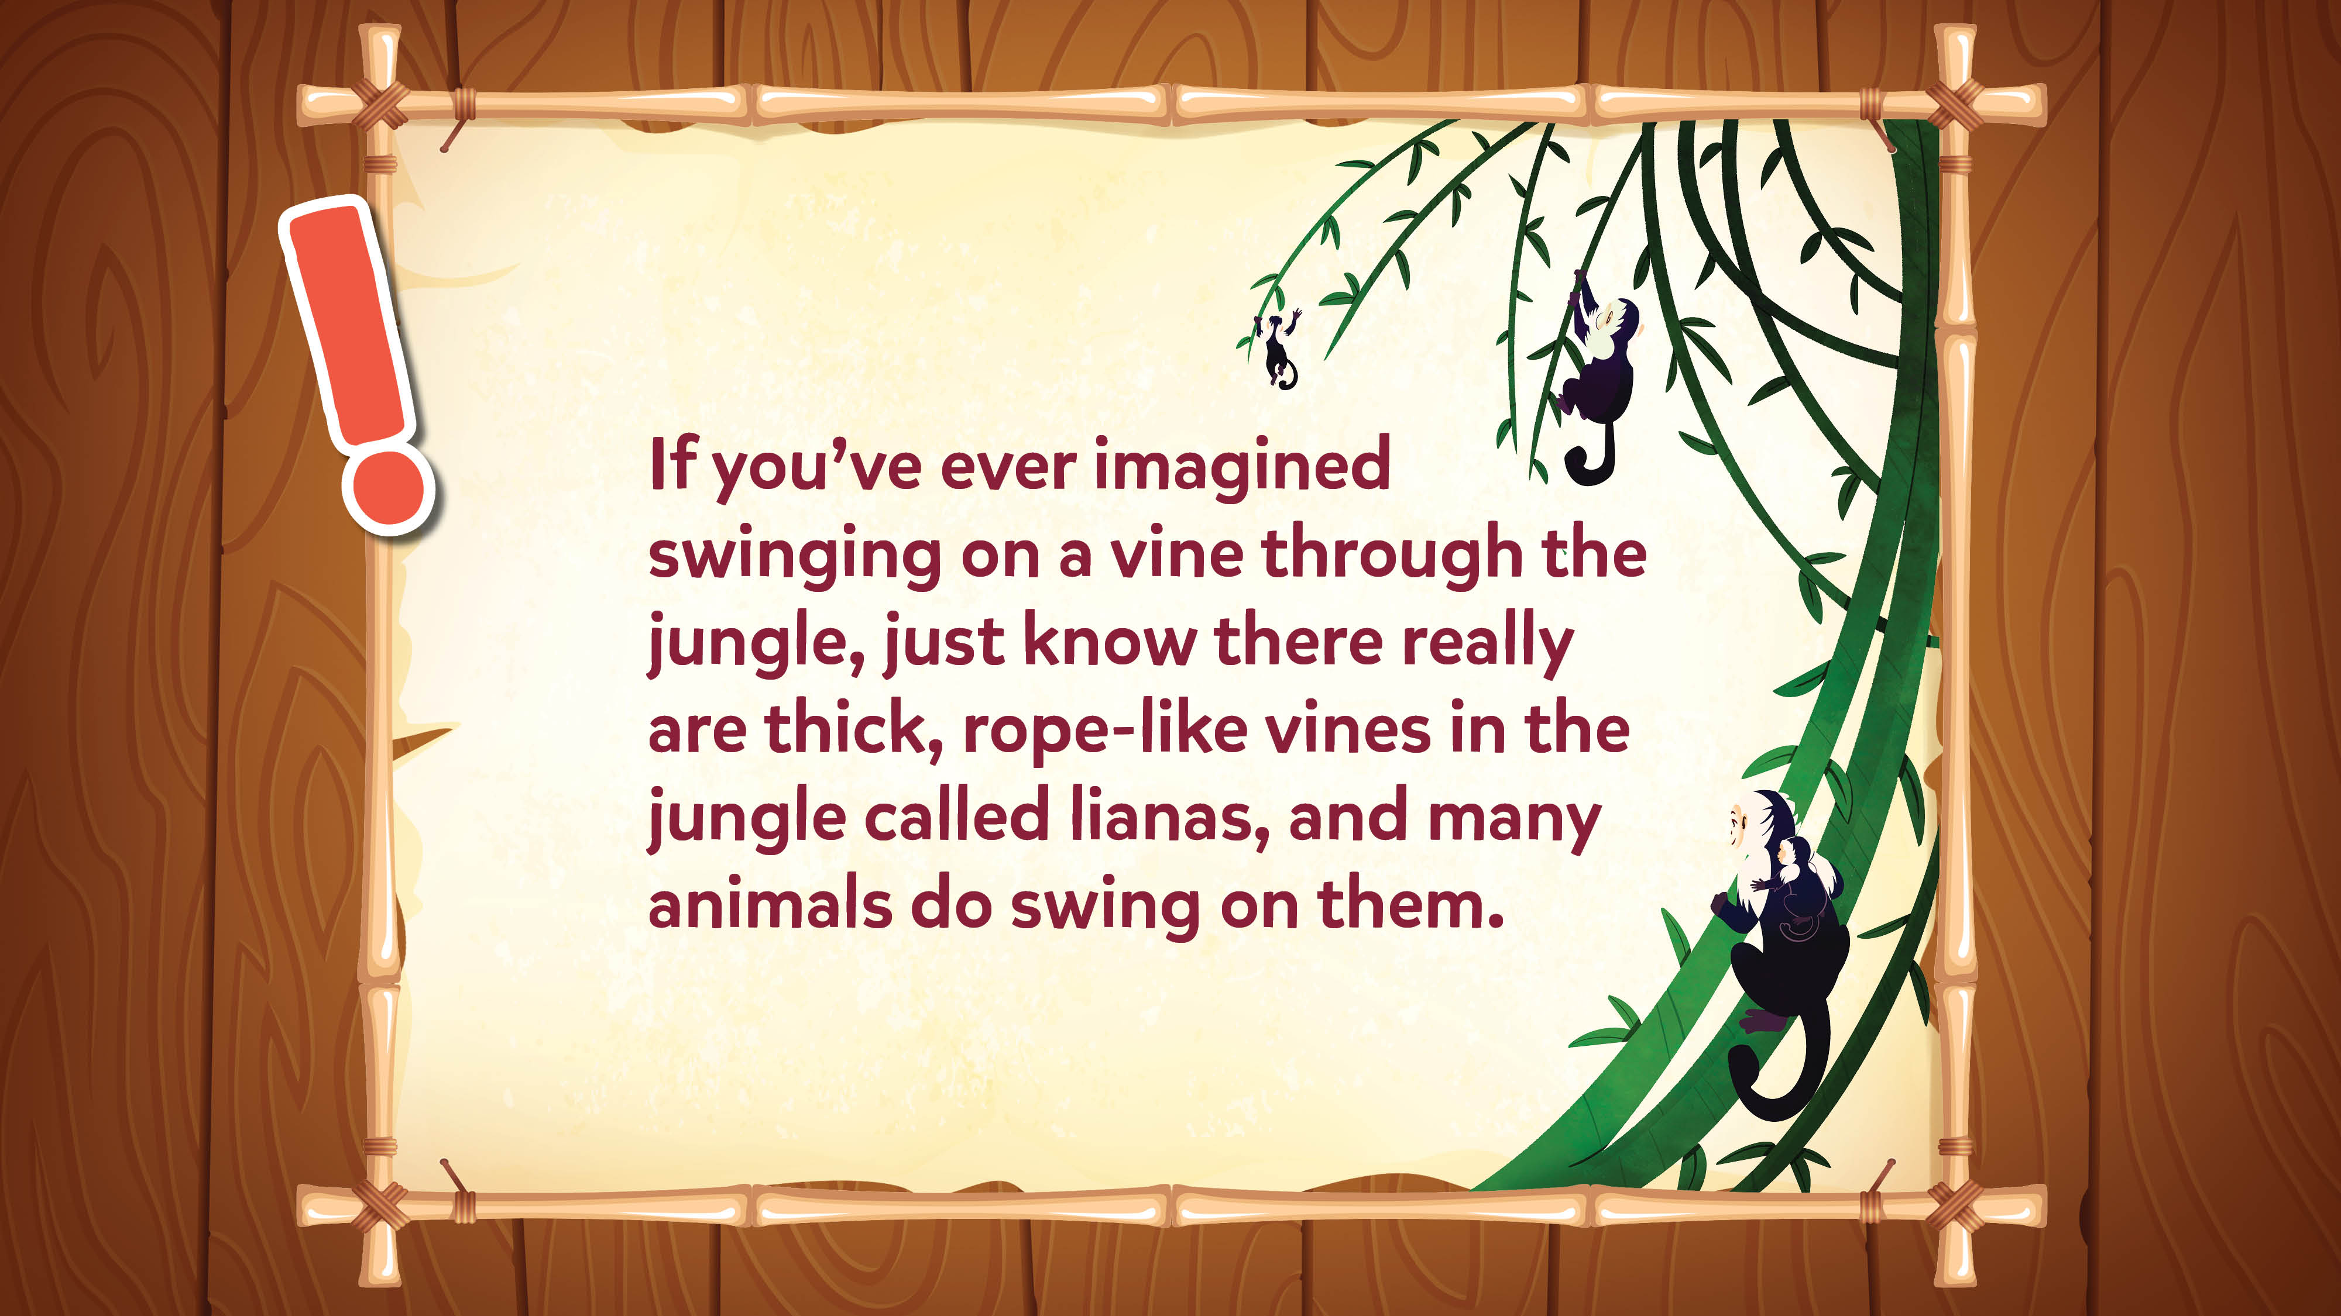
Jokes and Trivia

Slide 49
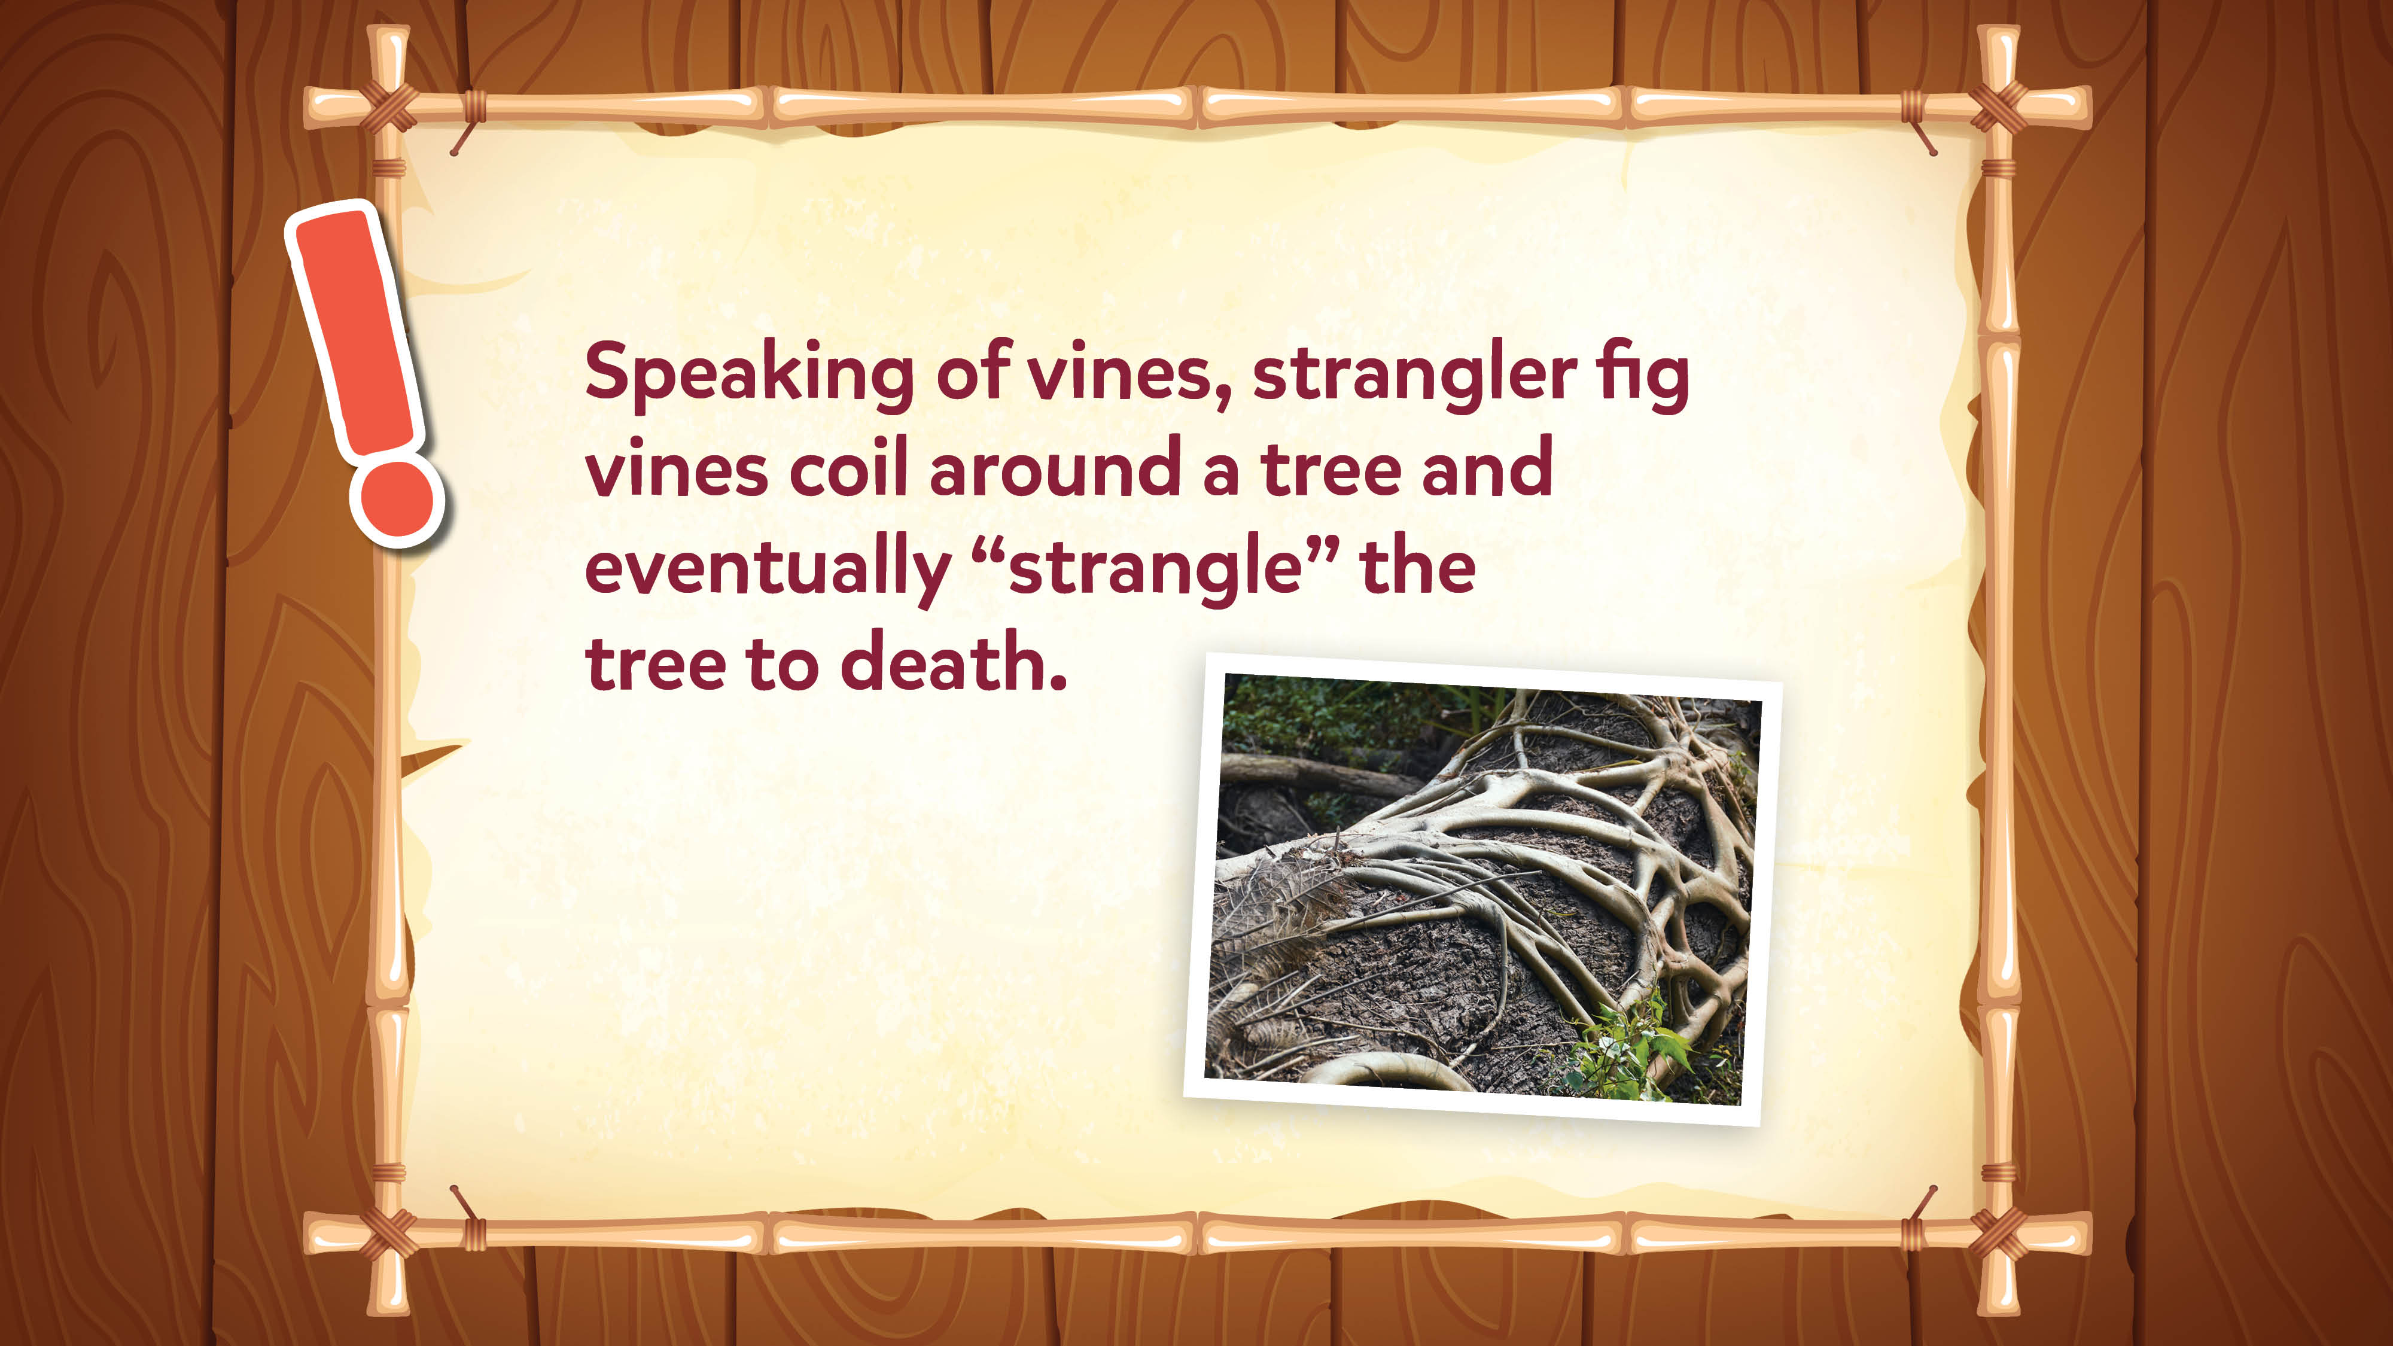
Jokes and Trivia

Slide 50
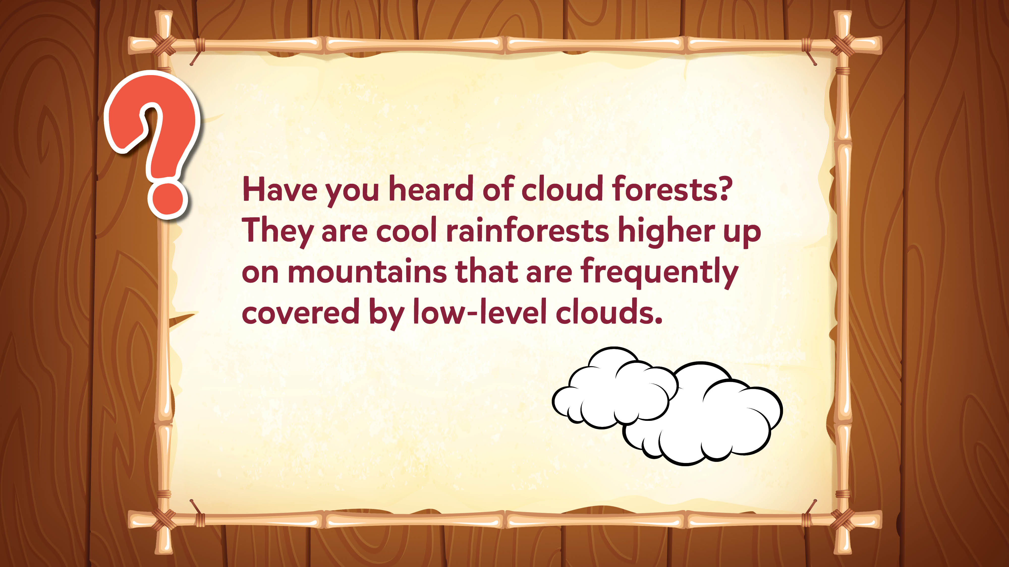
Jokes and Trivia

Slide 51
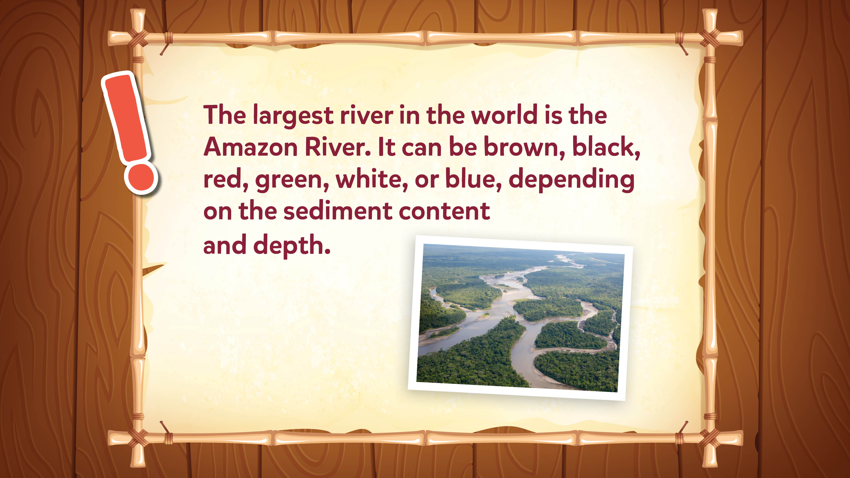
Jokes and Trivia

Slide 52
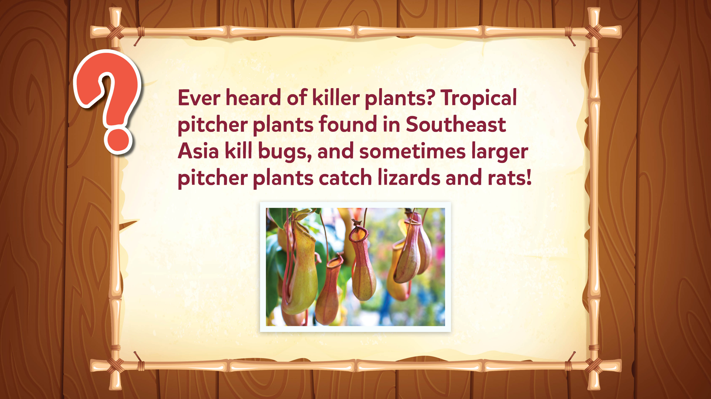
Jokes and Trivia

Slide 53
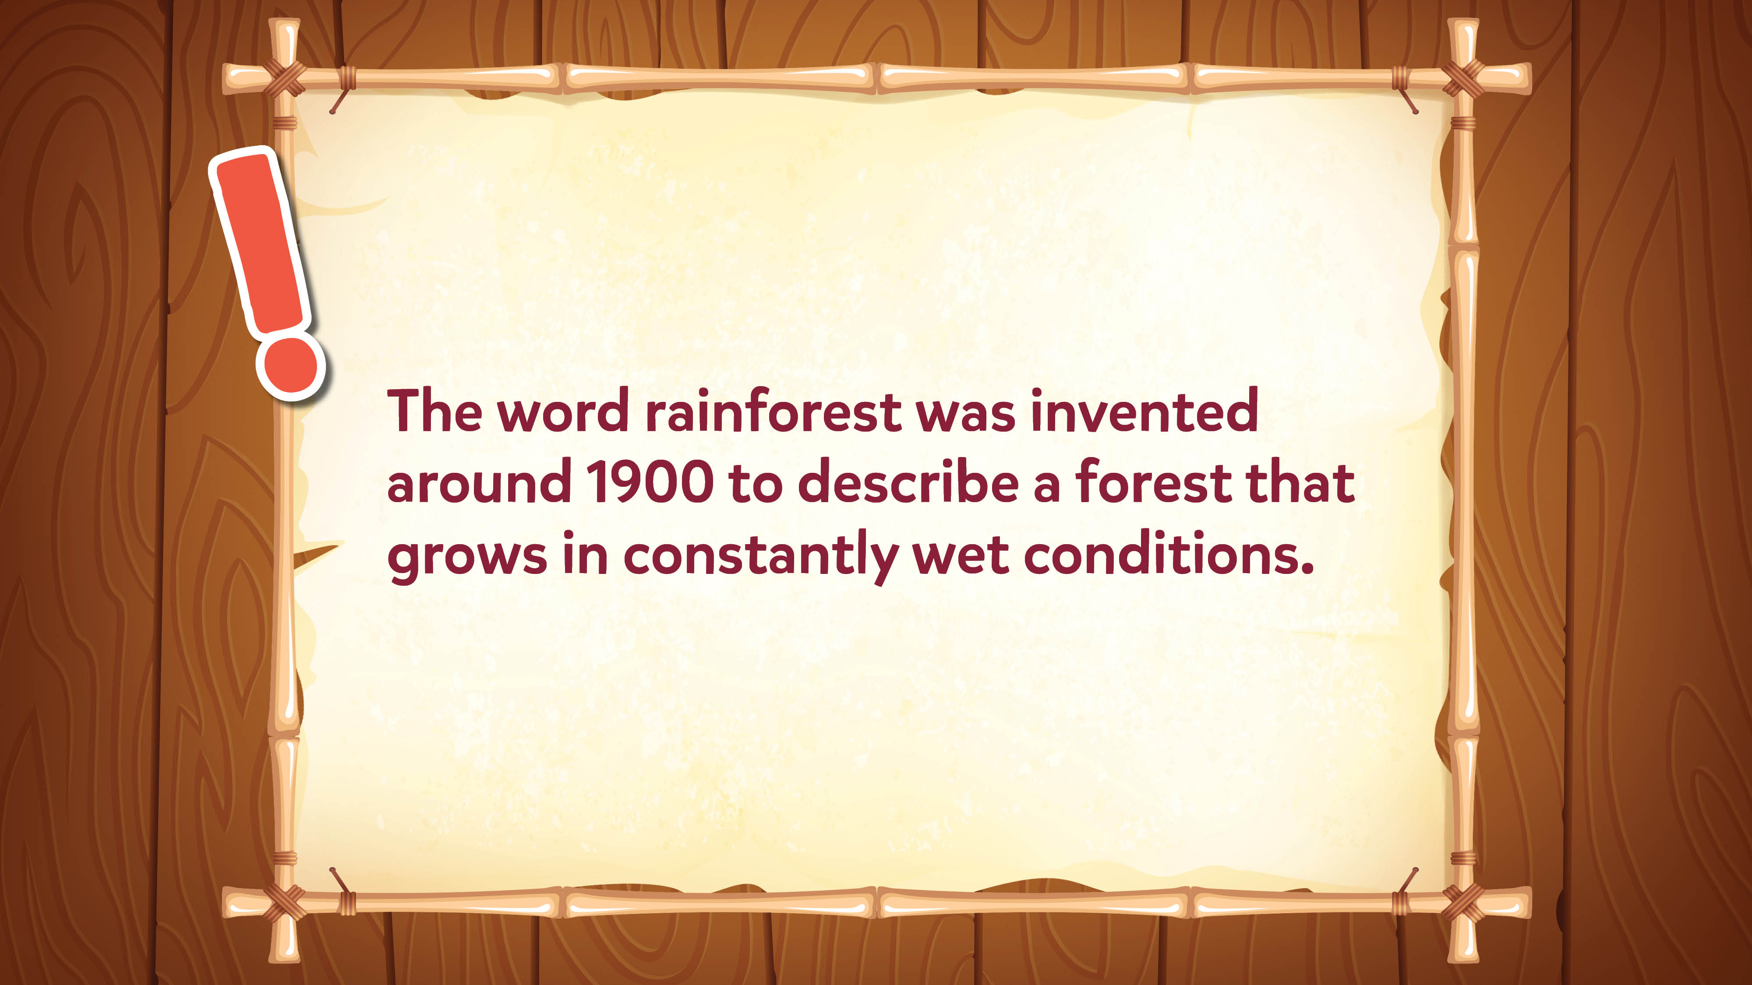
Jokes and Trivia

Slide 54
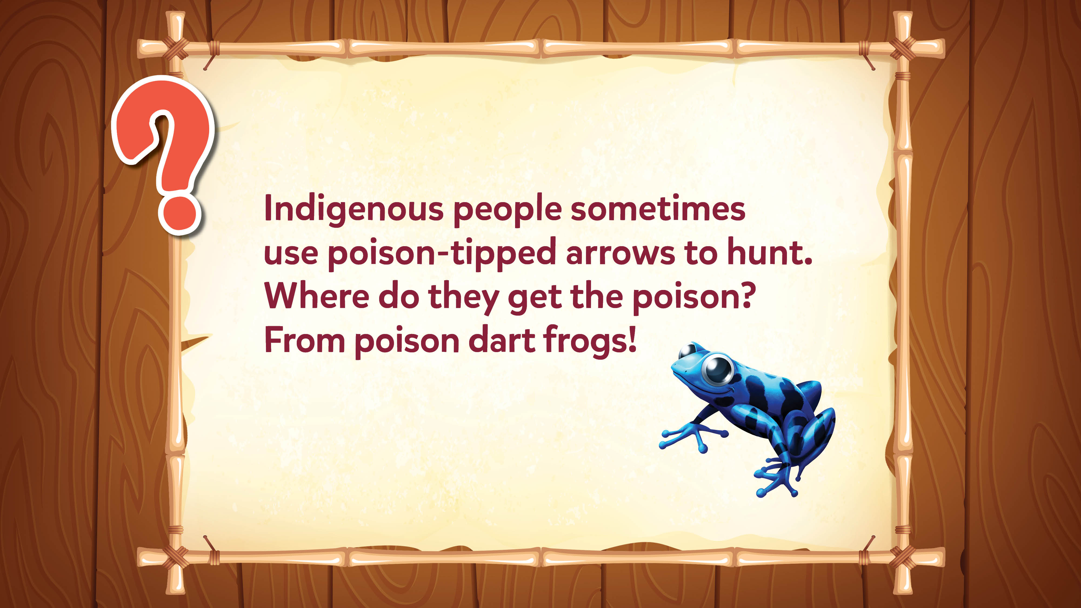
Jokes and Trivia

Slide 55
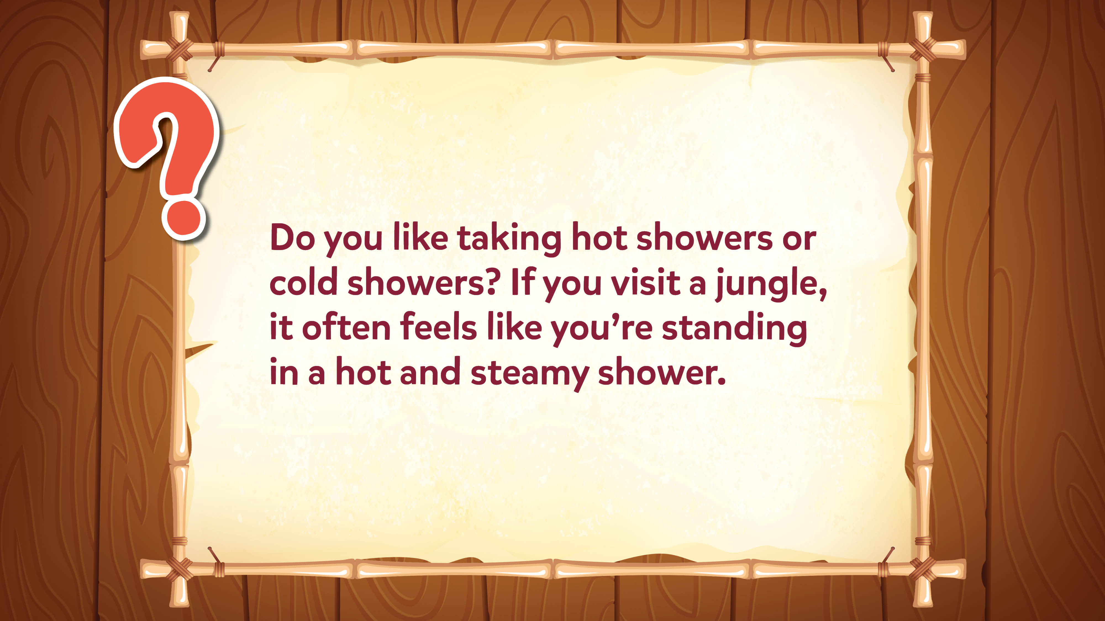
Jokes and Trivia

Slide 56
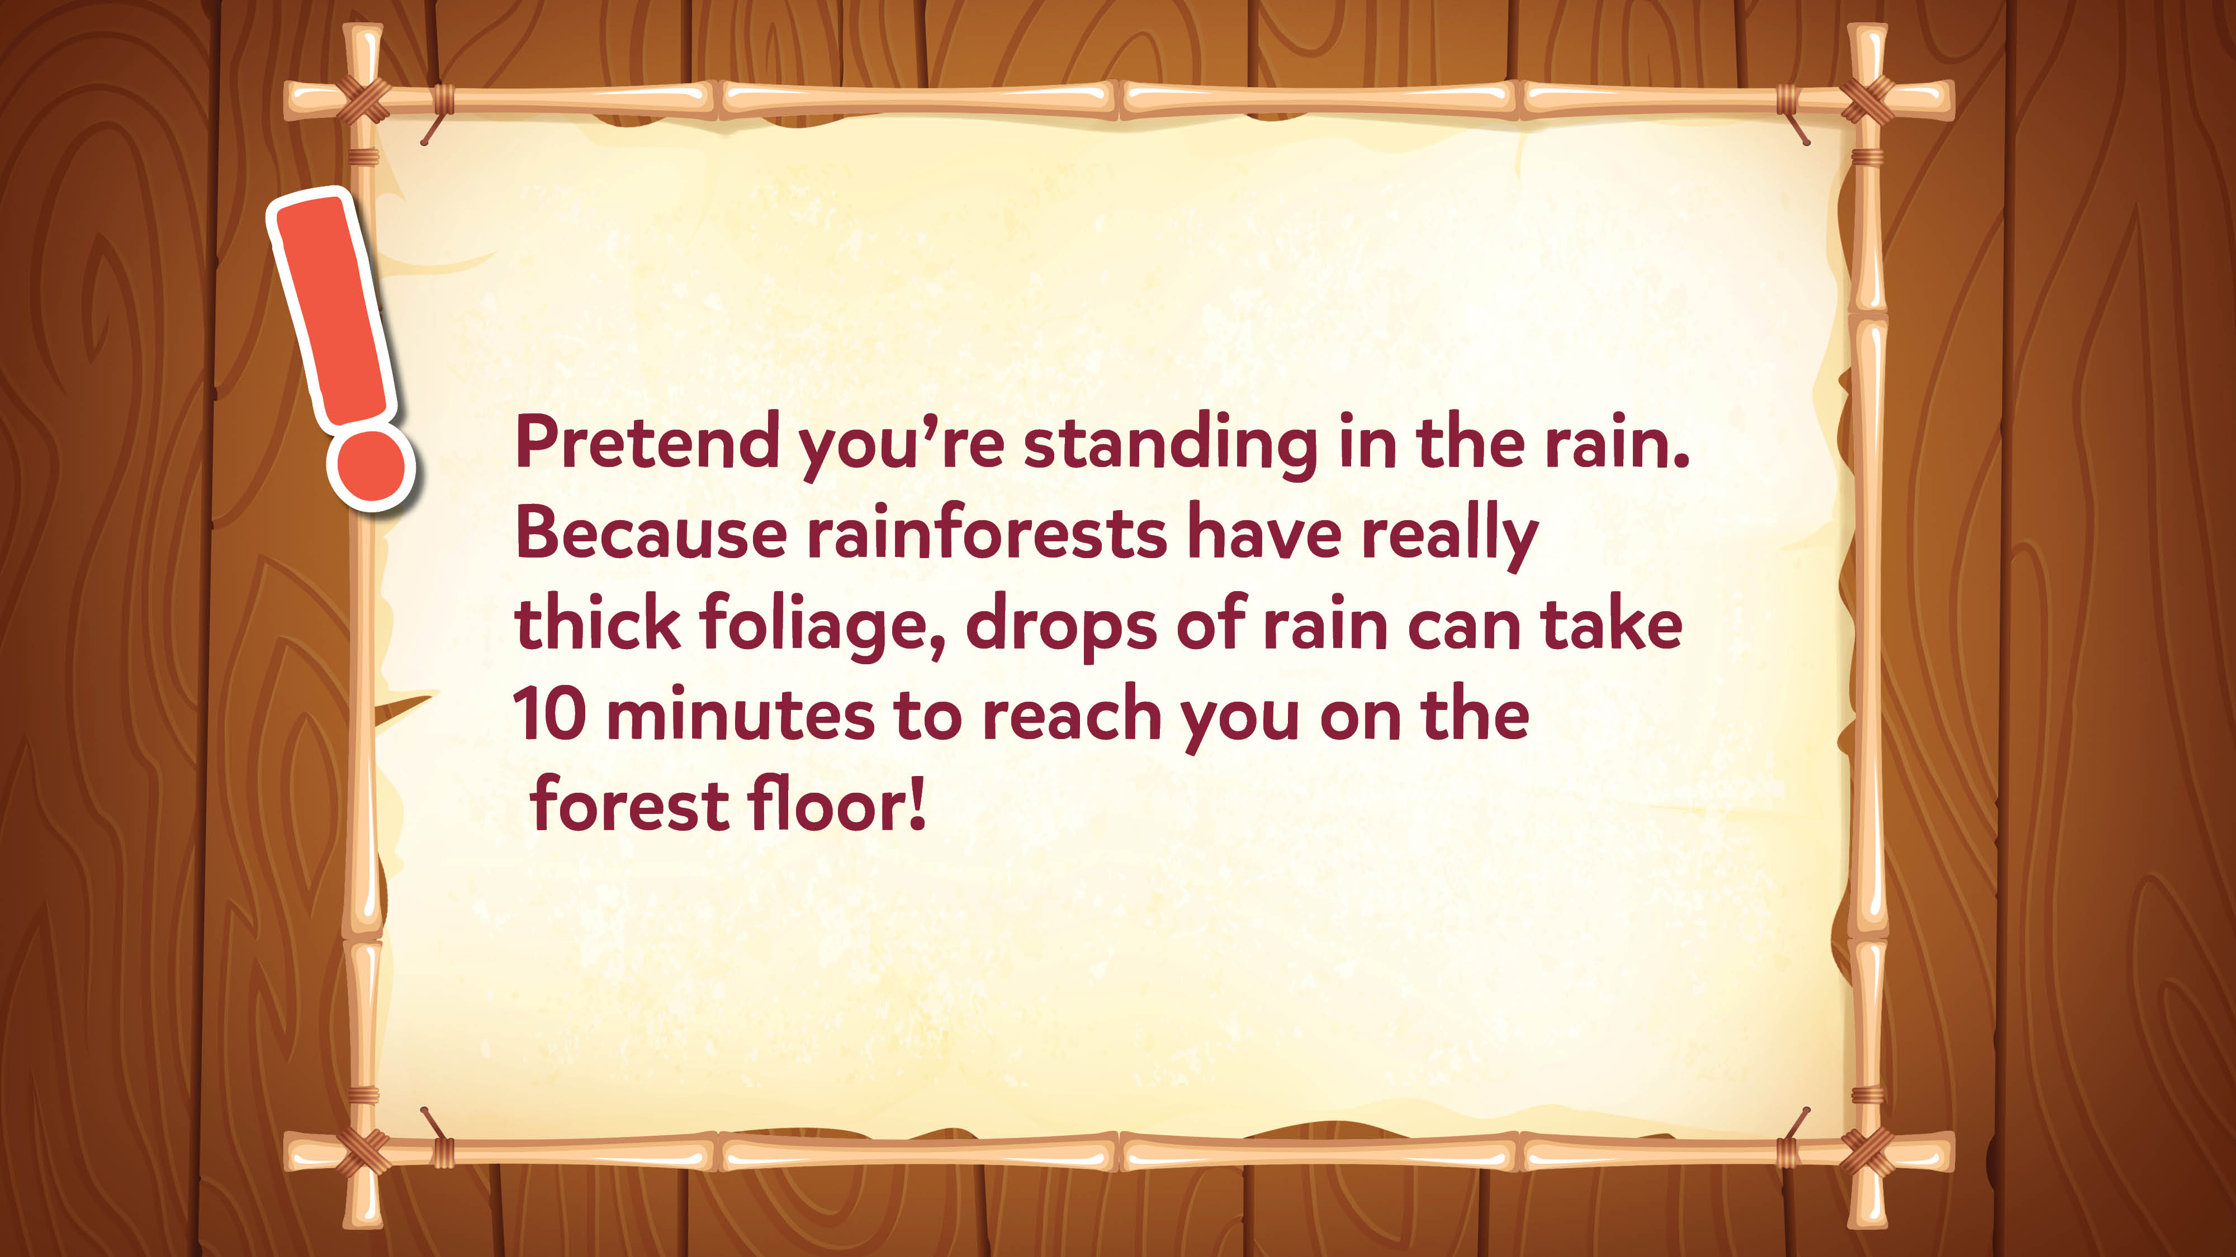
Jokes and Trivia

Slide 57
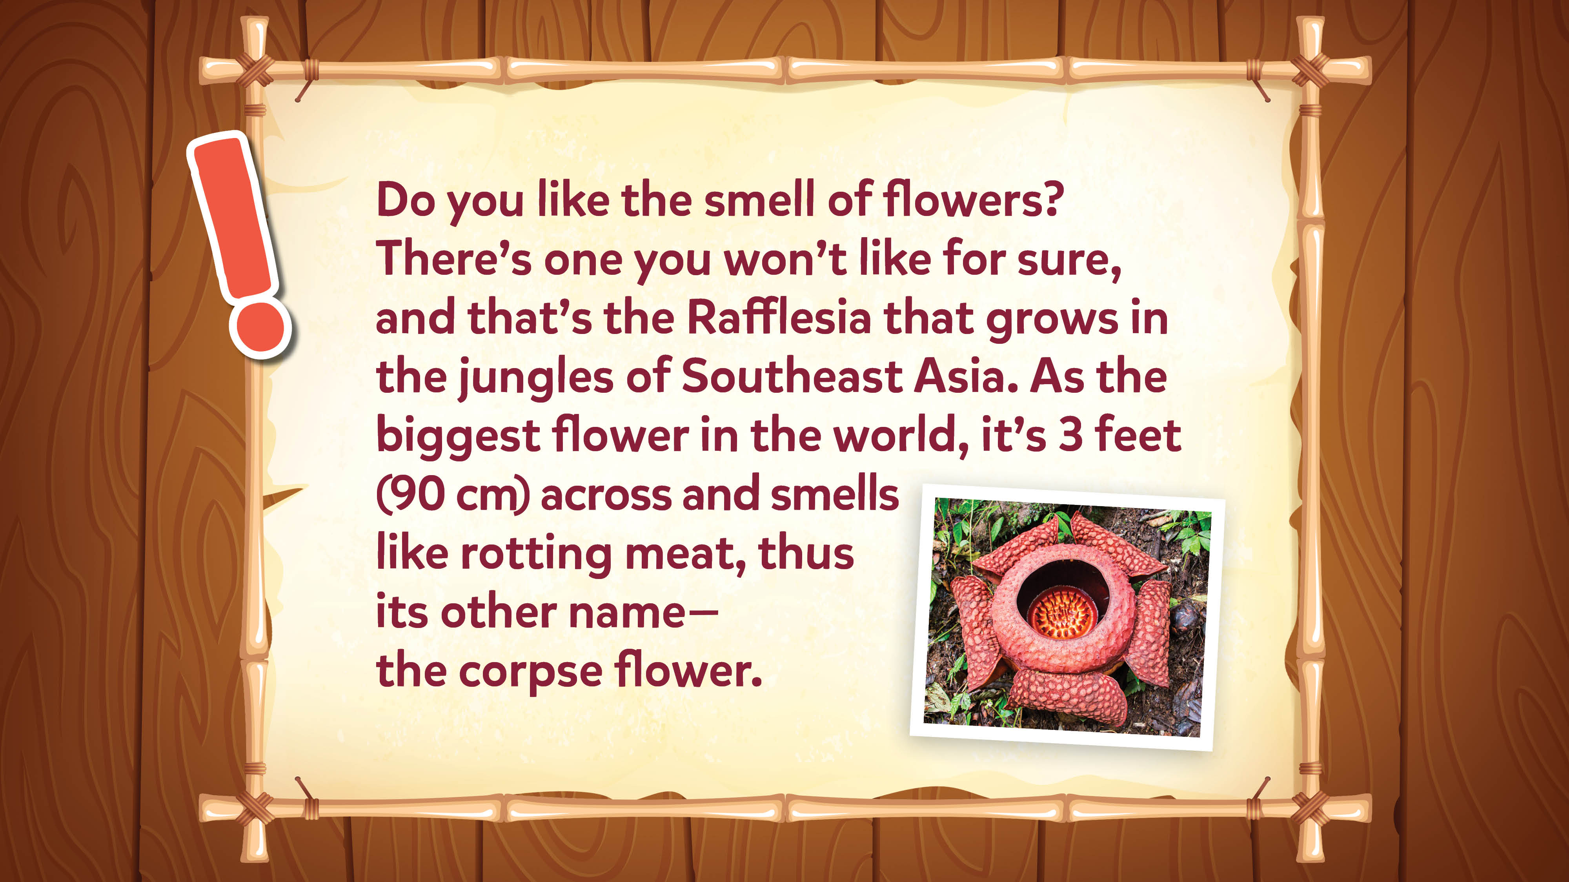
Jokes and Trivia

Slide 58

Jokes and Trivia

Slide 59

Jokes and Trivia

Slide 60

Jokes and Trivia

Slide 61

Jokes and Trivia

Slide 62

Jokes and Trivia

Slide 63

Jokes and Trivia

Slide 64

Jokes and Trivia

Slide 65

Jokes and Trivia

Slide 66

Jokes and Trivia

Slide 67

Jokes and Trivia

Slide 68

Jokes and Trivia

Slide 69

Jokes and Trivia

Slide 70

Jokes and Trivia

Slide 71

Jokes and Trivia

Slide 72

Jokes and Trivia

Slide 73

Jokes and Trivia

Slide 74

Jokes and Trivia

Slide 75

Jokes and Trivia

Slide 76

Jokes and Trivia

Slide 77

Jokes and Trivia

Slide 78

Jokes and Trivia

Slide 79

Jokes and Trivia

Slide 80

Jokes and Trivia

Slide 81

Jokes and Trivia

Slide 82

Jokes and Trivia

Slide 83

Jokes and Trivia

Slide 84

Jokes and Trivia

Slide 85

Jokes and Trivia

Slide 86

Jokes and Trivia

Slide 87

Jokes and Trivia

Slide 88

Jokes and Trivia

Slide 89

Jokes and Trivia

