Slide 1
Toddler Pre-Primary

Slide 2
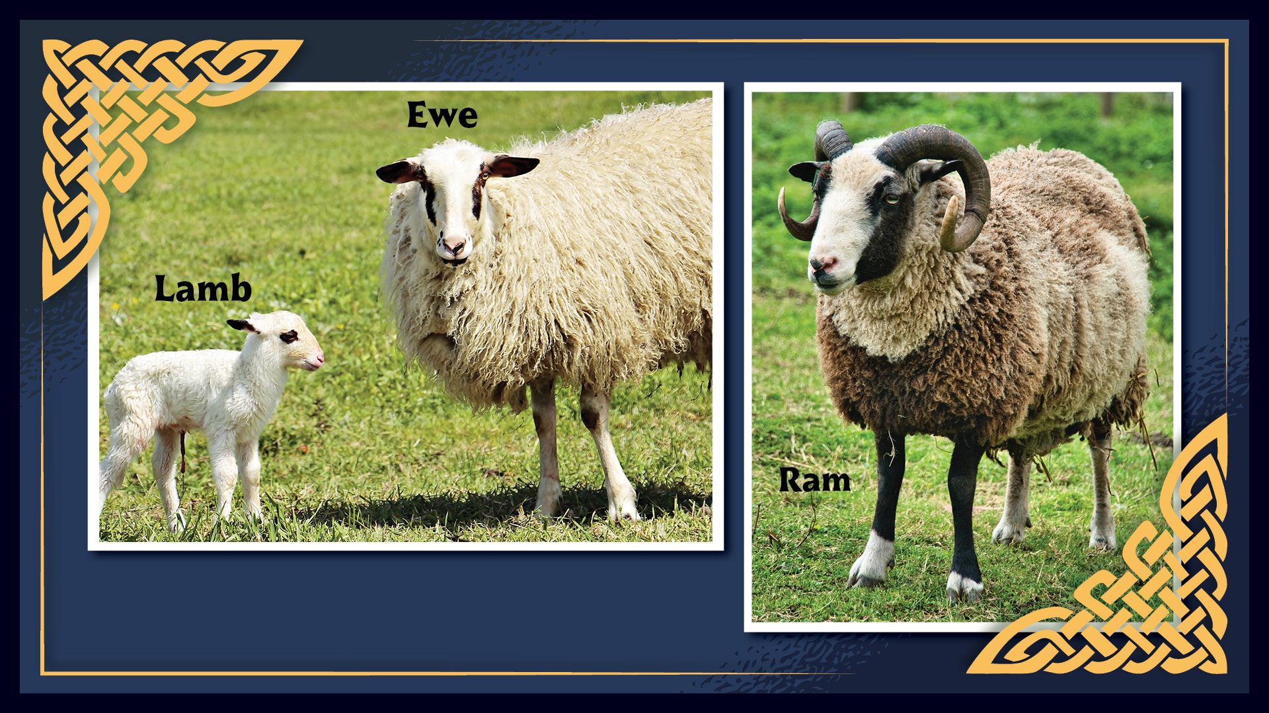

Slide 3


Slide 4
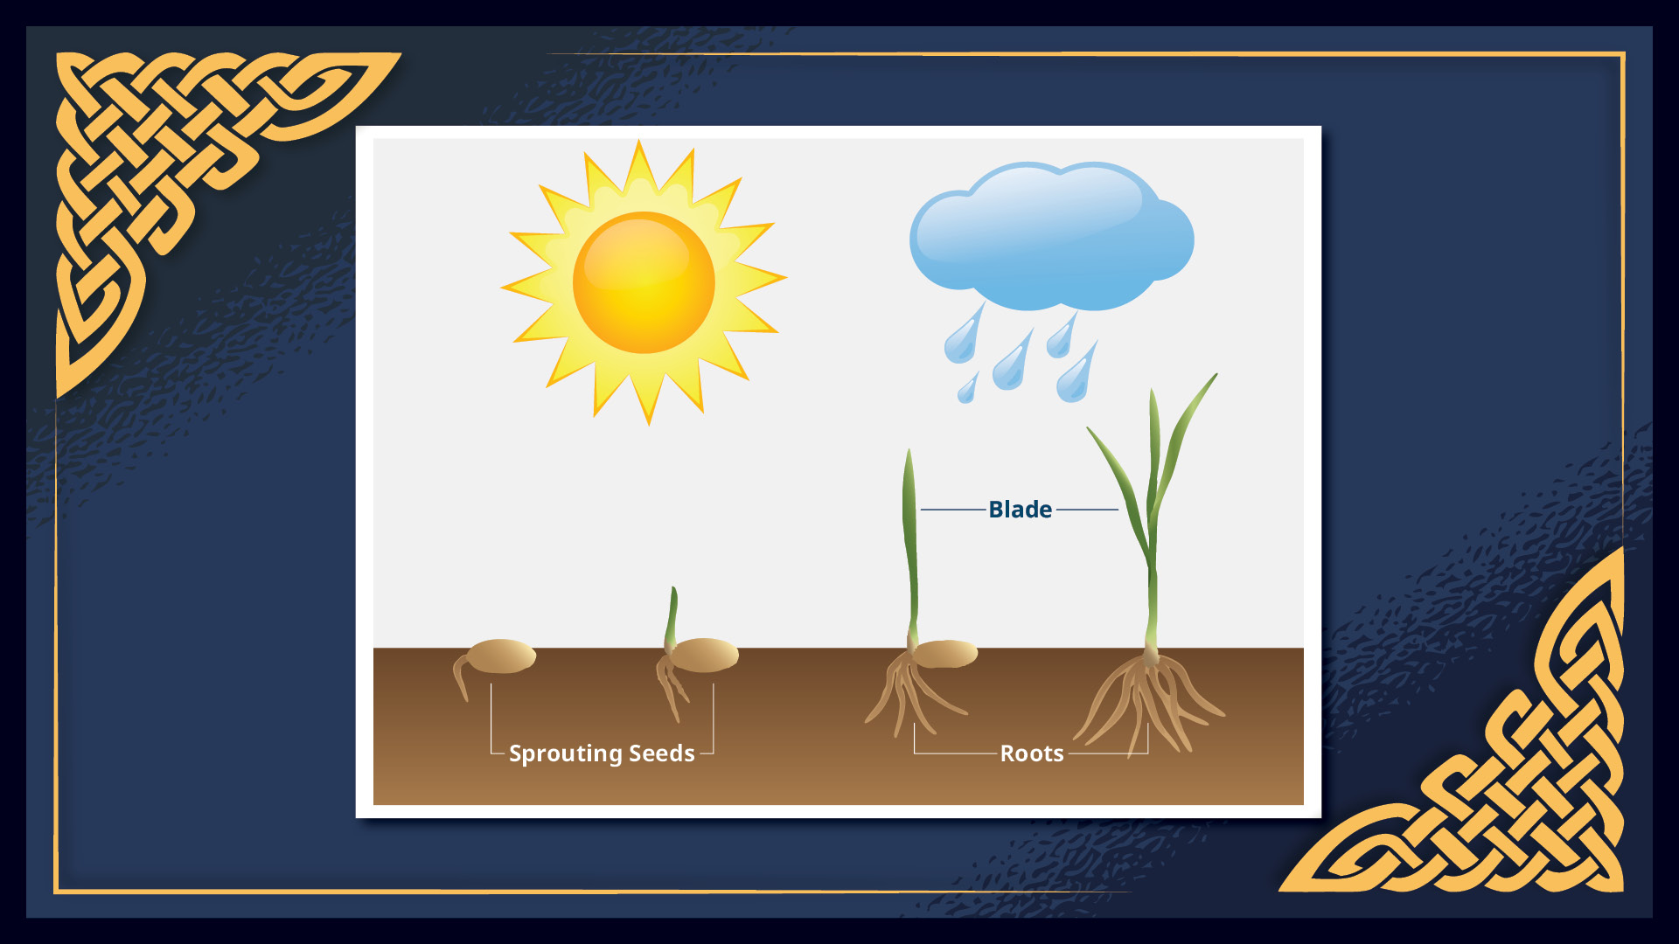

Slide 5


