Slide 1


Slide 2


Slide 3


Slide 4
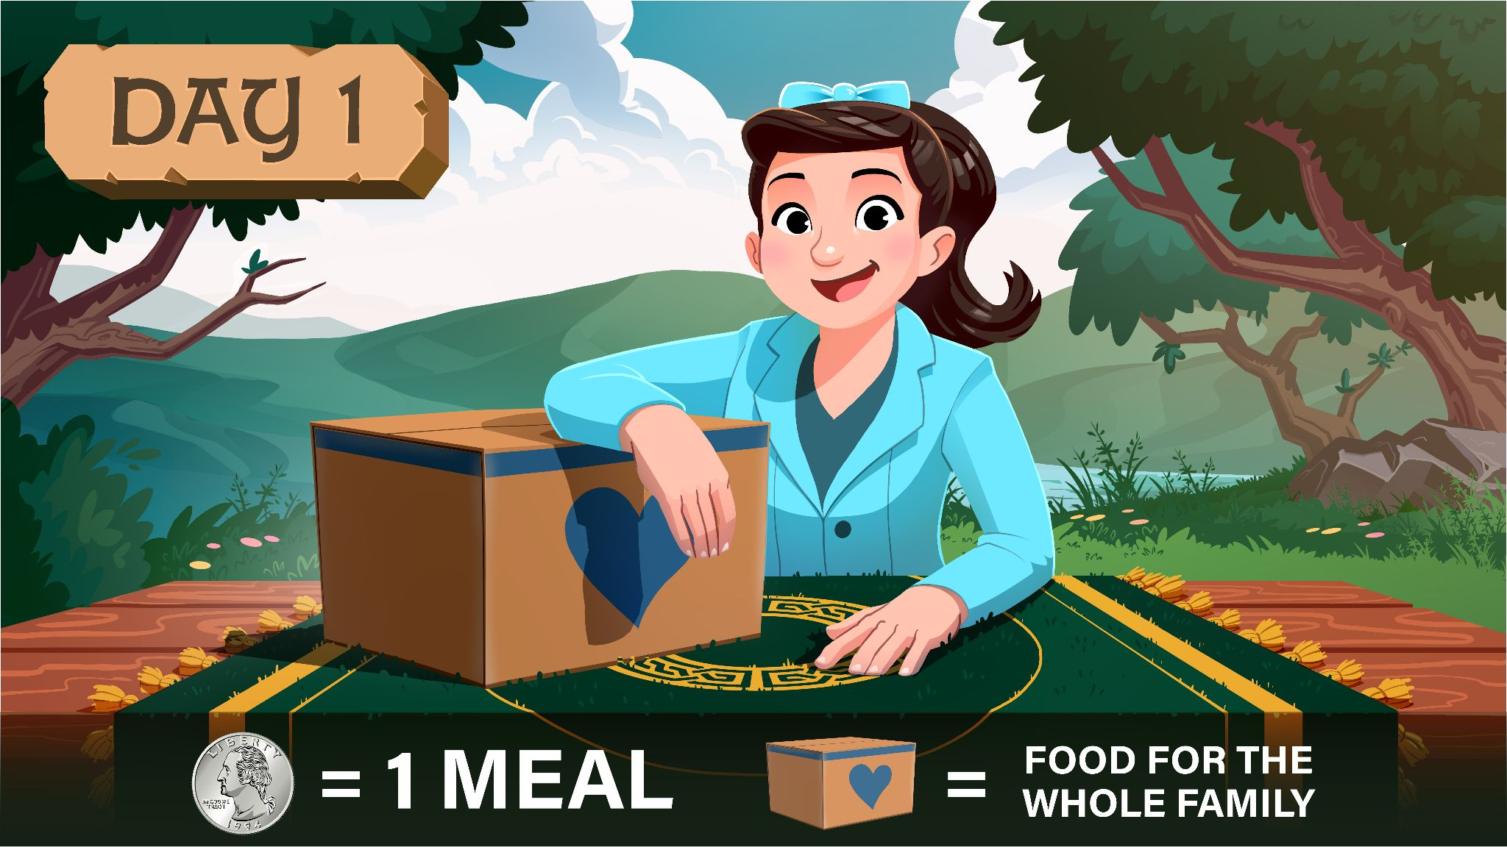

Slide 6


Slide 8

? ? ? MEALS

Slide 10


Slide 12

? ? ? MEALS

Slide 14


Slide 16
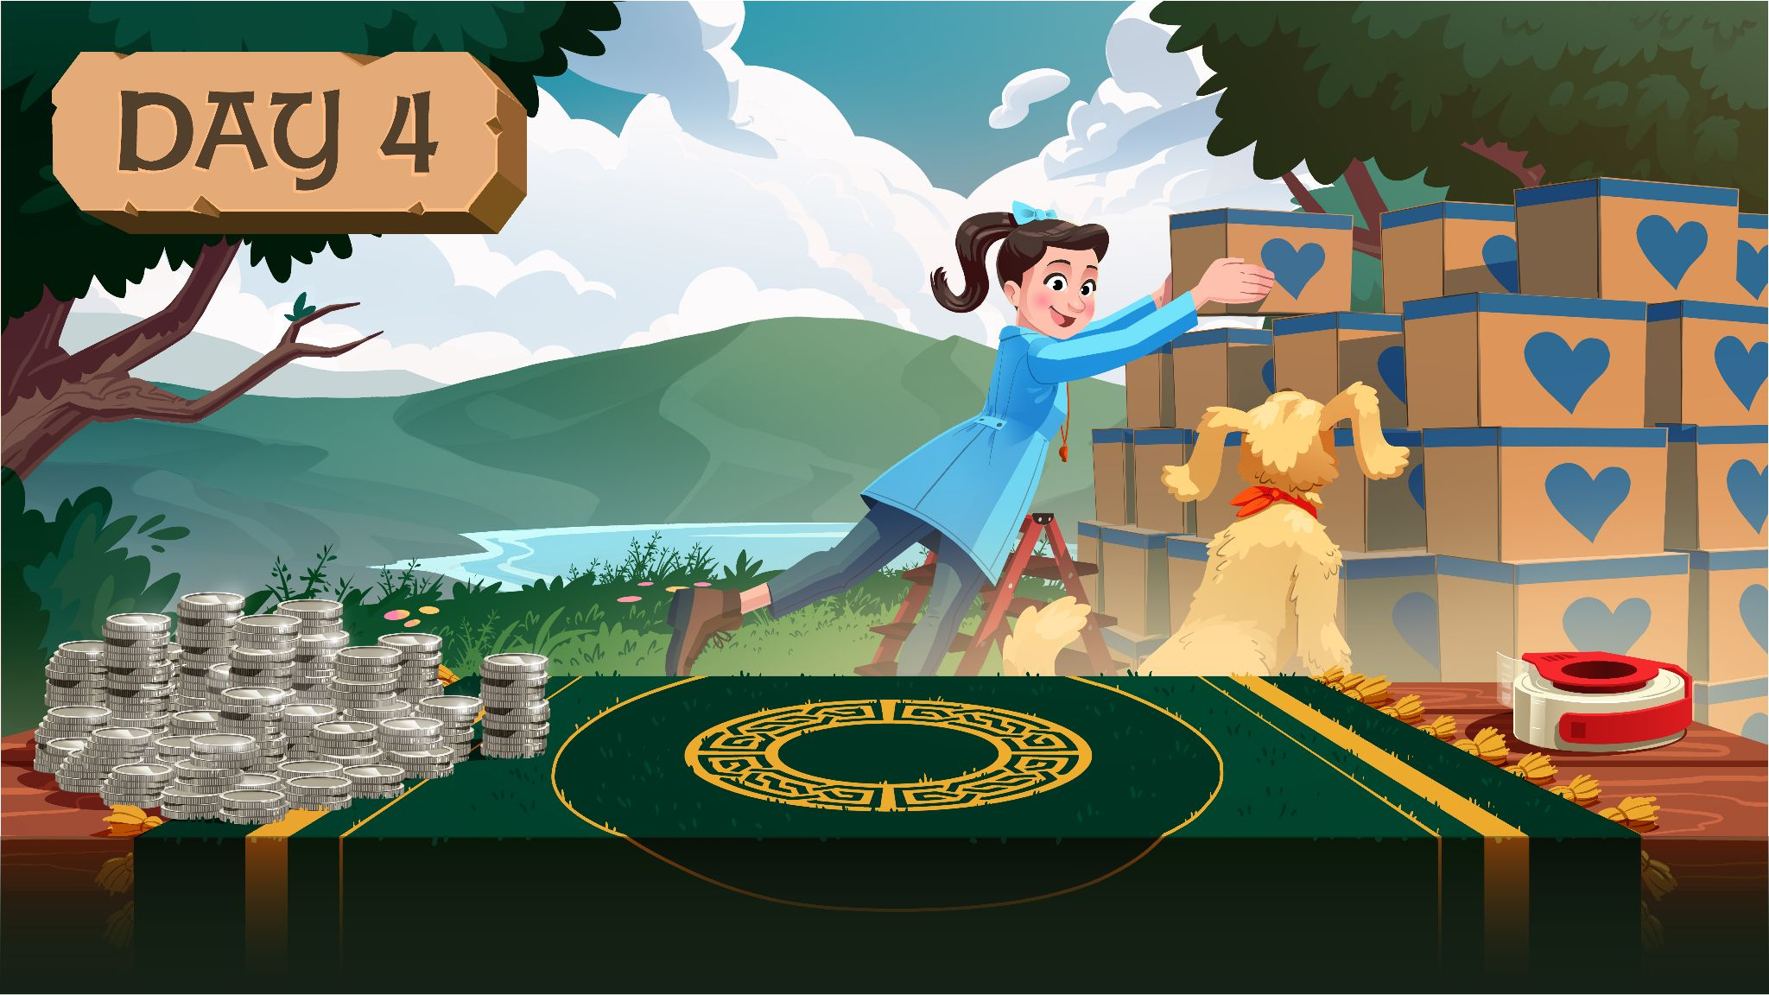
? ? ? MEALS

Slide 18


Slide 20
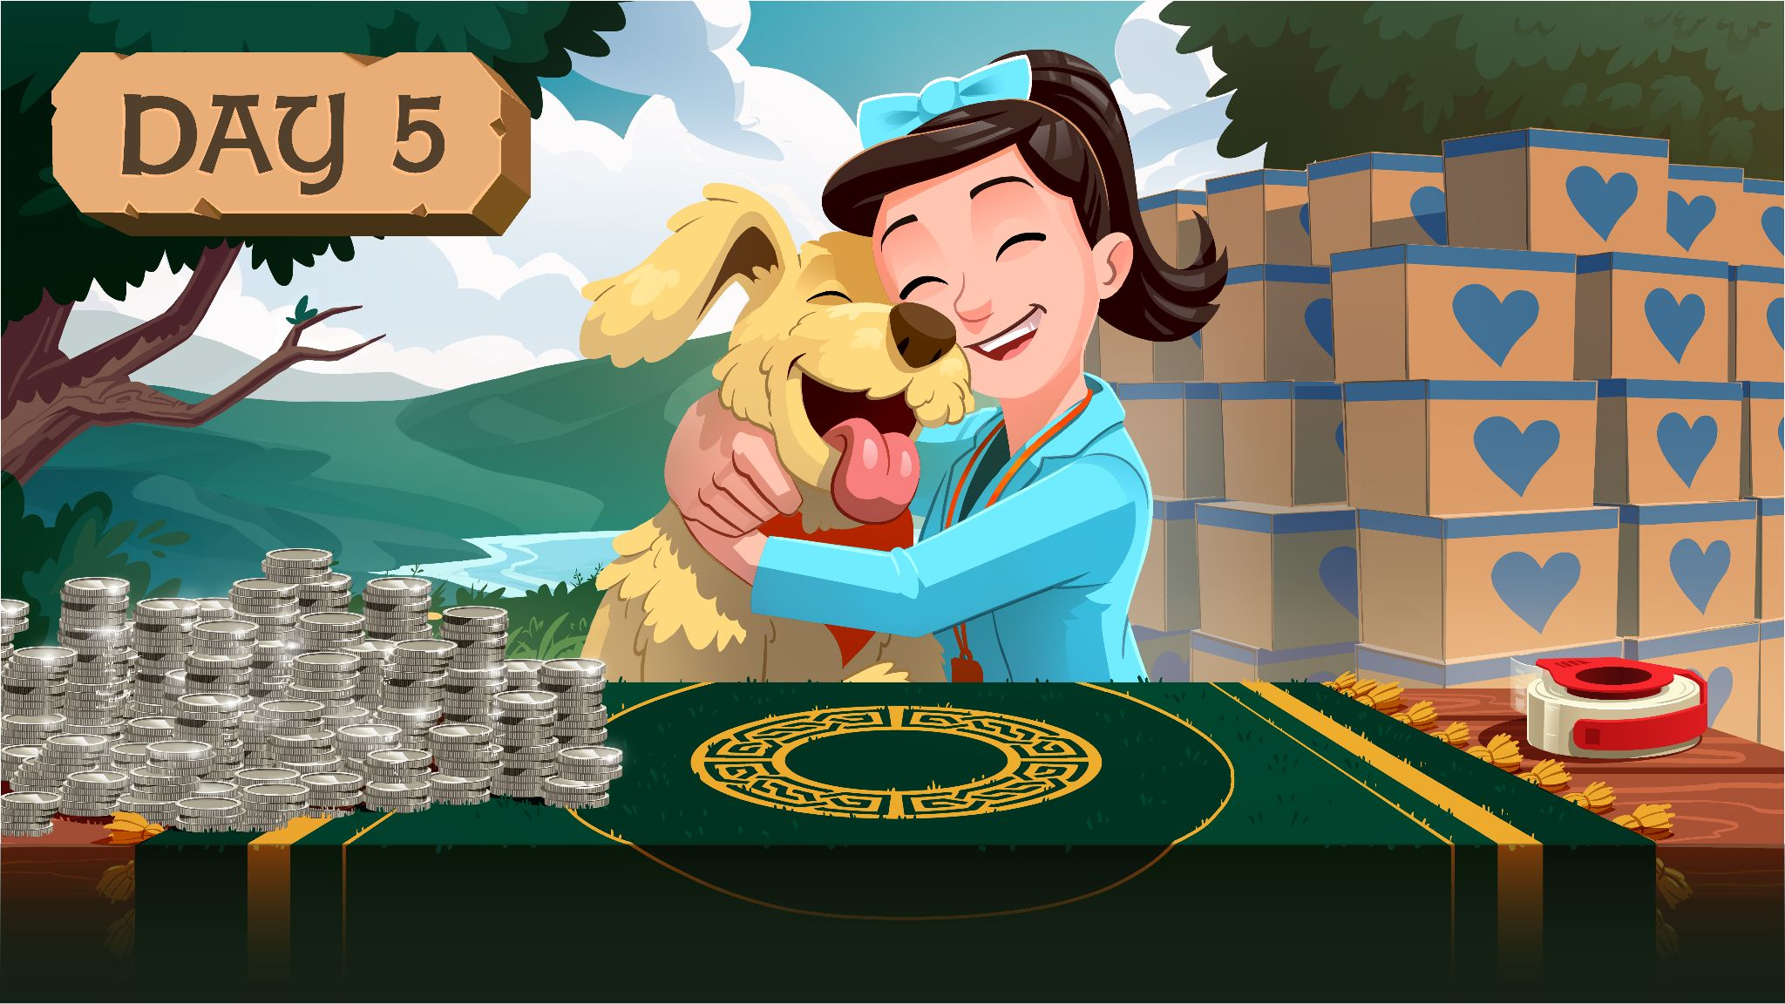
? ? ? MEALS

