Slide 1


Slide 2
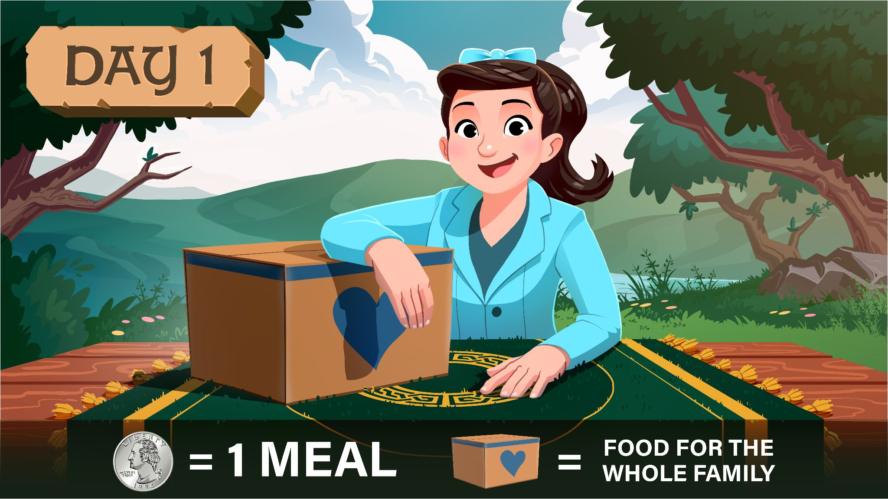

Slide 3

? ? ? MEALS

Slide 4

? ? ? MEALS

Slide 5
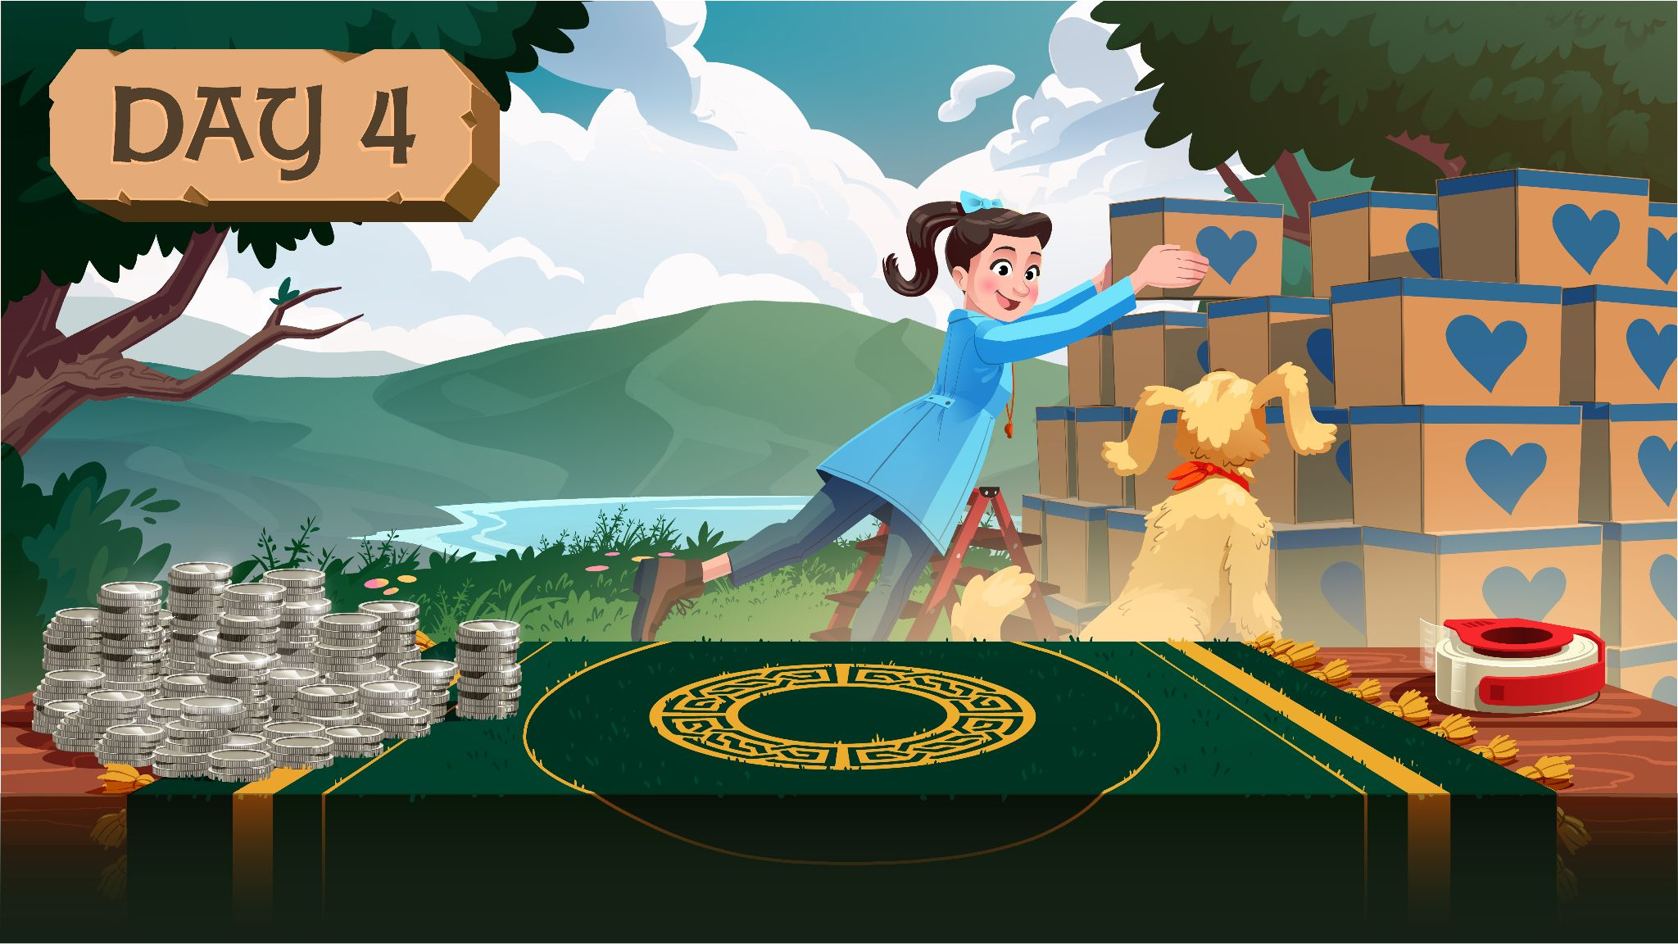
? ? ? MEALS

Slide 6

? ? ? MEALS

